Slide 1
A.P. U.S. Government
Chapter 1
The Study of American Government

Slide 2
What is Political Power?
Power: The ability of one person to get another person to act.
Ex. The POTUS’s speech writer has power. Why?
Power is found in all human relationships. This course is only concerned with power as it is used to affect who will hold U.S. government office and how U.S. government will behave. (whenever you see italics… do not write!)
Authority: The right to use power.
“Formal Authority” – POTUS, Senators, Federal Judges have formal authority to take certain actions.

Slide 3
What is Political Power?
Q: What makes a law or constitution a source of right?
A: Legitimacy
Legitimacy: Political authority conferred by law or by a state or national constitution.
The U.S. Constitution is widely (almost unanimously) accepted as a source of legitimate authority.
This was not always the case….
The Civil War was a bloody struggle over the legitimacy of the federal union
Americans agree that no exercise of political power by gov at level is legit if it is not in some sense democratic.

Slide 4
All Governments can be classified by…
1. Who can participate in the governing process.
2. The geographic distribution of governmental power within the state.
3. The relationship between the legislative and executive branches of government

Slide 5
Who can participate in the governing process?
Rule by many (Democracy):
Democracy: Government by the people, exercised either directly or through elected representatives
Direct/Participatory Democracy: Democratic system in which all citizens participate in politics and decision-making
Representative Democracy: Democratic system in which policies are made by officials accountable to the people who elect them

Slide 6
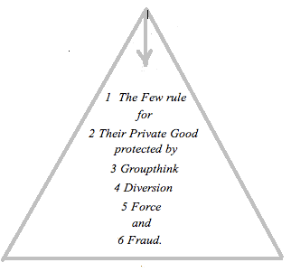
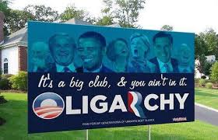
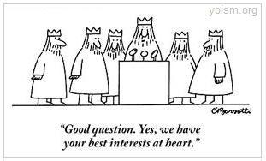
Who can participate in the governing process?
Rule by few (Oligarchy):
Aristocracy: “Rule by the finest,” power determined by social status, wealth or level of education
Theocracy: Power to rule lies in the hands of religious groups
Political Party: Control of all power by one political party

Slide 7
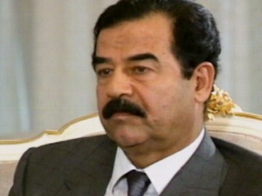
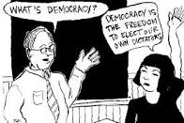
Who can participate in the governing process?
Rule by one (Autocracy):
Absolute Monarchy: Ruler gains power through inheritance
Dictatorship: Absolute ruler controls all power, usually by fear or force, ignores the will of the people

Slide 8
What is Democracy?
Democracy – A rule by many (Aristotle’s definition)
Direct Democracy – a government where all or most citizen participate directly. (or participatory dem.)
Greece 4th Century B.C. – small city and all free adult male property owners could participate.
Recent Examples of Aristotelian ideals: New England Town Hall meetings, Referendums (policy choice that appears on the ballot)
Representative Democracy – A government in which leaders make decisions by winning a competitive struggle for the popular vote. (popular = people)
Another term we use is REPUBLIC

Slide 9
Is Representative Democracy Best?
What factors must there be for Representative Democracy to work?
Individuals or parties can run and win elections.
Communication must be free
Voters perceive that a meaningful choice exists.
Framers of the Constitution favored Republic over direct democracy.
They believed that govt. should mediate not mirror popular view.
Is the word “Democracy” in the constitution?

Slide 10
Framer’s Beliefs
Citizens did not have the time, info, interest, and expertise to make reasonable choices among competing policy positions. (Explained in the article “Myth of the rational voter.”)
Even highly educated people could be manipulated by demagogue leaders who play on fears and prejudices.
Republics proceed slowly and prevents sweeping policy change.
“government capable of doing great good quickly also can do great harm quickly”
Majority rule with minority rights!
Majorities can turn into the angry mob. We will learn more about the safeguards created by the Framers in Ch. 2

Slide 11
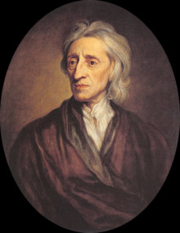
John Locke
The decisive influence on the Framers
17th-century English philosopher
Argued against power kings in favor of popular consent
Believed people can exist in the State of Nature (without government) if they can securely own their farms, live off what they produce, & protect themselves
“A decent gov must exist with the consent of the governed and be managed by majority rule. The prevent a majority from hurting a minority of the people the gov should separate its powers, with different and competing legislative and executive branches” -Locke

Slide 12
Forms of Government as it relates to the geographic distribution of governmental power within the state.
Parliamentary Government: The executive leaders are chosen by and responsible to the legislature
Chief executive is Prime Minister or Premier and is a member of the legislature (as are the members of his/her cabinet)
Not popularly elected, but heads the majority party or coalition of parties
Presidential Government: The legislative and executive branches are separate & function independently
Chief executive is the president, popularly elected
Both groups balance & check one another
President is totally separate from the legislative branch

Slide 13
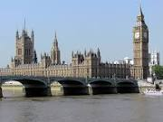
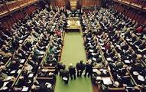

Slide 14
More forms of government as it relates to the relationship between the legislative and executive branches of government
Unitary System: Form of government where all the powers of government are held by a single unit or agency
Rules applied equally to all, avoids costly duplications
Examples include France, Japan, Denmark, Great Britain
Federal System: From of government where powers are divided between a central authority and a number of regional political subdivisions
Powers are separate but overlapping
Confederations: Political system in which a weak central government has limited authority & the states have ultimate power
Loose grouping of independent states

Slide 15
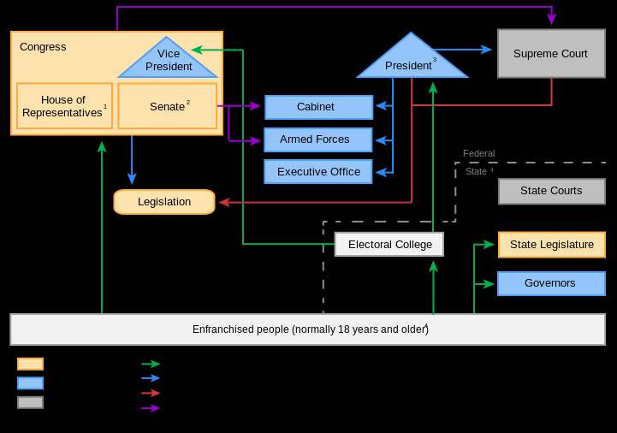
United States Government

