Slide 1
The Courts & the Judicial Branch
Chapter 13
Section 1

Slide 2
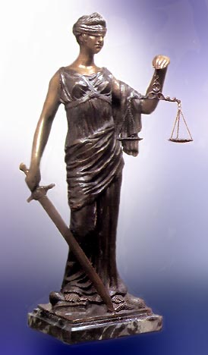
Foundations of the Judicial System:
Established by Article III of the constitution
Article III also gives congress the power to create lower, federal courts
Judiciary Act of 1789
State courts were already in place

Slide 3
Foundations of the Judicial System:
Dual court system:
State and federal courts exist side-by-side
Federal courts base their authority on the constitution and federal law
State courts base their authority on state constitutions and state laws
State courts principal job is to decide disputes between private persons and between private person and the government

Slide 4
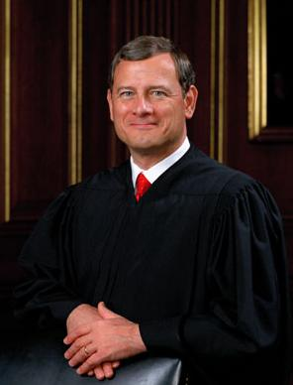
Foundations of the Judicial System:
Constitution provides for federal judges’ independence from president and congress
May serve as long as they practice “good behavior”
Salary cannot be reduced while they are in office
Federal judges make between $125,000 to $180,000 per year
Appointed by the president, confirmed by the senate
Can be impeached

Slide 5
Foundations of the Judicial System:
Jurisdiction: The right to interpret and apply the law; a court’s range of authority
Federal court’s jurisdiction allows them to hear cases involving:
Ambassadors & members of foreign governments
Maritime law (law of the sea)
Bankruptcy cases
Citizens of different states
A state and a citizen of a different state or foreign country
Citizens of the same state claiming lands under grants of different states
U.S. laws and treaties, and interpretation of the constitution

Slide 6
Foundations of the Judicial System:
Exclusive Jurisdiction: The authority of the federal courts alone to hear and rule in certain cases
Cases involving the constitution, the (federal) laws of the U.S. and treaties
Disputes between the states
Concurrent Jurisdiction: The authority to hear cases shared by federal and state courts
Disputes involving citizens of different states
Crimes that violate both state and federal law can be tried at either level (or both)

Slide 7
Foundations of the Judicial System:
Original Jurisdiction: The court’s authority to hear and decide a case for the first time
Trial courts (court in which the case is originally tried)
Appellate Jurisdiction: The court’s authority to hear cases on appeal
If you lose in a trial court, you can “appeal” and take your case to an appellate court
If you lose at the appellate level, you can take your case to the supreme court (which has both original and appellate jurisdiction

Slide 8
Foundations of the Judicial System:
Civil Law: Type of law dealing with the rights and relationships of private citizens
Make up the majority of cases in the federal courts
Governs the relations between individuals & defines their rights
Plaintiff: Person who files a suit in a civil case
Defendant: Person against whom a legal charge has been made

Slide 9
Foundations of the Judicial System:
Criminal Law: Type of law dealing with crimes & providing for their punishment
Most criminal cases settled in state courts, usually don’t involve federal questions
Only about 2% of criminal cases are heard in federal courts
Examples of federal crimes include kidnapping, tax fraud, selling drugs, driving stolen vehicles across state lines
Government is always the prosecutor bringing charges against a defendant
Punishment includes fines, prison time, etc.

Slide 10
Foundations of the Judicial System:
Constitutional Law: Type of law relating to he interpretation of the constitution
Mostly handled in federal court
Courts decide whether a law or action conflicts with the constitution
Decide the limits of government power and the rights of the individual

Slide 11
Foundations of the Judicial System:
Judicial Review: The power of the courts to establish the constitutionality of national, state or local government actions
Established by the Marbury v. Madison case
President Adam’s last minute appointments
Paperwork not given to Marbury before Jefferson takes office
Marbury argues Judiciary Act of 1789 compelled Jefferson to give him his appointment
John Marshall (chief justice) ruled that portion of the Judiciary Act as unconstituional

