Slide 1
The Courts & the Judicial Branch
Chapter 13
Section 3

Slide 2
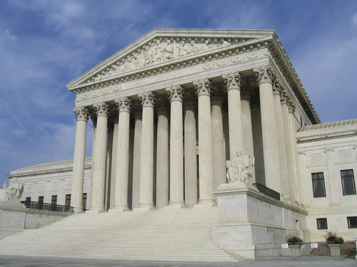
The Supreme Court:
9 justices sit on the Supreme Court
Number has varied historically from 5-10
Fixed at 9 since 1869
Constitution does not list any specific duties for the justices
Duties developed form laws and through tradition
Deciding which cases to hear, deciding the cases themselves and explaining the court’s decision

Slide 3
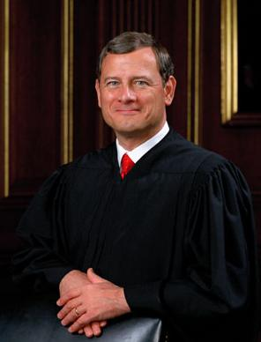
The Supreme Court:
Chief Justice has additional duties
Presides over sessions and conferences
Writes majority opinion (if he agrees with it)
General administrator of the federal court system

Slide 4
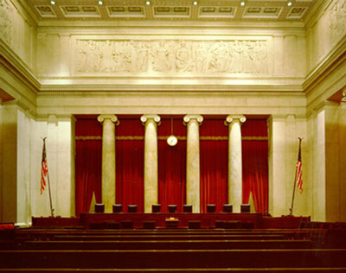
The Supreme Court: Choosing Cases
Receive about 7,000 or so petitions per year
Do not have to hear any case they don’t want to
Most petitions are thrown out
Writ of Certiorari: An order form a higher court requiring a lower court to send the record of a case for review

Slide 5
Choosing cases cont’d…
The Rule of Four
Writ of Cert granted when 4 justices rule to hear a case.
The Solicitor General
4th ranking member of the Dept of Justice
Responsible for handling all appeals on behalf of the U.S. govt. to SCOTUS
He/She influences the Court’s decision on which cases to hear.

Slide 6
Filing Briefs
Each party is required to file a brief (detailed written statement) arguing one side of a case.
Briefs cite relevant facts, legal principles, and precedents that support their arguments.
Amicus Curiae (“friend of the court”) Briefs
Interested persons and groups that are not actual parties to the case may file A.C. briefs
Cases involving abortion/affirmative action attract a large number of A.C. briefs.
SIG’s use these to lobby the Court.

Slide 7
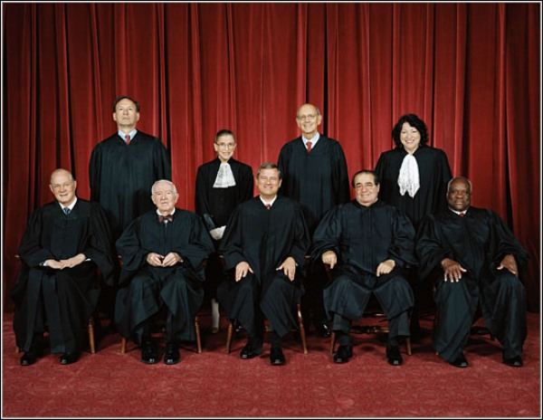
The Supreme Court: Hearing Cases
Hearings for cases are open to the public
Mondays, Tuesdays and Wednesdays in October
May hear each side of two or three cases per day
Some decided without oral argument however
Attorneys allowed 30 minutes to present their case
Session ends in June
Cases do not carry over

Slide 8
The Supreme Court: Deciding the Case
After the public hearing, the justices meet privately to decide the case
Done in absolute secrecy
Chief Justice opens with other justices expressing their opinions in descending order of seniority
About 1/3 of decisions are unanimous, rest are split
Their decision represents the final say

Slide 9
The Supreme Court: Deciding the Case
Justices give their rulings in writing:
Majority Opinion: The view of the Supreme Court justices who agree with a particular ruling
Dissenting Opinion: The opinion by one or more justices in the minority who oppose the ruling
Concurring Opinion: The opinion by one or more justices who agree with the majority’s conclusion but wish to offer differing reasons
Sometimes rulings are implemented immediately, sometimes it takes longer

Slide 10
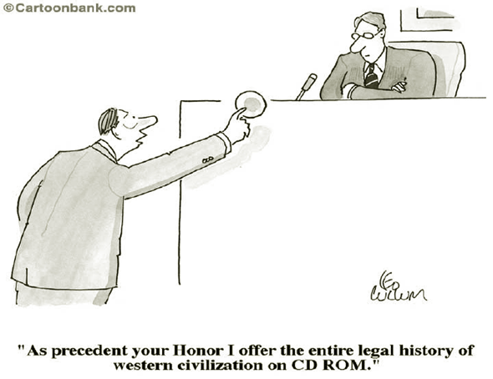
The Supreme Court: Policy Making Power
Precedents: A judicial decision that is used as a standard in later, similar cases
Stare Decisis: “Let the decision stand,” the practice of basing legal decisions on established Supreme Court precedents from similar cases

Slide 11
The Supreme Court: Policy Making Power
Judicial Activism: The belief that Supreme Court justices should actively make policy and sometimes refine the constitution
Judicial Restraint: The belief that Supreme Court justices should not actively try to shape social and political issues or redefine the constitution

Slide 12
The Supreme Court: Checks on Judicial Power
Limited Powers of Enforcement: Judges have no police force or army to enforce its laws
Congress: Can confirm or deny presidential appointees, impeach judges, alter the organization of the federal court and amend the constitution
The President: Can appoint justices or choose to enforce or ignore court rulings
Public Opinion: Rulings not supported by the people are sometimes impossible to implement

