Slide 1
Theory of Modern Government

Slide 2
Connection:
Over $6 Billion was spent on candidates, political parties, and special interest groups in the 2016 presidential election – the most in any presidential election.
Perhaps that is why many people believe in the elite theory of government
A theory of modern government
This Photo by Unknown Author is licensed under CC BY-ND

Slide 3
Introduction
Government Impact
On the manner in which we are able to function as part of our society
Ex.) Manner in which our recycled garbage is picked up to the speed limit on the interstate
Government meaning: institutions that create public policy
Set-up:
National Government - State - Local Government
Many moving parts in government that help implement public policy
Bureaucracies
Regulatory agencies
Independent executive agencies
Government corporations
Cabinet

Slide 4
Politics
Not defined unlike government
Not defined constitutionally
Evolved from the writing of
Alexander Hamilton
James Madison Federalist Papers
John Jay
Unwritten traditions and precedents were set by the first formation of political parties
Philosophical differences emerged after candidates were elected to office
Characterized by:
Conflict and resolution
Compromise
Interrelationship of individuals and groups
What are you??

Slide 5
Formula
Government + Politics = creation of public policy
In other words:
What government does thru politics results in public policy
Evaluating public policy
Look at the extent of what that policy has achieved

Slide 6
Basic Functions of Government
What do you see it as?
Not everyone has the same needs, shares the same ideology, or has the same priorities
Our government role in our life is stated in the Preamble
Introduction to our Constitution
Establishment of a more perfect union
Establishment of justice
Insurance of domestic tranquility
Promotion of the general welfare
Security of individual liberty
Government is essential
because it has an impact
on your everyday life

Slide 7
Meaning of Politics
A person’s individual needs, values, and attitudes
Others with same needs, values, and attitudes
Band together and form political parties
Politics, the means by which
individuals and groups get involved,
results in the formal election of officials
Success of the political party
Must have success in electing it members
Must have proper electoral support
Has to maintain financial support
People reelected have the
advantage and entrench
themselves into the system
Political mavericks have a
hard time breaking into
the system

Slide 8
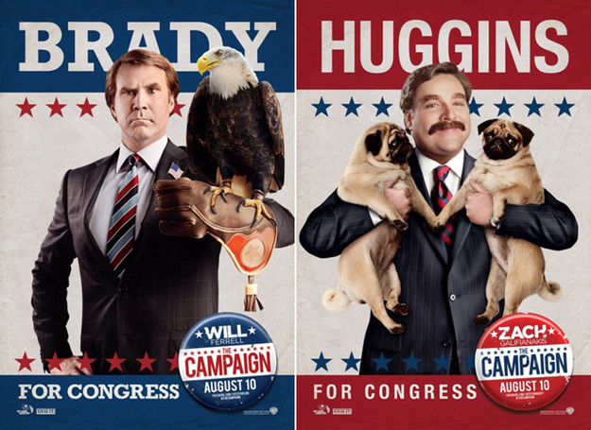
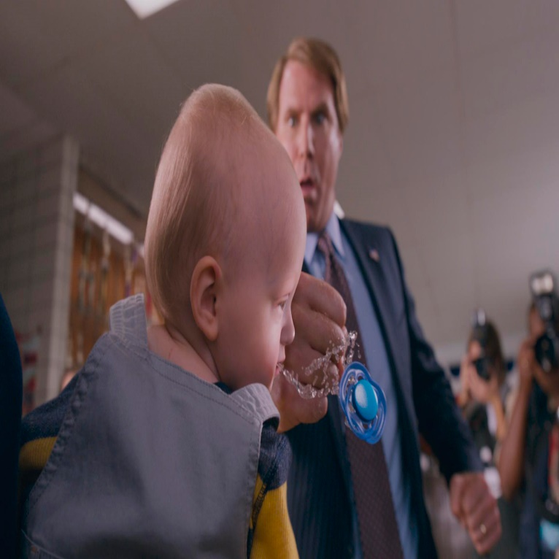
The Electorate (all people in a country who are entitles to vote )
How voters perceive candidate’s position on the issues
How do you find this out?
The way people feel about the party
What are your perceptions of the parties?
Comfort level of the voter in relation to candidate and the party
Can you trust them?
Influence on media and its effect on the election
What do you see on TV and hear on the radio?
Helps determine how
the individual’s get involved

Slide 9
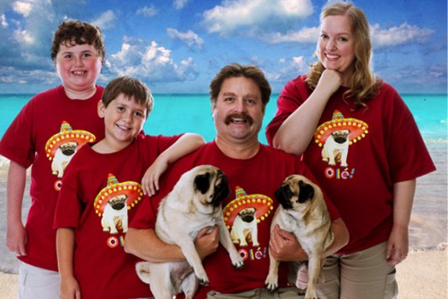
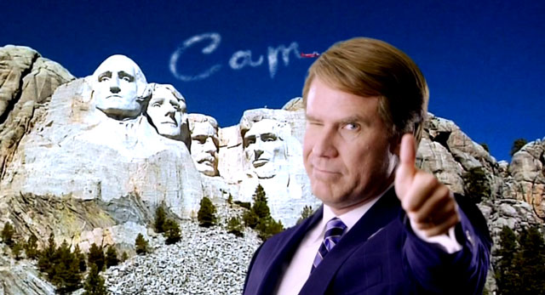
The Electorate - Elections
2000 Election
Bush (R)
Gore (D)
2004 Election
Bush (R)
Kerry (D)
2008 Election
Obama (D)
McCain (R)
2016 Election
Gore won popular vote, but lost electoral vote
Bush re-elected b/c America wanted to keep their commander – in – chief during the turmoil
America believed – “change we can believe in”
Trump (R)
Clinton (D)
The change election
Trump won the electoral but lost popular vote
Most faithless electors – people who voted for the other candidate ever amongst the electoral votes
All campaigns bring different messages/slogans
The people vote for the change they believe is needed or
swayed to believe based on the message presented by the electorate

Slide 10
Federalist v. Anti-Federalist
Federalist Papers
Federalist
For the ratification
Constitution
Anti-Federalist
Not for the ratification
Explains how the U.S. political system was characterized
Explained how groups based on differing attitudes formed a new government
James Madison was one of the key authors

Slide 11
Federalist v. Anti-Federalist
Ratification of the Constitution separated
Separated based on the strength of national government and personal freedoms
Constitution ratified with the acceptance of the Bill of Rights
After-effect: Two parties formed
Federalist
Headed by Alexander Hamilton
Democratic-Republicans
Led by Thomas Jefferson
Countries upper class
Supported strong national government
Policies filtered towards solving the nation’s economic problems
Appealed to business interests
Looked at as the “common man”
Limited role of government
Strict constructionist
Followers were farmers, merchants, and middle class
Disapproved of a powerful President – Congress should be the main component
3rd Parties have developed:
Tea-Party
Derived from the Boston patriots of the Boston Tea Party
3rd parties play a significant role with elections
Make-up
Consist of Republicans who serve in the House of Reps.
Beliefs
Grass roots movement of people: Bottom - up
Less government
Lower taxes
Lower government spending
Slogan “taking their government back”

Slide 12
Linkage Institutions
Meaning: connects the people to the government
Individual’s express preferences regarding the development of public policy
Ex.) Elections, political parties, interest groups, and the media
Both political parties have a platforms
This is where they address stances on various public issues
Platform: Government
Stands for less government
Supports government involvement
Platform: Social Issues
Against Abortion
Favoring choice
Preferences are voiced to political parties
Specific political issues are resolved
Now is basis for policy/change

Slide 13
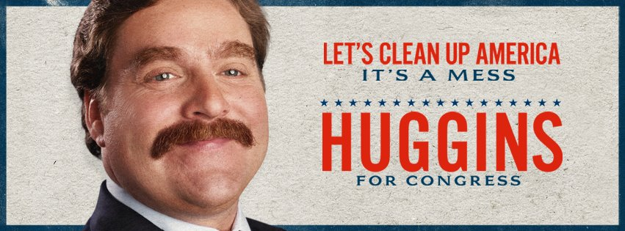
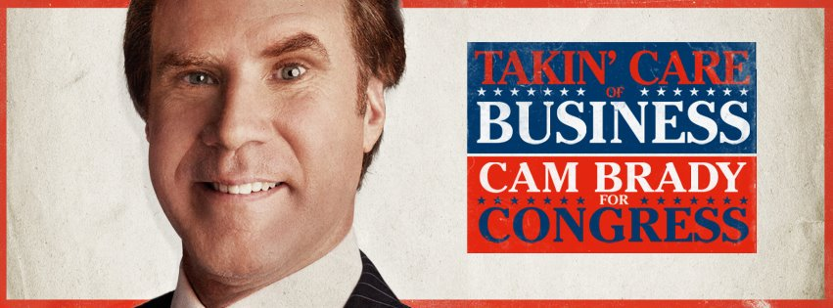
Linkage Institutions
To be elected to office: Candidates need to…
Think about who to gear towards?
Are there single issue groups?
Special interest groups who base their vote on a single issue
Candidates issues broad enough to attract followers?
Need a following
Media Influence
Sound bites and photo ops
All set up the candidates platform while running for office
This connection to groups (interest groups) sets up their policy agenda
Media can help get the candidates message out

Slide 14
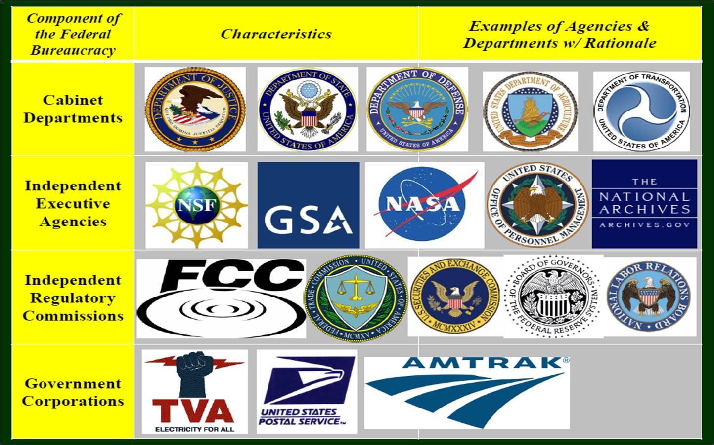
Policy-Making Institutions
Stated clearly in the Constitution
Bureaucracies have become the 4th branch of government
They have independent regulatory power and is connected directly and indirectly to government
Roles in Public Policy
Executive Branch
President proposes legislative agenda – direction of government
Decision to sign or veto legislation
Legislative Branch
Through committee system (votes) – determine fate of President’s budget
Nation deficit is a huge issue and plays a big role with approval
A budget proposal – that supports vision

Slide 15
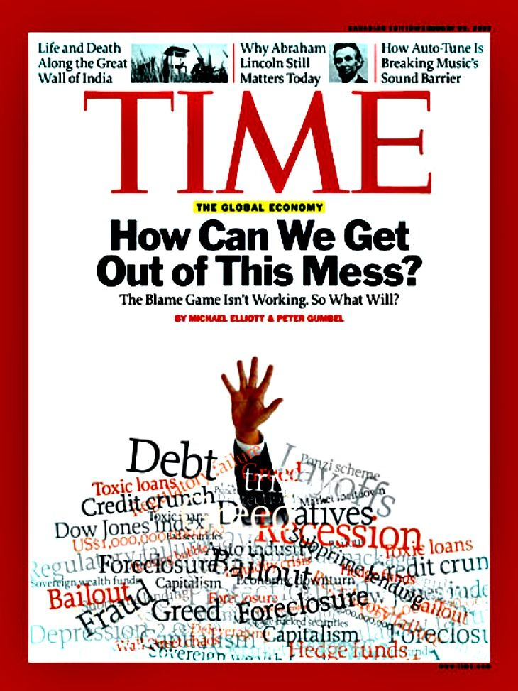
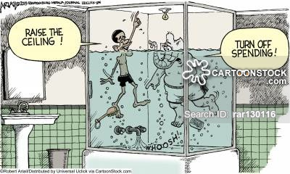
Policy-Making Institutions
Example of Policy Making based on Current Events (Recession mid-2000’s)
2009: President Obama signed the American Recovery and Reinvestment Act
Law cost more than $1 trillion and included tax cuts for 95 percent of American
Helped ailing banks, auto industries, and housing market
Put our government in the largest deficit, totaling more than 1 trillion dollars
Congress approved – only because
something had to happen

Slide 16
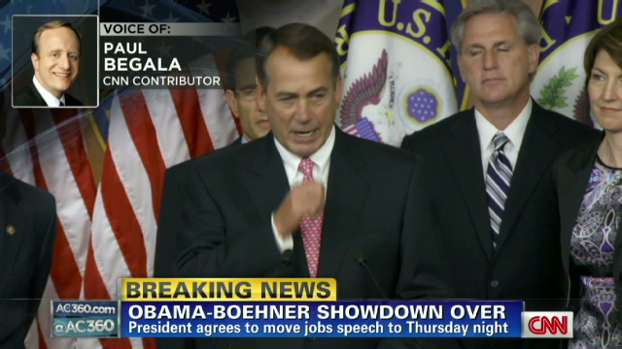
Policy-Making Institutions
Power of Congress
Threaten to not authorize an increase in the national debt in 2011 unless Obama agreed to spending cuts
Result:
Postponed:
Elimination of Bush’s tax-cuts until 2012
Defense cuts
Discretional spending (sequester)
Reductions in spending in these areas saved the government 85.4 billions dollars
Government workers taking furlough days also contributed

Slide 17
Policy-Making Institutions
The Supreme Court
Examples of Decisions
Has DIRECT impact on public policy
By its interpretation of the Constitution
Court cases sets the precedents for policy-making
Courts that show judicial restraint
Maintain status quo
Mirror decisions of other branches have established as current policy
Decisions that establish the legitimacy of state restrictions
Abortion, parental approval, narrower interpretation of Miranda Rights
Characteristics of a Conservative Court
Courts will either go status quo or rock the boat

Slide 18
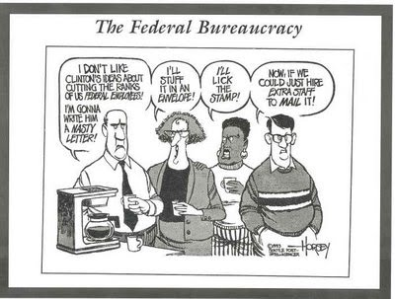
Policy-Making Institutions
Bureaucracies
Directly has increased the size of the government since WWII
The influence of these agencies has directly affected public policy
FDA: Food and Drug Administration
EPA: Environmental Protection agency
All have issued directives (rules) based on legislation
Do not have terms – so there longer than elected officials

Slide 19
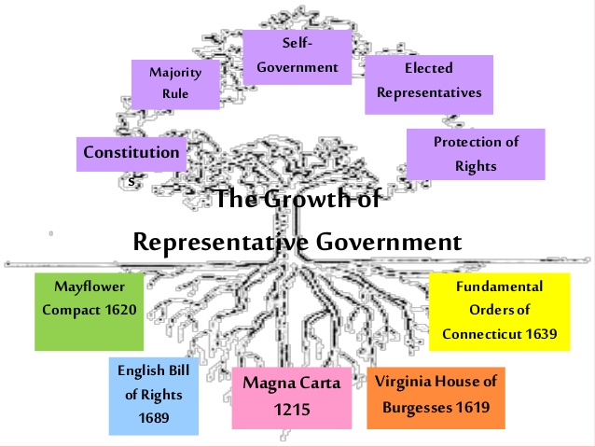
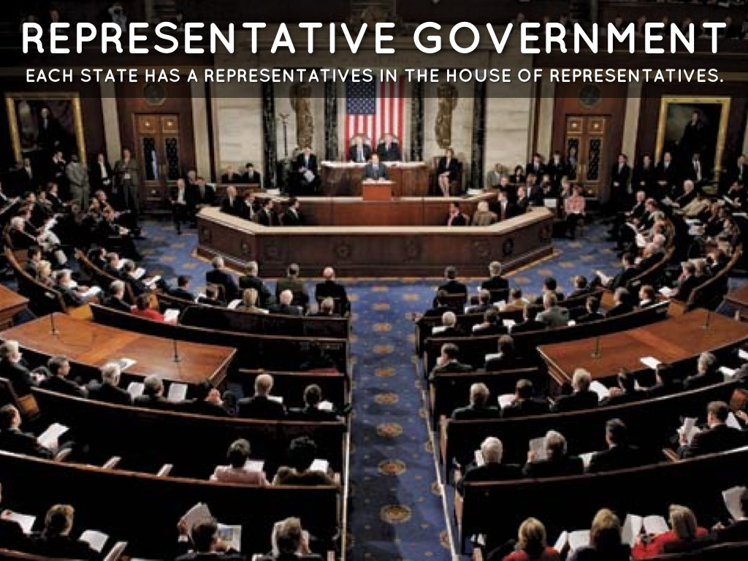
Evolution of Representative Government
The development of our Representative Democracy evolved from other forms of democracies
Enlightenment thinkers:
John Locke (Social Contract) & Montesquieu (Seperation of Powers)
Political system of Ancient Greece
Principles outlined in our Declaration of Independence
Magna Carta &
English Bill of Rights

Slide 20
Evolution of Representative Government
Ruled by “Many”
Concept that began in Greece
Purest for of Direct Democracy
Every citizen attending a town meeting and voting on every issue
Decision based on majority rules
Very difficult to do based on size of our country
Will see it at a smaller scale
Closest example: New England town meeting – where a town budget is approved

Slide 21
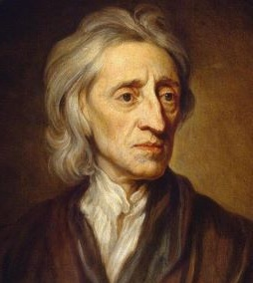
Evolution of Representative Government
Enlightenment Thinkers
The Change
Belief: a democracy should rely on the consent of the people
John Locke: Social Contract & Natural Rights
Give consent to being ruled – your vote is your consent
Life, Liberty, and Property – Basis to our concept in the Declaration of Independence
The individual became the central focus of our government policy
Equality
Freedom
Order
Became our driving force
of our democracy
Thomas Jefferson would incorporate
unalienable rights (cannot be taken away or denied)
in the Declaration of Independence & progressed to our Constitution

Slide 22
Evolution of Representative Government
Elections
In order to work:
Elections have to be open to all citizens
Issues and policy statements of candidates had to be available to the electorate
Citizens could form political parties to advocate policies
Elections would be determined by the majority
Did not meet this criteria always:
Slaves and women could not vote
Property requirement at one time
State legislatures determined who would represent the states as senators
Electoral college – takes away the popular vote

Slide 23
Evolution of Representative Government
Basic concepts of democracy today rely on:
Worth and dignity of the individual
Respect for equality
Majority rule with minority rights
Compromise
Guarantee of individual freedoms
Is our democracy is working?
Relies on individuals determine the final fate of who runs the government and how policy is determined
How it is ran through the individual:
Linkage Institutions and Sovereignty
Must have a forum to vote to determine their elected officials
Guarantees of voting equality
Everyone is involved
Recognition that the size and make-up of congressional districts should be as democratic as possible

Slide 24
Evolution of Representative Government
Is it really working?
Another way to decipher:
Check by the participation in government
2012 Scenario: states tried to implement new policy regarding voter identification
Claimed it would help with voter fraud
Courts rules these measures as unconstitutional
2013: Supreme Court provision allow 9 southern states to adjust their voting laws w/o federal approval
Many states implemented voter’s I.D.
Resulted in less people voting in these states

Slide 25
Evolution of Representative Government
Role of Government
Has to be responsive
Individual freedoms must be respected and protected
Must operate on the basis of consensus and compromise

Slide 26
Evolution of Representative Government
Problems that hurt our government in the past
Gridlock – lack of bipartisanship
Can not move legislative agenda because a divide in Congress
When it occurred
1995: Republican controlled Congress threatened gov’t shutdown b/c of budget stalemate
1996: New president and Congress reached compromise (Bipartisanship reached)
2006: Iraqi War discontent gave Democrats the majority in House and Senate against Bush (Republican)
2010: Republicans controlled H.of.Rep
2014: Republicans gain control of Congress
2016: Republican controlled Congress and new Republican president (Trump)
Talked about reversing many initiatives – Affordable Care Act
Examples of Bipartisanship
-OR-
Lack of Bipartisanship

Slide 27
Importance of Control
Key point:
If you control the agenda you will be the one who gets the what, when, and how.
Agenda: is a set of issues and policies laid out by ideological or political groups
Modern political theory revolves
around who controls the agenda

Slide 28
Importance of Control – Schools of Thought
Pluralist
Involves different groups vying for control of policy agenda
Groups are forced to compromise
Elite and Class Theory
Revolves around the Economic strata of society
Majoritarian Model
Purest form of democracy
A moderate political view is created (centrist position)
Pluralist agree on what a mutually acceptable position
Ex.) Amish Country
Upper Class – Rich
Use their interests to try to manipulate the political agenda
Relies on direct democracy
Proposals will be voted on with a majority rules
Representative Democracy
Voters electing their representatives as their own delegates
Act as the exclusive voice for the people in Congress
Attitudinal view:
Voters electing the representatives as their own trustees
Gives them autonomy to act for the good of constituents even if its against the majority

Slide 29
Importance of Goals
Every official should have goals
Is our government failing or succeeding?
Ask yourself this: Are our officials meeting the needs of the public they serve?

