Slide 1
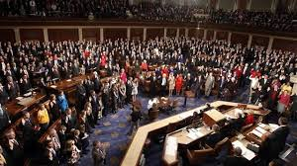
Congress

Slide 2
A Bicameral Congress
Introduction
1. The Framers of the U.S. Constitution created a bicameral congress consisting of a House of Representatives and a Senate.
2. The two houses of Congress have different characters.

Slide 3
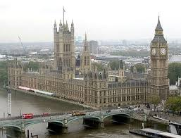
A Bicameral Congress
Reasons why the framers created a bicameral legislature
1. Drawing on historical experience
The Framers were intimately familiar with the British system of gov
The British system featured a bicameral system with a House of Lords and a House of Commons
Most of the colonial legislatures and state legislatures were bicameral

Slide 4
A Bicameral Congress
Fulfilling the Connecticut “Great” Compromise
Led by Virginia, the large states wanted a bicameral legislature based on population. Led by New Jersey, the small states wanted a unicameral Congress with equal representation for each state.
The Framers resolved the dispute by agreeing to a compromise calling for a bicameral Congress with representation in a House of Representatives based on population and a Senate in which the staets would have equal representation.

Slide 5
A Bicameral Congress
Implementing Federalism
A bicameral legislature provided for 2 types of representation. The House represented the interests of the people, while the Senate represented the interests of the states.
A bicameral legislature fragmented power, thus checking majority interests while protecting minority interests.
A bicameral legislature slowed the legislative process, thus encouraging careful deliberation and compromise.

Slide 6
Differences Between the House and the Senate
House of Representatives
Senate
435 members
Two-year terms
Must be at least 25
An America citizen for 7 years
A resident of the state from which s(he) is elected.
100 members
Six-year terms
Must be at least 30
An America citizen for 9 years
A resident of the state from which s(he) is elected.

Slide 7
Differences Between the House and the Senate
Election
1. Members of the House of Reps have always been elected by eligible voters. When the Constitution was ratified, the House was the new government’s only body directly elected by the people. “The People’s House”.
2. Senators were originally chosen by state legislatures. The 17th Amendment (1913) mandated that senators be elected by voters in each state.

Slide 8
XVII Amendment

Slide 9
Differences Between the House and the Senate
SPECIAL POWERS
1. House of Reps
Initiates revenue bills
Brings charges of impeachment against the president, vice pres., and all civil officers of the U.S.
Chooses the president when the electoral college is deadlocked
2. Senate
Ratifies treaties negotiated by POTUS
Possesses the sole power to try of judge impeachment cases
Confirms judicial appointments, including US attorneys, federal judges, and SCOTUS
Confirms executive appts., including cabinet heads, the director of the FBI, and the U.S. Attorney General

Slide 10
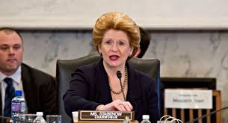
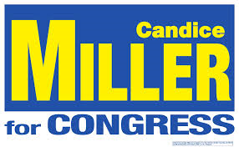
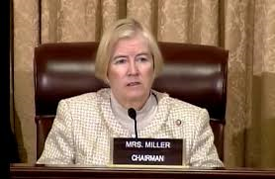
Your Legislators

Slide 11
THE HOUSE OF REPS
SIZE & APPORTIONMENT
1. The Constitution does not set the exact size of the House of Reps. It does stipulate that its size shall be apportioned or distributed among the states based on their respective populations.
2. The Constitution guarantees that each state will have at least one rep, regardless of its population. Seven states currently have one seats in the HOUSE.

Slide 12
THE HOUSE OF REPS
REAPPORTIONMENT
1. The Constitution directs Congress to reapportion (reallocate) House seats after a census taken every 10yrs.
As the population increased, so did the # of seats. By 1929, the House had grown to 435 seats.
Reapportionment Act of 1929 set the permanent size of the House at 435 members. As a result, each seat now represents an average of 700,000 people.
It increases/decreases/maintains a state’s influences in the H of R and selecting the POTUS

Slide 13
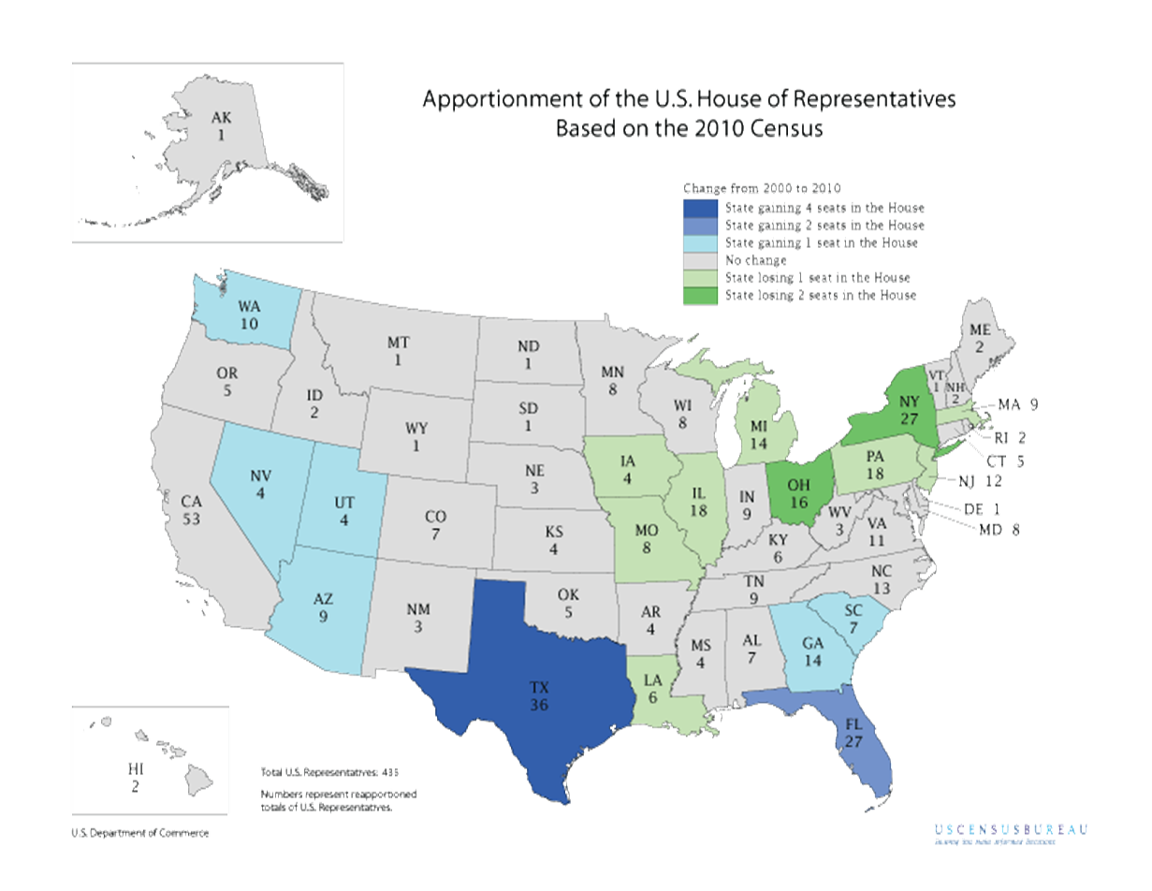

Slide 14
THE HOUSE OF REPS
DISTRICTS
1. The constitution does not define or discuss congressional districts.
2. In 1842, Congress stipulated that all seats in the HofR would be filled from single-member districts.
3. The 1842 law assigned each state legislature the responsibility of drawing the boundary lines of its congressional district.

Slide 15
THE HOUSE OF REPS

Slide 16
114th Congress: House of Representatives

Slide 17
THE HOUSE OF REPS
GERRYMANDERING
1. Gerrymandering is the legislative process by which the majority party in each state legislature redraws congressional districts to ensure the maximum number of seats for its candidates.
2. Consequences:
It protects incumbents and discourages challengers.
It strengthens the majority party while weakening the opposition party.
It increases or decreases minority representation.

Slide 18
THE HOUSE OF REPS
SUPREME COURT LIMITATIONS ON CONGRESSIONAL REDISTRICTING
1. Because rural areas dominated many state legislatures, congressional districts often favored less-populous rural areas of a state.
2. Wesberry v. Sanders (1964) set forth the principle of “one person, one vote” in drawing congressional districts. The case triggered widespread redistricting that gave cities and suburbs greater representation in Congress.

Slide 19
THE HOUSE OF REPS
3. SCOTUS decisions have placed the following limitations on congressional redistricting:
Districts must be compact. Lines must be contiguous or connected.
Cannot dilute minority voting strength.
District lines cannot be drawn based solely on race. However, race can be one of a variety of factors that are considered.
4. It is important to note that Supreme Court decisions have not eliminated gerrymandering for partisan political purposes.

Slide 20
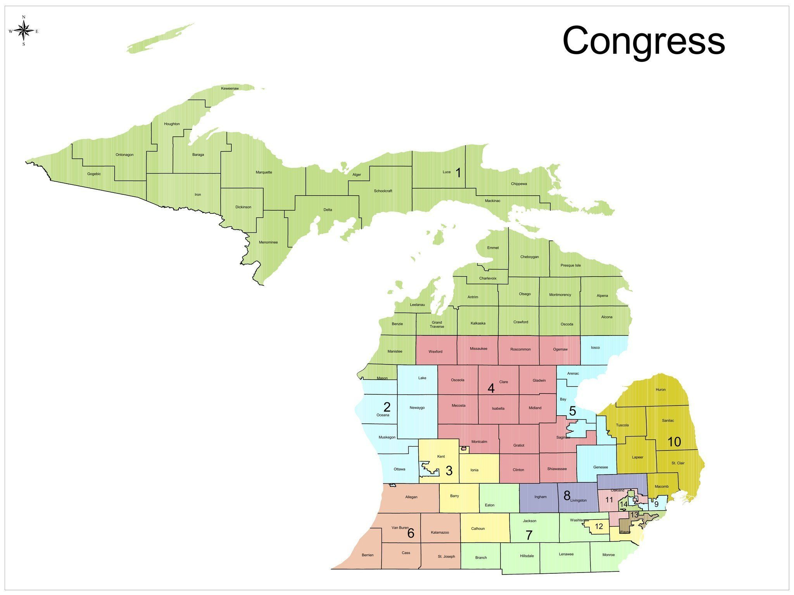

Slide 21
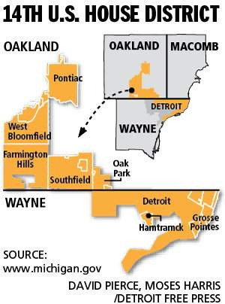
Gerrymandered 14th

Slide 22
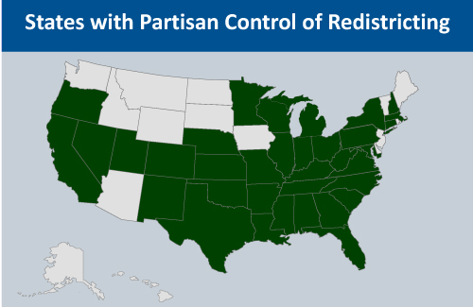

Slide 23
Congressional Elections
INCUMBENTS USUALLY WIN
During the last 50 years, incumbency has been the single most important factor in determining the outcome of elections.
Over 90% of House incumbents seeking reelection WIN
Over 75% of Senate incumbents seeking reelection WIN

Slide 24
Congressional Elections
REASON WHY INCUMBENTS WIN
1. Money
Incumbents are usually able to raise more campaign contributions than their challengers.
PACs contribute more $ to incumbents than challengers
Incumbents outspend challengers by a ratio of + 2 to 1.
2. Visibility
Better known to the voters than challengers.
Have opportunities to participate in highly visible activities that are covered by local newspapers and local TV

Slide 25
Congressional Elections
REASON WHY INCUMBENTS WIN…
3. Constituent service
There is a close link between constituent service and reelection.
Members are able to win supporters by performing casework for their constituents and by brining home money and jobs (“pork”) for their district.
Casework consists of helping individual constituents, often by cutting through bureaucratic red tape.

Slide 26
How Congress is Organized
The Role of Political Parties
Political parties play a key role in the organization of both houses of Congress.
The majority party is the party in each chamber with the most votes.
The minority party is the party in each chamber with the 2nd most votes.
The majority party enjoys the following advantages:
It holds committee chairs.
It chooses the Speaker of the House
It assigns bills to committees.
It holds the majority on each committee.
It controls the House Rules Committee.
It set the legislative agenda.

Slide 27
How Congress is Organized
The House of Representatives
1. Larger than the Senate.
The result, it has a more formal structure and is governed by stricter rules. (i.e. Debate is more restricted)
2. The Speaker of the House
Presides over the House of Reps
Overseas House business
Stands second in line for POTUS succession
3. Other House leaders
Majority Leader – elected leader of the party that controls the H of R
Minority Leader – elected leader of the party with the second-highest # of elected reps.
Whips – both parties have elected whips who maintain close contact w/ their members & try to ensure part unity on important votes.

Slide 28
How Congress is Organized
The Senate
1. The Senate is smaller & thus less formally organized than the HofR. In contrast to the House, the Senate operates more on informal understandings.
2 The Vice President
The Constitution makes the VP the President of the Senate
The VP may vote only to break a tie.
3. Other Senate Leaders
President Pro Tempore – presides over the Senate in the absence of the VP. The position is held by a member of the majorty party w/ the longest service in the senate.
MAJORITY LEADER – is the elected leader of the party that controls the Senate. ** He/She is the true leader of the Senate**
Minority Leader – is the elected leader of the party with the 2nd-highest # of members in the Senate

Slide 29
The Committee System
The Importance of Committees
Both the House & Senate are divided into committees.
Committees play a dominant role in congressional policy making.
The committee system is particularly important in the House of Representatives.

Slide 30
Standing committees
Permanent bodies that continue from one Congress to the next.
They focus on legislation in a particular area, such as foreign relations or agriculture.
All bills are referred to standing comm., where they can be amended, passed, or killed.
They foster the development of expertise by their members.
They are divided into subcommittees, where the details of legislation are worked out. (marked up)

Slide 31
Other types of committees
Select Committees: Separate in each house, usually temporary and study specific issues (juicy issues such as investigatory issues)
Joint Committees: Made up of members of both houses, usually more mundane, day-to-day issues
Conference Committee: Temporary, made up of both houses and makes sure both senate and house bills have the same language
Having the right committee assignment can really help a person’s career (TV appearances, Newspapers)

Slide 32
House Rules Committee
1. The Rules Committee is controlled by the Speaker. It is often called the “traffic cop” or the Speaker’s “right arm”.
2. The Rules Committee sets the guidelines for floor debate. It gives each bill a rule that places the bill on the legislative calendar, limits time for debate, and determines the type of amendments that will be allowed.
3. A closed rule sets strict time limits on debates & forbids amendments from the floor.
4. An open rule sets less strict time limits on debate and permits amendments from the floor.

Slide 33
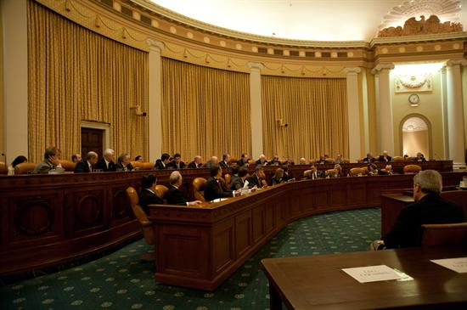
House Ways and Means Committee
1. The committee has jurisdiction on all taxation, tariffs, and other revenue-raising measures.
2. Members of the Ways and Means Committee cannot serve on other House committees.

Slide 34
Committee Chairs & the Seniority System
1. Committee chairs exercise great power and enjoy considerable prestige.
They call meetings, schedule hearings, hire staff, recommend majority members to sit on conference committees, and select all subcommittee chairs.
They often receive favors from lobbyists and contributions from PAC’s.
2. Historically, committee chairs were chosen by a seniority system in which the majority party member w/ the most continuous service on the committee automatically became the chair.
3. Chairs in both the House and Senate are now elected positions. However, seniority is still the norm for selecting chairs in both.

Slide 35
The Legislative Process

Slide 36
Introduction
1. Approximately 5,000 bills are introduced each year.
2. Only about 125, or about 2.5%, of these bills are made into laws.
3. The bicameral Congress and its complex committee system present a formidable series of legislative obstacles that defeat most bills.
4. The legislative process is lengthy, deliberate, fragmented, and characterized by negotiation and compromise.

Slide 37
Floor Action
HOUSE OF REPRESENTATIVES
The House Rules Committee gives the bill a rule, placing it on the legislative calendar, allowing a specified time for debate, and determining if any amendments will be allowed.
The bill is debated and a vote is ultimately taken by the full House.

Slide 38
Floor Action
SENATE
Unlike the House, Senate procedures permit members to speak on the floor as long as they wish.
A filibuster is a way of delaying or preventing action on a bill by using long speeches and unlimited debate to “talk a bill to death”.

Slide 39
Creating Bills
1. Anyone can write a bill.
2. Most bills are not written by members of Congress.
3. Most bills originate in the executive branch.
4. Business, labor, agriculture, and other interest groups often draft bills.
5. Only members of Congress can introduce bills. They do so, by dropping a bill into the “hopper,” a box hanging on the edge of the clerk’s desk.

Slide 40
Committee Action
1. The House and the Senate have parallel processes.
2. Bills are assigned a number and then sent to an appropriate committee. The bill is usually referred by the committee chair to a subcommittee for study, hearings, revisions, and approval.
3. Most bills die in committee, where they are pigeonholed or buried.
If a majority of the House wishes to consider a bill that has been pigeonholed, the bill can be blasted out of the committee w/ a discharge petition signed by a majority of the House members.

Slide 41
Committee Action cont’d
5. Bills approved by a subcommittee are then returned to the full committee, where members can mark up or add items to the bill.
6. Committees can reject the bill or send it to the House or Senate floor with a positive recommendation.

Slide 42
FLOOR ACTION

Slide 43
HOUSE OF REPRESENTATIVES
The House Rules Committee gives the bill a rule, placing it on the legislative calendar, allowing a specified time for debate, and determining if any amendments will be allowed.
The bill is debated and a vote is ultimately taken by the full House.

Slide 44
SENATE
Procedures permit members to speak on the floor as long as they wish.]
FILIBUSTER is a way of delaying or preventing action on a bill “talking a bill to death”
Filibuster can be stopped on if 60 senators vote for cloture to end debate
Filibusters are so successful that you truly need a 3/5th vote to pass any major legislation. Majority rule?
In addition to threatening to filibuster, a senator can ask to be informed before a particular bill is brought to the floor. Known as a “hold”, this procedure stops a bill from coming to the floor until the hold is removed.
If a bill overcomes these obstacles, it will ultimately be voted up or down by the full Senate.

Slide 45
CONFERENCE ACTION

Slide 46
Conference Committee
If a bill is passed in different versions by the House and the Senate, a conference committee will be formed to work out the differences.
Comprised of members from the original House and Senate committees.
The conference committee bill is then returned to each chamber for a vote.

Slide 47
HOW MEMBERS VOTE

Slide 48
Reasons why members vote the way they do
Representational – based on the reasonable assumption that members want to get reelected, and therefore they vote to please their constituents.
Organizational – based on the equally reasonable assumption that since most constituents do not know how their legislator has voted, it is not essential to please them. But it is impt. to please fellow members of Congress, whose goodwill is valuable in getting things done & in acuiring status and power in Congress.
Attitudinal – there are so many conflicting pressures on members of Congress that they cancel one another out, leaving them virtually free to vote on the basis of their own beliefs.

