Slide 1
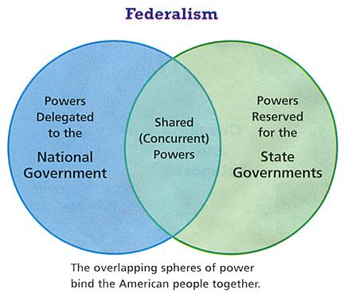
FEDERALISM
CHAPTER 3

Slide 2
Three systems of government
Unitary
A centralized system which all power is vested in a central government. Ex. GB, France, China
Confederate
A decentralized system of government in which a weak central government has limited power over the states. Ex. United Nations
Federal
A system in which power is divided by a written constitution between a central gov. and regional govs. Two or more levels of government have formal authority over the same area and people. Ex. USA, Mexico, Canada, Germany, India

Slide 3
The constitutional division of powers
THE FRAMERS CHOOSE FEDERALISM
They chose to balance order and freedom by creating a federal system that assigned powers to the national gov while reserving other powers to the states.

Slide 4
The constitutional division of powers
EXPRESSED POWERS
Expressed powers (also called enumerated powers) are specifically granted to the federal government by the Constitution.
Article 1, Section 8 lists 18 separate clauses that enumerate 27 powers to Congress. Article 2, Section 2 assigns POTUS several expressed powers. Article 3 grants “the judicial power of the United States” to the Supreme Court. And finally, several amendments contain expressed powers. For example, the 16th Amendment gives Congress the power to levy an income tax.
Key expressed powers
The power to regulate interstate and foreign commerce.
The power to tax and spend.
The war power.

Slide 5
The constitutional division of powers
IMPLIED POWERS
Implied powers are not expressly stated in the Constitution.
Implied powers are derived from the Elastic Clause (A1,S8,C18)
The necessary and proper clause enables the national government to meet problems the Framers could not anticipate. It thus insured the growth of national power by enabling the federal gov to extend its powers beyond those enumerated in the Constitution.
McCulloch v. Maryland (1819) used the necessary and proper clause to create a new government power.

Slide 6
The constitutional division of powers
INHERENT POWERS
Inherent powers derive from the fact that the United States is a sovereign nation.
Under international law, all nation-states have the right to make treaties, wage war, and acquire territory.

Slide 7
The constitutional division of powers
RESERVED POWERS
Reserved powers are held solely by the states.
The 10th Amendment states, “The powers not delegated to the US by the Constitution, nor prohibited by it to the states, are reserved to the states respectively, or to the people.”
Examples:
Licensing doctors
Establishing public schools
Establishing local governments
Police power – the authority of a stae to protect and promote the public morals, health, safety, and general welfare.

Slide 8
The constitutional division of powers
CONCURRENT POWERS
Concurrent powers are exercided by both national and state governments.
Examples: power to tax, borrow money, and establish courts.
PROHIBITED POWERS / DENIED POWERS
Denied Powers are denied to both the national government, state govt., or both
Examples: Tax exports, and states cannot make treaties with foreign nations, and see Art. 1, Sec. 9

Slide 9
Milestones in establishing national supremacy
The Cardinal Question
“The relationship between the national government and the states is the cardinal question of our constitutional system. The relationship cannot be settle by one generation because it is a question of growth, and every successive stage of our political and economic development gives it a new aspect, makes it a new question.” - Woodrow Wilson

Slide 10
Milestones in establishing national supremacy
MCCULLOCH V. MARYLAND (1819) AND IMPLIED POWERS
Background of the case
Congress chartered the Second National Bank of the United States in 1816.
In 1818, the Maryland legislature passed a law imposing a substantial tax on the operation of the Baltimore branch of the bank.
James McCulloch, cashier of the Baltimore branch, refused to pay the tax.
When the Maryland state courts ruled against hi, McCulloch appealed to the United States Supreme Court.

Slide 11
Milestones in establishing national supremacy
MCCULLOCH V. MARYLAND (1819) AND IMPLIED POWERS
Constitutional Questions
Does the Constitution permit Congress to charter a bank?
Does a state have a constitutional right to tax an agency of the United States government?
SCOTUS DECISION
Although the Constitution does not specifically enumerate creating a bank, it does grant Congress the power to “make all laws necessary and proper for carrying into execution the foregoing powers.” Congress may thus reasonably decide that chartering a national bank is a “necessary and proper” way to carry out its expressed powers.

Slide 12
Milestones in establishing national supremacy
MCCULLOCH V. MARYLAND (1819) AND IMPLIED POWERS
Significance
McCulloch v. Maryland confirmed the right of Congress to utilize implied powers to carry out its expressed powers. Federal programs to build interstate highways, regulate labor-management relations, and inspect food and drugs are all justified as implied powers of Congress
The decision validated the supremacy of the national gov. over the states by declaring that states cannot interfere with or tax the legitimate activities of the federal gov.

Slide 13
Milestones in establishing national supremacy
NULLIFICATION AND THE CIVIL WAR
John C. Calhoun of S. Carolina argued that a state can nullify or refuse to recognize an act of Congress that it considered unconstitutional.
The Civil War was both a confict over slavery and a dispute over the relationship between the Southern states and the national gov.
The Civil War forcibly refuted the doctrine of nullicication while also confirming that the federal union is indissoluble.

Slide 14
Milestones in establishing national supremacy
GIBBONS V. OGDEN (1824) AND THE COMMERCE CLAUSE
Background of the case
The New York legislature granted Aaron Ogden an “exclusive license” to run a ferry service on the Hudson River between NY and New Jersey.
Thomas Gibbons obtained a license from the federal government to operate a competing NY-New Jersey ferry service.
Ogden claimed that Gibbons infringed on the monopoly rights granted to him by the NY legislature.
When the NY courts ruled against him, Gibbons appealed to the SCOTUS.

Slide 15
Milestones in establishing national supremacy
GIBBONS V. OGDEN (1824) AND THE COMMERCE CLAUSE
Constitutional questions
Did the NY law violate the Constitution by attempting to regulate interstate commerce?
Does Congress have the exclusive right to regulate interstate commerce?

Slide 16
Milestones in establishing national supremacy
GIBBONS V. OGDEN (1824) AND THE COMMERCE CLAUSE
The Court’s decision
Led by John Marshall, the Sup Ct. defined commerce as all commercial business dealings. Commerce thus includes the production, buying, selling, renting, and transporting of goods, services, and properties.
Because congress regulates all interstate commerce, the Court upheld Gibbons’ right to operate a ferry service in competition with Ogden.
Significance
Marshall’s broad definition of commerce enabled Congress to promote economic growth by supporting the construction of roads, canals, and railroad lines.

Slide 17
Milestones in establishing national supremacy
THE EXPANSION OF THE COMMERCE CLAUSE
The commerce clause has played a key role in the expansion of federal power.
The national government now regulates a wide variety of commercial activities, including radio signals, telephone messages, and financial transactions.
The SCOTUS upheld the 1964 Civil Rights Act forbidding discrimination in places of public accommodation such as restaurants and hotels on the basis of its power to regulate interstate commerce.

Slide 18
Milestones in establishing national supremacy
THE STRUGGLE OVER SCHOOL DESEGREGATION
In 1954, in Brown v. Board of Ed, SCOTUS unanimously held that school segregation was unconstitutional.
President Eisenhower sent federal troops to Little Rock’s Central High School to enforce court-ordered desegregation.
Despite initial resistance, national standards of racial equality ultimately prevailed.

Slide 20
INTERGOVERNMENTAL RELATIONS
DUAL FEDERALISM
A system of government in which the national and state governments remain supreme within their own spheres. For example, the nat’l gov. is responsible for foreign policy, while the states have exclusive responsibility for the public schools.
Often called “layer cake” federalism. It characterized the relationship between the national and state govts. Until the advent of the New Deal during the 1930’s.

Slide 21
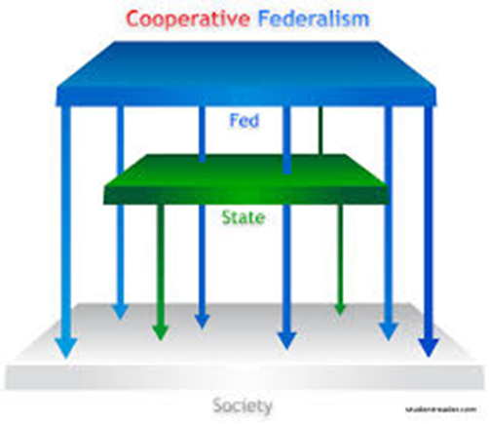
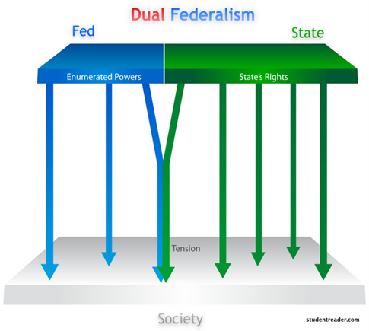
INTERGOVERNMENTAL RELATIONS
COOPERATIVE FEDERALISM
A system of government in which the national and state governments work together to complete projects. For, example, the interstate highway program features a partnership in which national and state governments share costs and administrative duties.
Often called “layer cake” federalism because of the blurred distinction between the levels of government.

Slide 25
INTERGOVERNMENTAL RELATIONS
FISCAL FEDERALISM
Refers to the pattern of spending, taxing, and providing grants in the federal system.
In 2010, state and local governments received about $480 billion in federal grants. These grants accounted for about 21% of all funds spent by state and local governments.
Fiscal federalism can be classified in three major program areas:
Categorical grants (project and formula)
Block grants
Revenue sharing

Slide 26
Categorical grants
Categorical grants are defined as federal aid that meets the criteria of a specific category and has specific criteria attached to them. These criteria can range from nondiscriminatory practice to minimum wages.
Two Types of Categorical grants
Project grants – are based on competitive applications by states and individuals
Formula grants – which are based on specific formulas developed by Congress.

Slide 27
BLOCK GRANTS
Block grants are a form of federal aid with far fewer strings attached. Made for broadly defined purpose. They go to local communities for specific purposes, and the states decide where and how to spend the money. i.e. homeland security and community development.

Slide 28
Revenue sharing
Gives money directly to the states with no strings attached.
Richard Nixon used revenue sharing to reverse the policies of LBJ.
The Clean Air Act of 1970 – set national standards for air quality but directed the states to implement the law and enforce it.

Slide 29
mandates
A mandate is a rule telling states what they must do to comply with federal guidelines.
Civil rights and environmental protection are the most common mandates. For example, state programs may not discriminate against people because of their race, se, age, or ethnicity.
An unfunded mandate requires state and local governments to provide services without providing resources for the services
i.e. Handicapped Children’s Protection Act required public schools to build access ramps and provide special buses, but the act did not provide federal funds to pay for these additions.

Slide 30
devolution
Refers to a movement to transfer responsibilities of governing from the federal government to state and local governments.
For example, the Welfare Reform Act of 1996 gave the states the money to run their own welfare programs. States had wide discretion in implementing the federal goal of transferring people from welfare to work.
“Contract with America“ – In the 1994 congressional elections, Congressman Newt Gingrich had Republican candidates sign a document in which they pledged their support for such things as a balanced budget amendment, term limits for members of Congress, and a middle-class tax cut.

Slide 31
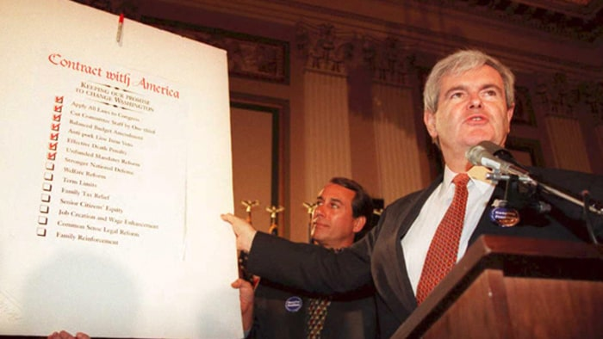
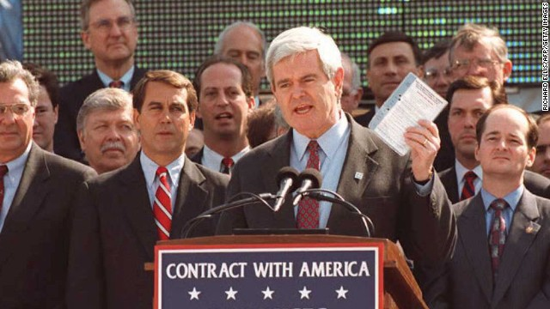
Contract with America 1994

Slide 32
devolution
Devolution proponents harbor a deep-seated ideological mistrust of federal government and believe that state governments are more responsive to the people
Deficit politics encouraged devolution (NATIONAL DEBT!) www.usdebtclock.org
Devolution is supported by public opinion, but the strength of that support is uncertain

Slide 34
Advantages and disadvantages of federalism
ADVANATAGES
Promotes diverse policies that encourage experimentation and creative ideas.
Provides multiple power centers, thus making it difficult for any one faction or interest group to dominate government policies.
ENCOURAGES PARTICIPATION by keeping the government close to the people.

Slide 35
Advantages and disadvantages of federalism
DISADVANTAGES
Promotes inequality because states differ in the resources they can devote to providing services.
Enables local interests to delay or even thwart majority support for a policy.
Creates confusion because the different levels of government make it difficult for citizens to know what different governments are doing.

