Slide 1
Federalism Chapter 3

Slide 2
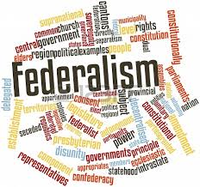
FEDERAL SYSTEM
TWO Constitutionally recognized levels of government, each with sovereignty over different policy matters and geographic areas.
The national government has no legal superior over matters which the Constitution gives in (Article I)
The state governments have no legal superiority over matters which the Constitution gives it (8th Amendment)

Slide 4
Pros and Cons of Federalism
Negative view: Federalism blocks progress and protects powerful local interests
Positive view: Federalism contributes to governmental strength, political flexibility, and fosters individual liberty
Federalist #10: small political units allow all relevant interests to be heard
Federalism increases political activity

Slide 5
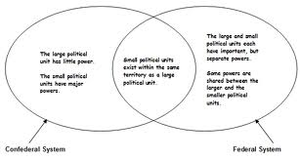
NATIONAL SOVEREIGNTY
ENUMERATED POWERS
THE POWERS OF THE NATIONAL GOVERNMENT THAT ARE LISTED IN THE CONSTITUTION.
IMPLIED POWERS
POWERS OF THE NAT’L GOVT THAT ARE NOT LISTED, BUT ARE CLAIMED BY THE NECESSARY AND PROPER CLAUSE (ART 1, SECT 8, CLAUSE 18)
NECESSARY AND PROPER CLAUSE / ELASTIC CLAUSE
GIVES CONGRESS THE POWER TO DO WHATEVER IT DEEMS IT NECESSARY TO CARRY OUT ITS ENUMERATED POWERS

Slide 6
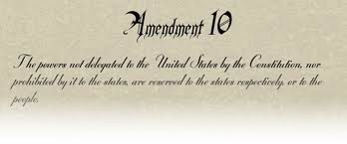
STATES SOVEREIGNTY
DELEGATED POWERS
TO RATIFY AMENDMENTS TO THE CONSTITUTION AS WELL AS, ELECTION OF REPRESENTATIVES TO NAT’L GOVERNMENT
RESERVED POWERS
1Oth Amendment
Police Powers
States exercise authority over the ordinary, daily affairs of their citizens

Slide 7
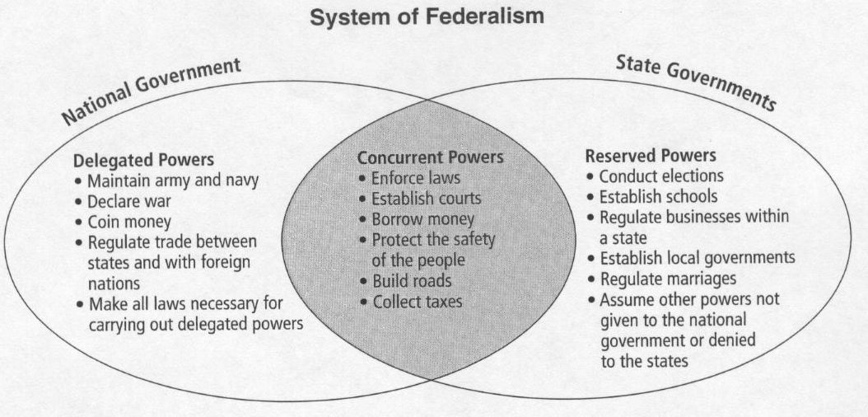

Slide 8
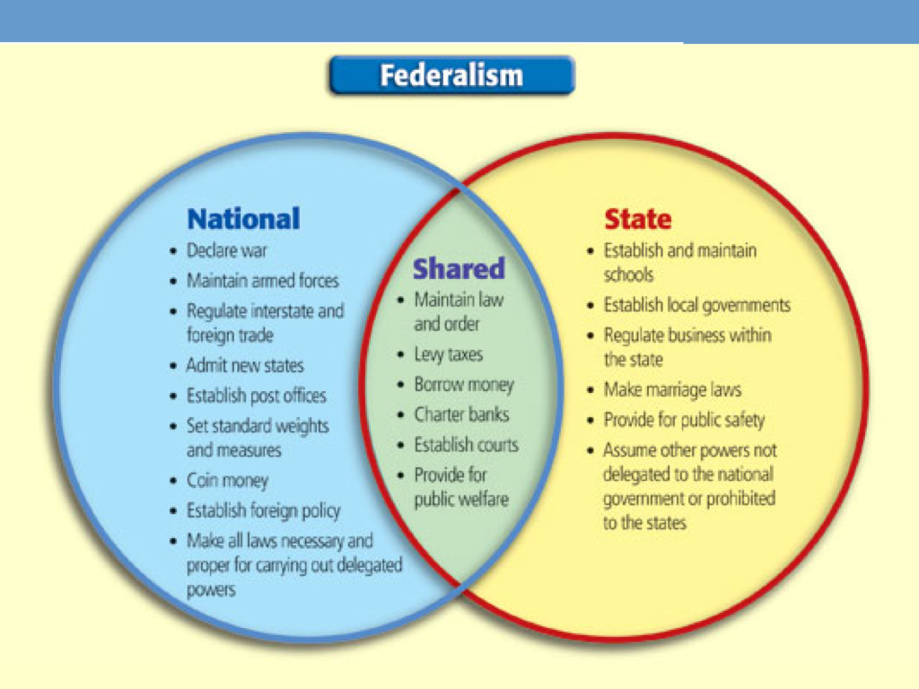

Slide 9
The Founding
1. Founders believed that neither national nor state government would authority over the other since power comes from the people.
2. New plan had no historical precedent

Slide 10
Elastic Language in A1.8.c18
Hamilton’s view: national supremacy since the Constitution was the supreme law of the land (Article 6)
Jefferson’s view: states’ rights with the people as ultimate sovereign; the national gov was likely to be the principal threat to individuals’ liberty

Slide 11
McCulloch v. Maryland 1819
Could Congress charter a national bank? Yes, even though this power is not explicitly in the Constitution (Necessary and Proper Clause)
Could states tax the national bank? No, because “the power to tax is the power to destroy”

Slide 12
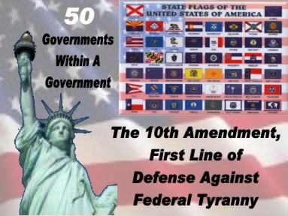

Slide 13
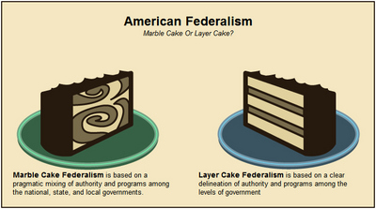
Evolution of Federalism
Dual Federalism
The relationship between the national and state govt’s whereby the two levels functioned independently of each other to address their distinct constitutional responsibilities.

Slide 14
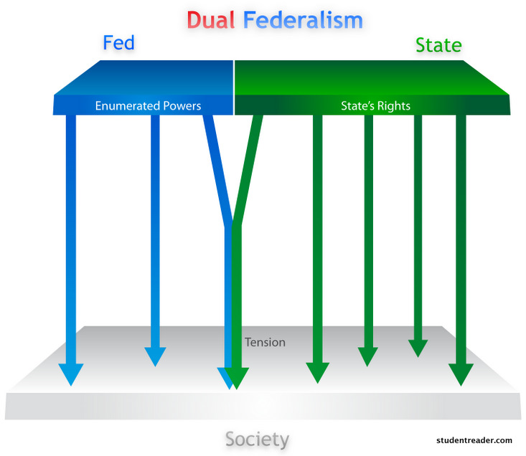
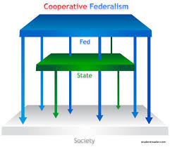
Cooperative Federalism
The relationship between the national and state govts whereby the two levels work together to address domestic matters reserved to the states.

Slide 15
Centralized Federalism
The relationship between the national and state govts whereby the national imposes its policy preferences on state governments.
Which kind of federalism do we have today?

Slide 16
Landmark in the Evolution of Federalism
Civil War Amendments
13th, 14th, 15th, (post war 16th & 17th)
Supreme Court Decisions
McCulloch v. Maryland (1819)
United States v. Lopez (1995)
Grants in-Aid
The transfer of money from one government to another that does not need to be paid back.
Mandates
Clauses in national law that directs state and local governments to comply with national legislation and standards
i.e. Americans With Disabilities Act (ADA)
Conditions in Aid
tell state governments what they must do if they wish to receive grant money
Preemption
The constitutionally based principal that allows the national govt to supersede state or local laws.

Slide 17
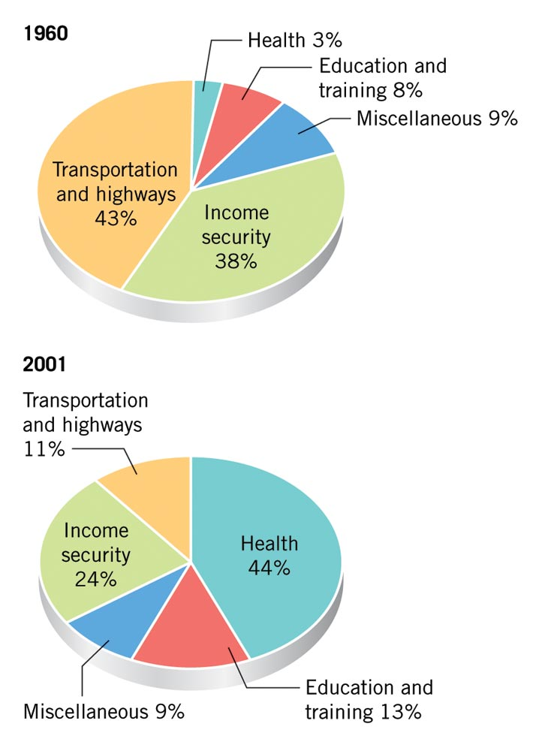
Grants in Aid
Dramatically increased in scope in 20th
century
Grants were attractive to state officials for various reasons
Required broad congressional coalitions with wide dispersion of funds, because every state had incentive to seek grant money
Note: The chart shows the changing purpose of Federal grants to states and local governments

Slide 18
Categorical Grants v. Revenue Sharing
Categorical grants for specific purposes defined by federal law; often require local matching funds
Block grants (sometimes called special revenue sharing or broad-based aid) devoted to general purposes with few restrictions—states preferred block to categorical grants
Revenue sharing (sometimes called general revenue sharing) requires no matching funds and can be spent on almost any governmental purpose

Slide 19
Evolution of Federalism continued
Conflicted Federalism
Involves the conflicted elements of dual, cooperative, and centralized federalism.
For some policy areas, the national and state governments operate independently of one another.
For most policy areas, intergovernmental relations are the norm. (9/11 changed homeland security)
Sometimes they are Voluntary and a means to advance state policy priorities (cooperative fed)
Sometimes they are compelled by national legislation (centralized federalism)

Slide 20
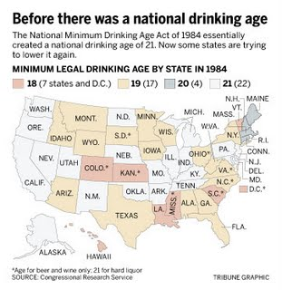
Conditions in-Aid and CONFLICTED FEDERALSIM
Federal government says you will do this or else. You have a choice but you really don’t.

Slide 21
State-to-State Obligations
Horizontal Federalism
Interstate Compacts
Agreements between states that the national government has the right to review & reject.
Ex. Water rights between Georgia, Florida, Alabama
Extradition
The legal process of sending individuals back to a state that accuses them of having committed a crime, and from which they have fled.
Privileges and Immunities
States must extend to other states’ citizens the privileges and immunities it provides for it’s citizens
Full Faith and Credit
States must recognize as legally binding the public acts, records, and judicial proceedings of every other state.

Slide 22
Devolution
Devolution initiatives returned program management to the states, with some federal guidelines, but there is no guarantee of federal support
Block grants fund entitlements

Slide 23
Devolution Revolution
Devolution proponents harbor a deep-seated ideological mistrust of federal government and believe that state governments are more responsive to the people
Deficit politics encouraged devolution
Devolution is supported by public opinion, but the strength of that support is uncertain

