Slide 1
The 60 vote requirement in rule 22:
Does not protect the right of the minority to debate – it gives the minority the power to prevent the majority from debating.
Does not foster deliberation – it allows the minority to prevent deliberation.
Does not promote compromise – it promotes gridlock by giving the minority an incentive not to compromise.

Slide 2
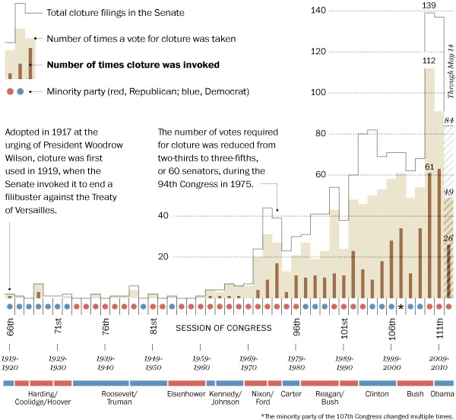
The history of the filibuster

Slide 3
The Filibuster rule
It Does however:
Promote obstruction
Promote hypocrisy
Prevent the president from filling judicial and executive vacancies
Allow the minority to nullify existing laws
https://ucsmail.uticak12.org/exchweb/bin/redir.asp?URL=http://www.youtube.com/watch?v=9wkcEijHgY0%26sns=em

