Slide 1
Chapter Ten
Elections and Campaigns

Slide 2
Campaigns
General Information
Consist of: (TASKS)
Talking to voters
Passing out campaign flyers
Putting up yard signs
Getting attention of local media
Calling people on the phone
National & State Campaigns
Two phases
1. Campaign before the party nomination
2. Effort between the time of nomination and the general election
Different rules apply to each phase
Financing rules

Slide 3
Presidential v. Congressional Campaigns
There is more voter participation in presidential campaigns
Presidential races are more competitive than House races

Slide 4
Presidential v. Congressional Campaigns
Lower turnout in off years means that candidates must appeal to more motivated and partisan voters
Members of Congress can do things for their constituents that the president cannot
Members of Congress can distance themselves from the “mess in Washington”

Slide 7
Presidential Campaign
Step One
Decision to Run
Must have the money and support
These issues need to be seriously evaluated
Are they ready for the psychological and personal toll?
Make it public through an announcement
Next step: gaining the most support at the primaries
Strategy must be planned to gain the most support
Step Two
Winning Delegates (1,144)
Primaries and Caucuses
Begin in February before the November of the general election
End in June of the same year
All states must complete their primaries and caucuses before the national convention delegates meet
Winning the initial primary is HUGE (New Hampshire)
Creates a big media buzz about the candidate

Slide 8
Presidential Campaign
Step 3
The Convention
Held in July or August before the November of the general election
Present conventions serve as a pep rally
Each party has known who its candidate has been
Used as a media tool
Step 4
General Election Stage
Constant campaigning until the day of the general election in November
During this stage:
Concentrate on the American public, not a political party
Hiring starts:
Campaign mangers
Media consultants
Speech writers
All to try to gain the advantage
Television debates
Very common and expected now
Debate the hot topics and educate the public

Slide 9
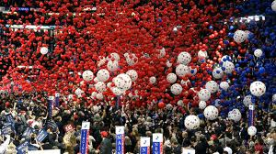
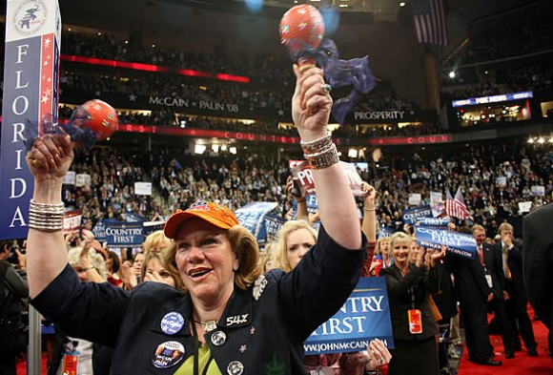
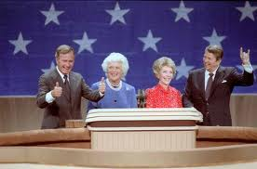
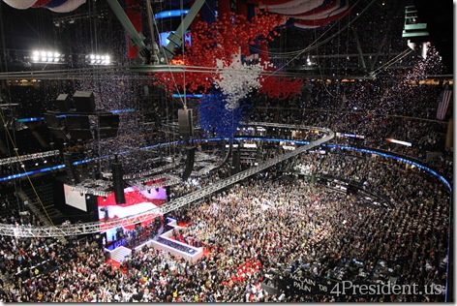
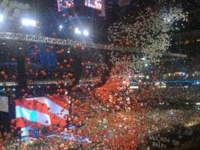
Convention

Slide 10
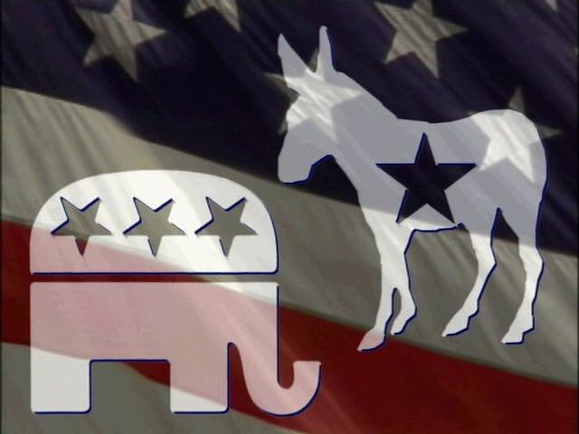
Congressional Campaigns
Positions up for battle?
Representatives
Senators
Differences from Presidential Campaign
Announcement of who is running is not made so far in advance
Races are smaller than presidential races
Less expensive to run
Less competitive

Slide 11
Congressional Elections
Incumbents have an extraordinary advantage – and no terms limits in Congress
Each state has two senators; number of House representatives based on state population, as determined by the census
House members are now elected from single-member districts

Slide 12
Campaign Financing
Funds needed?
Millions ….
Presidential campaigning requires an enormous amount of money
1996 presidential campaign:
Clinton and Dole campaigns spent about $232 million
$69 million in “issue ads” paid for by the Republican and Democratic National Committees
1996 Presidential + State + Local elections financing = 4.1 billion

Slide 13
Campaign Financing
Where does the money go?
Majority goes to television and radio ads
Ex.) Bill Clinton spent $44 million on these ads
Helped him win the presidency
Congressional campaigns
Spend less on these types of ads
If any incumbent has a lot of money, this can scare away challengers
Can’t compete with the lack of exposure
Federal Election Committee
FEC
Oversees campaign funding
Sets limits on contributions and expenditures
Two major issues:
Control of overall cost
Limits on individual limitation

Slide 14
Source of Funds
Public Sources
Government funding
Helps with Presidential funding
If you accept the funding, the candidate can not spend more than what is given to them
Government matches funds of all money no more than $250
Congressional Candidates
Receive no government funding
They rely on PAC money

Slide 15
Source of Funds
Private Sources
Private Individuals contribute to the campaigns they support
This was looked at as an unfair advantage – some people would give huge sums of money
There is a limit set by the FEC for how much an individual can give
Much funding come from average people donating $100 to $200
Political Action Committees
PAC
Created by any group that wants to influence government
Groups like:
Corporations
Labor Unions
Professional Organizations
Pool voluntary contributions of their members into a single fund
Give that money to their favored candidate

Slide 16
Review
Illustrate the Campaign timeline
Two Phases
Primaries and Caucus
Party Nomination
Democrat v Democrat -or- Republican v. Republican
National Convention
Candidates pay attention to the delegates
General Election
Democrat v. Republican
Candidates pay attention to the American voter

Slide 17
Review
Running for President?

Slide 19
Funding for Congressional Elections
Most money comes from individual small donors ($100–$200 a person)
$2,000 maximum for individual donors
$5,000 limit for PACs, but most give just a few hundred dollars
Challengers must supply much of their own money

Slide 20
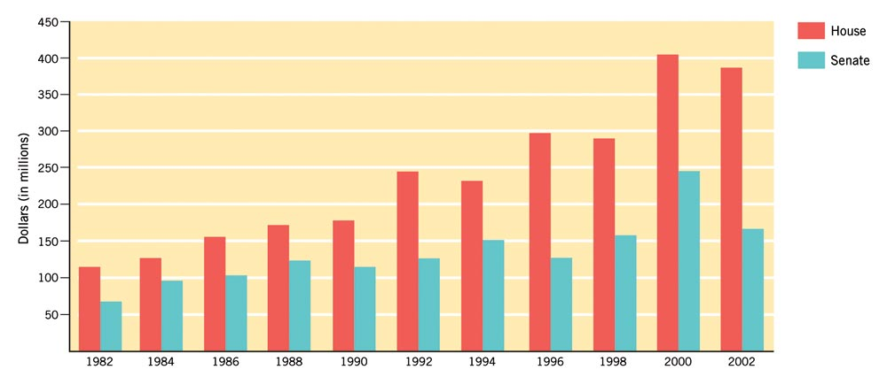
Figure 10.1: The Cost of Winning
Updated from Federal Election Commission report, May 15, 2001.
Notes:
Insert 10.1 (formerly 8.1 in 9e)

Slide 21
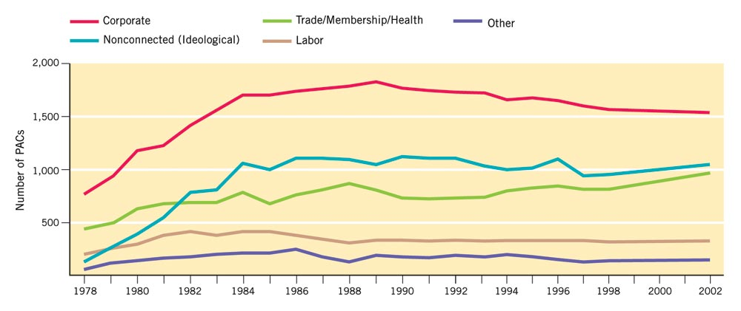
Figure 10.2: Growth of PACs
Super PAC
Federal Election Commission.
Notes:
Insert Figure 10.2 (formerly 8.2 in 9e)

Slide 22
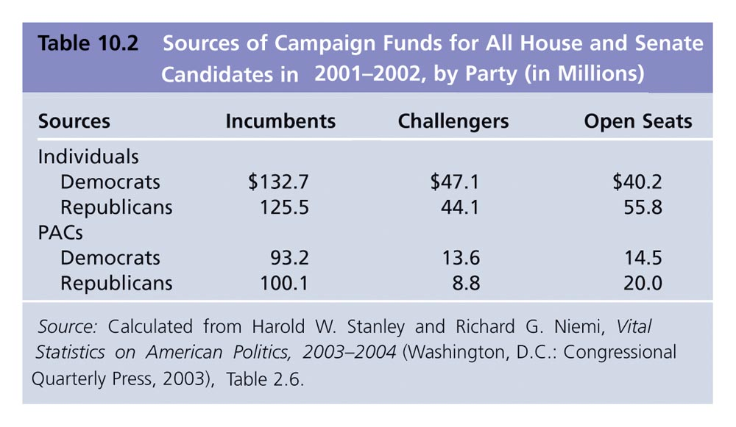
Table 10.2: Sources of Campaign Funds: All House and Senate Candidates in 2001-2002, by Party (in Millions)

Slide 23
Loopholes and Concerns
1. Soft Money
Money not regulated by federal law
Used by political parties for general expense
Party-building activities
Issue ads
Increase voting drives
Voter registration campaigns
No limit on soft money accounts
Parties are getting very creative with this account and what they spend it on
2. Fund-Raising Tactics
People using their power and perks
Bill Clinton was accused of allowing people to spend the night in Lincoln’s bedroom in the White House in return for money
Is this ethical?

Slide 24
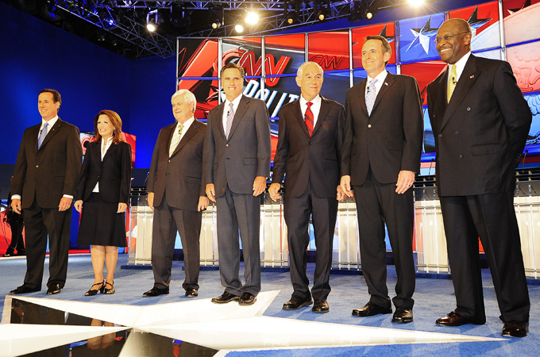
Loopholes and Concerns
3. The High Cost of Campaigns
Do you think spending over 2.7 billion on campaigns is necessary?
Should we have regulations that keep it fair?
If not, will the person with the most money always win?

Slide 25
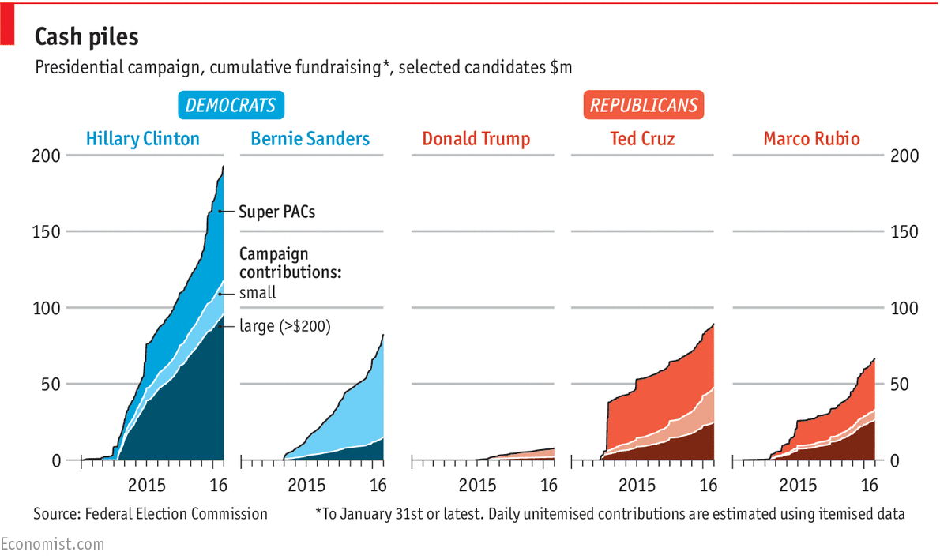
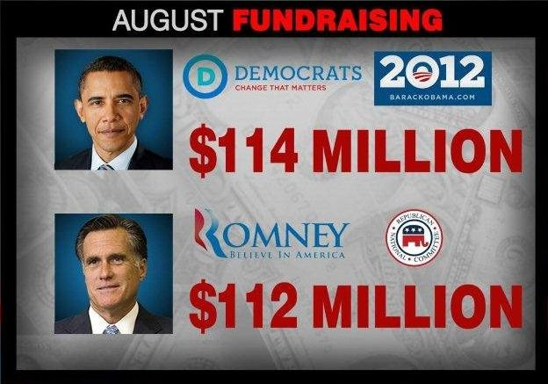
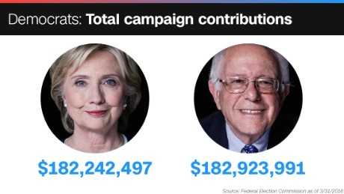
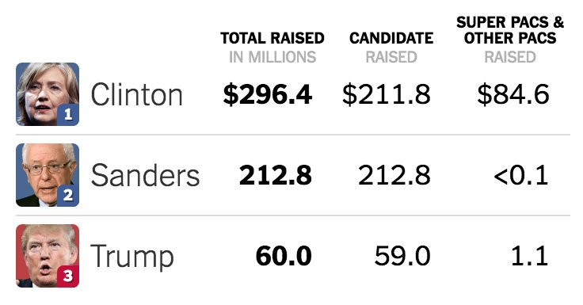
Money -- $$$

Slide 26
1974 Campaign Finance Reform
1972: Watergate and illegal donations from corporation, unions, and individuals catalyzed change
Brought about the 1974 federal campaign reform law and Federal Election Commission (FEC)

Slide 27
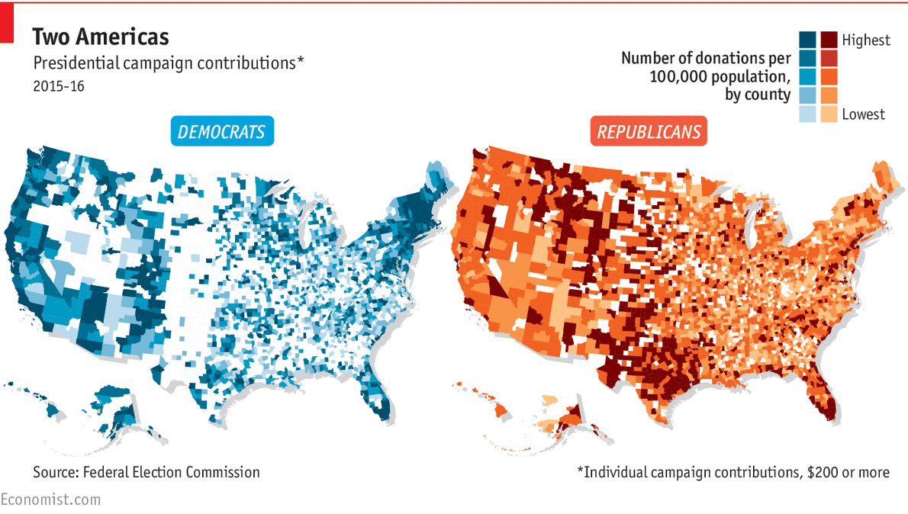
Raising Money
Individuals can give $2,000
PACs can give $5,000 in each election to each candidate
Want more $$, then do..
Candidates must raise $5,000 in twenty states in individual contributions of $250 or less to qualify for federal matching grants to pay for primary campaigns

Slide 28
Problems with Campaign Financing
Independent expenditures: an organization or PAC can spend as much as it wishes on advertising, so long as it is not coordinated with a candidate’s campaign
Soft money: unlimited amounts of money may be given to a political party, so long as a candidate is not named

Slide 29
Bipartisan Campaign Finance Reform Act
Banned soft money contributions to national parties from corporations and unions after the 2002 election
Raised the limit on individual donations to $2,000 per candidate per election

Slide 30
Bipartisan Campaign Finance Reform Act
Sharply restricted independent expenditures
Corporations, unions, trade associations, nonprofit organizations cannot use their own money for an advertisement referring to a candidate by name 30 days before a primary and 60 days before a general election

Slide 31
F.E.C Regulations on Independent Exp.
The Code of Federal Regulations defined independent expenditure as an expenditure for a communication "expressly advocating the election or defeat of a clearly identified candidate that is not made in cooperation, consultation, or concert with, or at the request or suggestion of, a candidate, a candidate’s authorized committee, or their agents, or a political party or its agents." 11 CFR 100.16(a).The term was first introduced in the Code of Federal Regulations in 2003
The Federal Election Commission defines an agent as someone who has "actual authority, either express or implied" to perform one or more of a list of actions on behalf of a campaign. It stipulates that an otherwise independent expenditure could be invalidated if an "agent" does something as simple as suggesting an advertisement be made. To prevent this, some groups claim that they sequester staff months before an election.
An organization making an independent expenditure must include a federally mandated disclaimer identifying the person or organization paying for the communication and stating that the communication was not authorized by a candidate or candidate’s committee.

Slide 32
527 Organizations
A new source of money under the Bipartisan Campaign Reform Act
Designed to permit the kind of soft money expenditures once made by political parties
They can spend their money on politics so long as they do not coordinate with a candidate or lobby directly for that person

Slide 33
Money and Winning
Presidential candidates have similar funds because of federal funding
During peacetime, presidential elections are usually decided on the basis of three factors:
Political party affiliation
The economy
Character

Slide 34
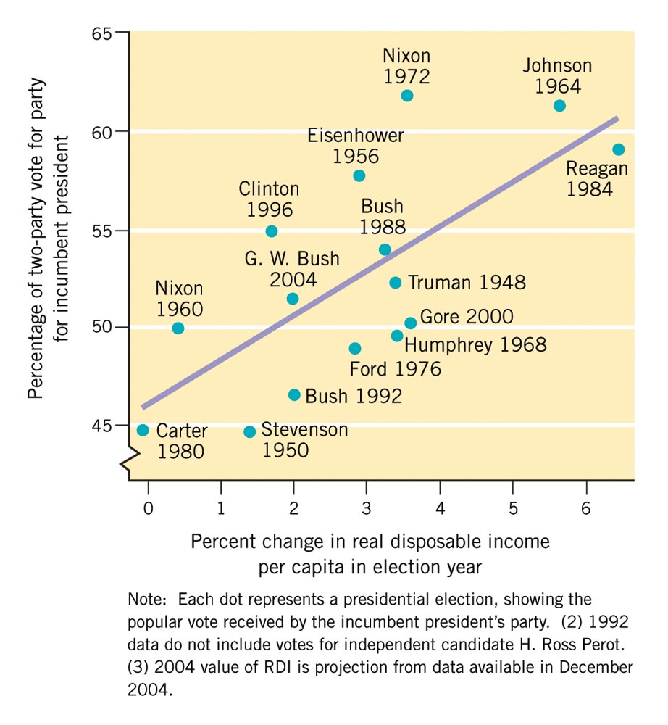
Figure 10.3: The Economy and Vote for President, 1948-2004
Updated from Robert S. Erikson and Kent L. Tedin, American Public Opinion, 5th ed., p. 271. Copyright © 1995 by Allyn & Bacon/Longman. Reprinted by permission of Pearson Education, Inc.
Notes:
Insert Figure 10.3 (formerly 8.3 in 9e)

Slide 35
Coalitions
Democratic coalition: African Americans, Jews, Hispanics (not Cuban)
Catholics, southerners and union members are leaving the Democrats
Republican coalition: business and professional people who are very loyal, farmers

Slide 36
Do Elections Make a Difference in Policy?
Many American elections do make differences in policy
Democrats agenda
Republican agenda
But the constitutional system generally moderates the pace of change
What political party controls congress?
Who is the president?
Key questions in changing policy

Slide 38
Information about Elections

Slide 39
Laws and The Electoral Process
Scheduling Elections
Elections are always held at a scheduled time
These times are usually set by our state and national rules
Elections always held at a specific time
Even if at war or national crisis
All elected officials are serving on fixed terms
A set amount of years
Representatives: 2 years
Senators: 6 years
President: 4 years

Slide 40
Laws and The Electoral Process
Polling Places and Ballots
Precincts responsibilities:
Count the votes casted
Voting place
Local precincts – Libraries, firehouses, schools
Voting
Secret ballots: person's vote is kept secret, but the amassed votes of various groups are revealed publicly
Absentee ballots: vote cast by someone who is unable or unwilling to attend the official polling station

Slide 41
Elections
Nomination Process
Primaries
Direct primaries held in the spring before the general elections in the fall
Direct primaries: Choosing the party’s main candidate for the general election
General elections: select the winners of the government positions
All primaries fall under state rule, so the rules could be different for each state

Slide 42
Types of Elections
Primaries
Type of Primaries
Closed Primaries
Only registered party members can vote
Most states use this type of primary
Restricts switching party affiliation
Open Primary
Any qualified voter can participate
Only in a few states use this primary
This allows voters to switch party affiliation

Slide 43
Types of Elections
Nomination Process
Caucuses
Meeting of leaders of a political party to select candidates
Most commonly used in state and local governments, but used infrequently
At these local meetings, party leaders meet to decide
Party support
Strategy
Conduct party business

Slide 44
Differences
Primaries
Caucus
Same as General Election
Turn in your vote and leave
Secret ballot in polling
Cast vote and leave
Higher turn out
Less time commitment
Voters stay for duration
Can be 15 minutes or 7 hours, etc…
Face to face votes
Show of hands
Discussion and debate
Try to gain votes, and may loss votes
Elimination of Candidates
Based on state rules
Ex.) Iowa: if you receive less than 15% of the vote, your eliminated

Slide 45
Types of Elections
General Election
Voting for Congress
By law, must be selected on the Tuesday after the first Monday in November
Voting for President and Vice President
Voted every other year of the Congressional election
State and local elections
May occur in odd-numbered years and not necessarily in November
Have to follow the Primaries, so voting occurs late spring, summer, and fall

Slide 46
Type of Elections
Mid Term Elections
Mid-term elections occur in the middle of a president's term in office
Hence the name mid-term
Mid-term elections usually involve
State governors
State and federal congressmen
Local elected positions:
County commissioners
City councilmen
Judges
Since US senators serve 6 year terms:
Their re-election campaigns are usually held during mid-term elections

Slide 48
Districts – Electoral Votes

Slide 49
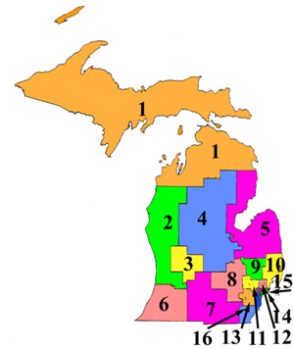
Districts
2000 Michigan Districts
2010 Michigan Districts

Slide 50
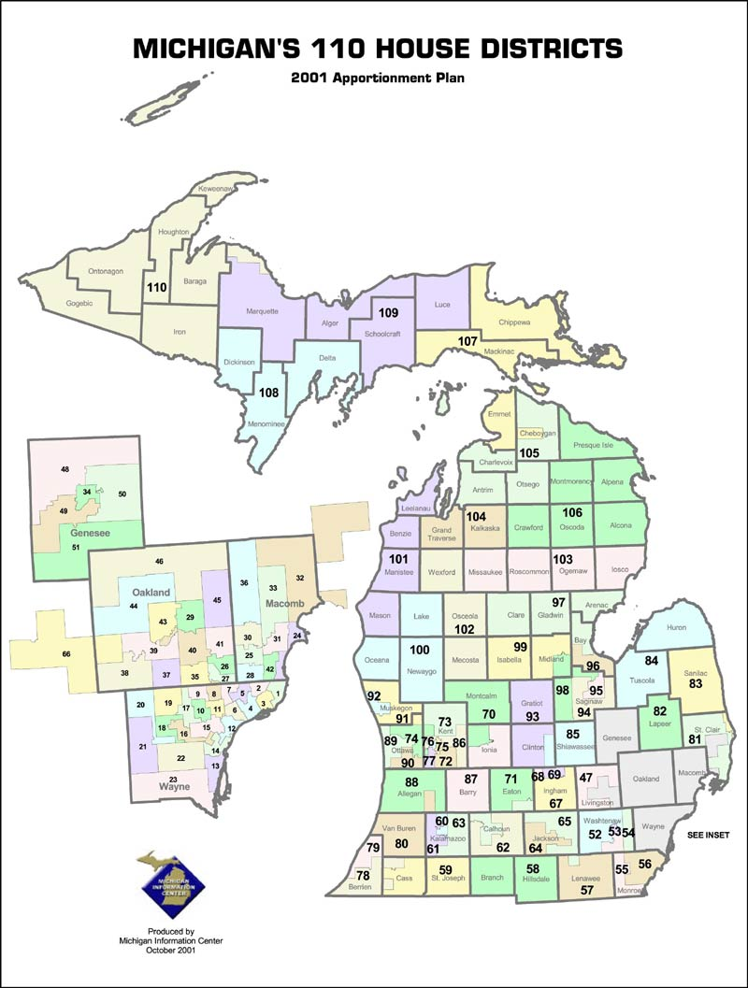
Michigan Representatives
There are 110 Michigan Representatives who are elected by the qualified electors of
Districts having approximately 77,000 to 91,000 residents
Legislative districts are drawn on the basis of population figures through the federal decennial census
Representatives are elected in even- numbered years to 2-year terms
Representative is limited to serving 3 terms

Slide 51
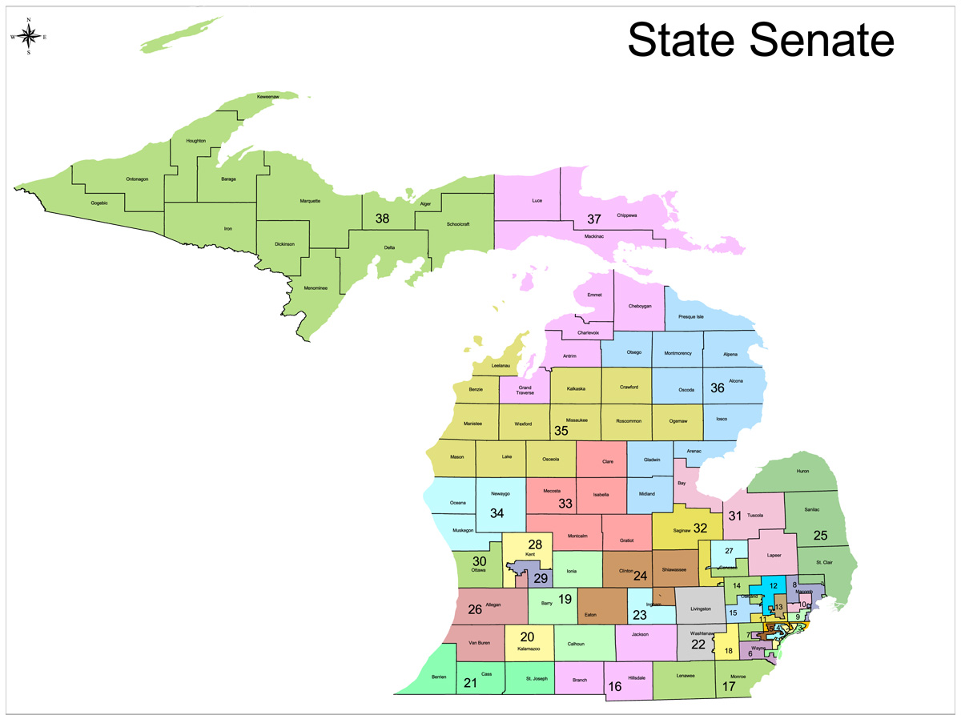
Michigan Senators
On November 3, 1992, almost 59 percent of Michigan voters
backed Proposal B, the Michigan Term Limits Amendment,
which amended the State Constitution, to enact term limits on
federal and state officials. In 1995, the U.S. Supreme Court
ruled that states could not enact congressional term limits, but
ruled that the state-level term limits remain. Under the amendment,
a person could be elected to the office of governor, attorney general,
and secretary of state two times each. It also limited the number
of times a person could be elected to the House of Representatives
to three times, and to the Senate two times. A provision governing
partial terms was also included. These provisions became Article IV,
section 54 and Article V, section 30 of the Michigan Constitution
The Senate consists of 38 members
Districts having approximately 212,400 to 263,500 residents
Senators are elected at the same time as the governor and serve 4-year terms concurrent with the governor's term of office

Slide 52
District Change
Census (population count)
Constitution provides that a census be given every 10 years
Each district is considered a apportionment
The amount of people each representative represents based on population
Census causes reapportionment
Periodic redistribution of people of U.S. congressional seats according to changes in the census figures
Causes for re-districting

Slide 53
Districts
2000 Michigan Districts
2010 Michigan Districts

Slide 54
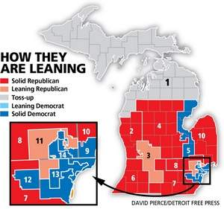
Districts
Gerrymandering
The process of dividing voting districts to give an unfair advantage to one candidate, party, or group
Given the name back in 1812
Governor Gerry Elbridge
District lines where drawn to favor a prominent political party
Painter drew wings, heads and claws on his district
Resembled a salamander

Slide 55
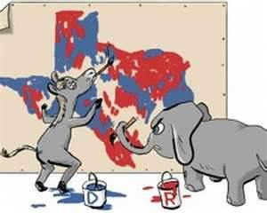
Districts
Gerrymandering
Governor Gerry created a district that would ensure the election
Supreme Court ruled: each district must represent
approximately the same number of people as all others

Slide 56
Drawing District Boundaries
Malapportionment: districts have very different populations, so the votes in the less-populated district “weigh more” than those in the more-populated district
Gerrymandering: boundaries are drawn to favor one party rather than another, resulting in odd-shaped districts

Slide 57
Electoral Votes
The number of Representative + (2) senators = States Electoral Vote

Slide 58
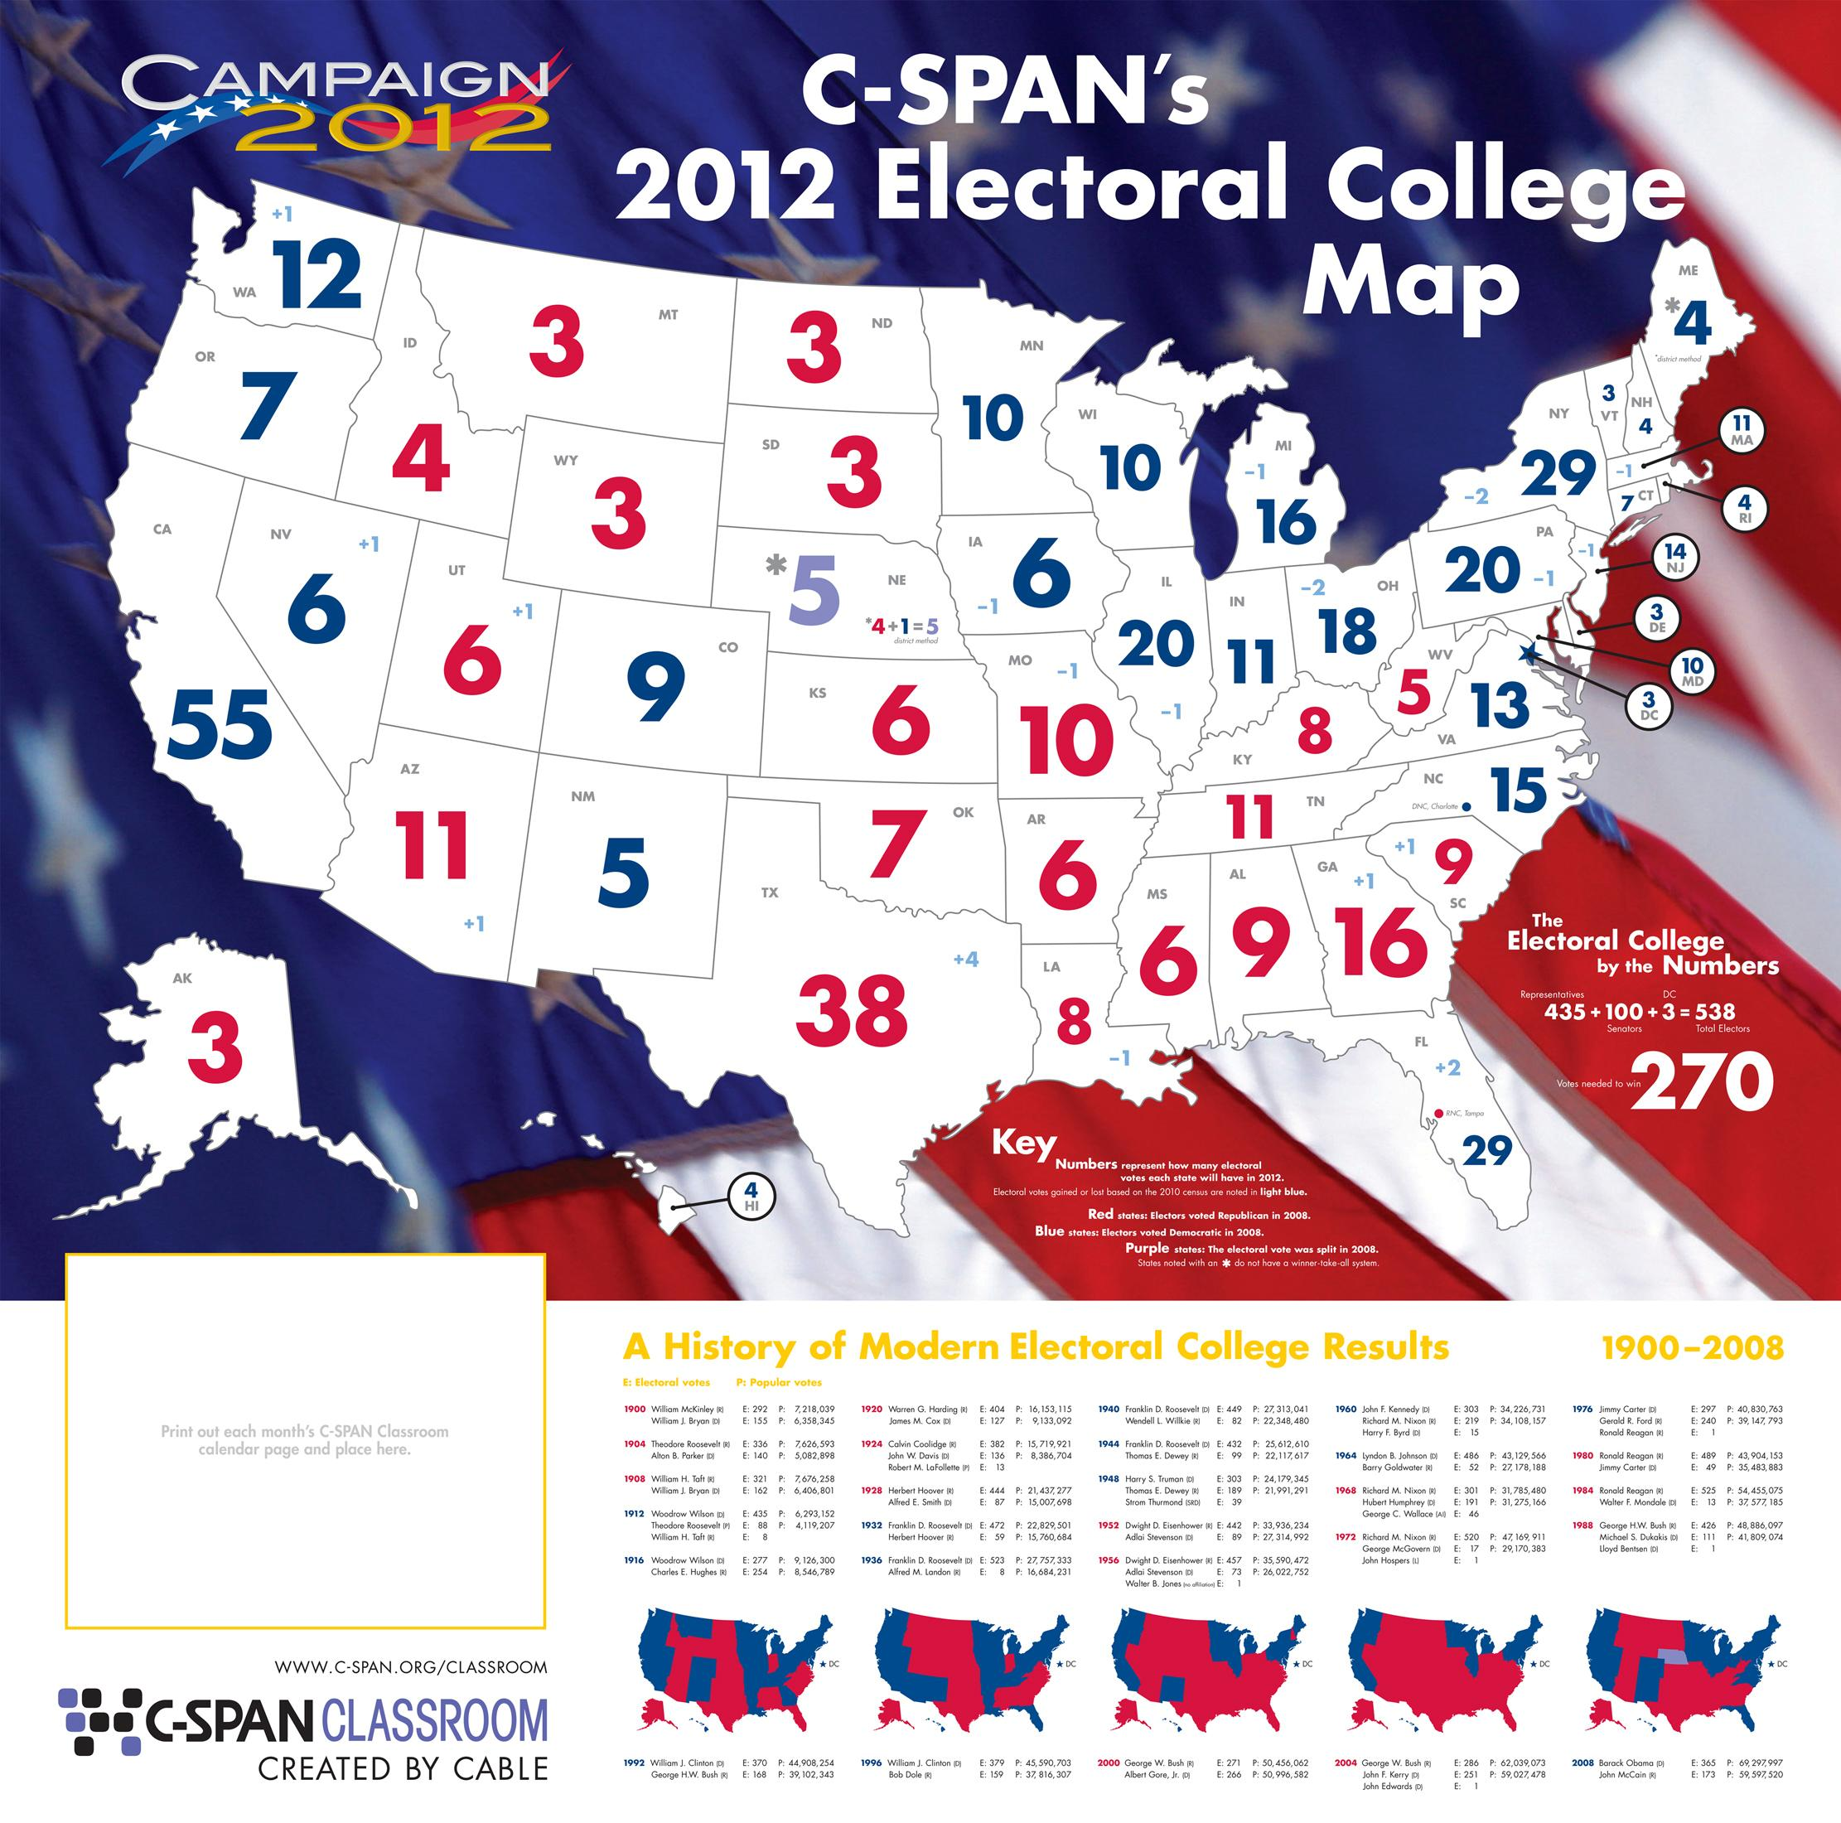
Electoral Votes
Amount of electoral votes needed to become President: 270
Electoral College selects our President of the United States

