Slide 1
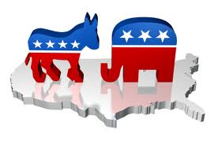
Political Beliefs and Public Opinion

Slide 2
American Political Culture
A. Key Definitions
Political Culture – a set of widely shared political beliefs and values.
Values and beliefs – deep-rooted ideals that shape an individual’s perception of political issues
Opinion- attitudes about institutions, leaders, political issues, and events.

Slide 3
American Political Culture

Slide 4
American Political Culture
IMPORTANCE
America’s political culture provides a broad consensus that shapes and limits the public debate about political issues

Slide 5
American Political Culture
CORE VALUES
Liberty / Freedom
Freedom of speech and religion are fundamental parts of the American political culture.
People should be free to lead their lives with minimal government interference.
Equality
Political equality – all adult citizens should have equal voting rights
Legal opportunity – entitled to equal treatment under the law
Equality of opportunity NOT in the equality of RESULTS

Slide 6
American Political Culture
Individualism
Respect for the dignity and importance of each individual.
People should be responsible for their own decisions and well-being.
Democracy
Government should be based on the consent of the governed.
Majority rule with Minority rights!
Citizens have a responsibility to support their local communities

Slide 7
American Political Culture
Liberty – rights
Equality – equal vote; equal chance to participate and succeed
Democracy – government is accountable to the people
Civic duty – take community affairs seriously and become involved when possible
Individual responsibility – individuals responsible for their own actions and well-being

Slide 8
American Political Culture
Americans tend to assert their rights
Emphasize individualism, competition, equality, following rules, treating others fairly but impersonally
Some other countries put more emphasis on harmony and equality

Slide 9
Attitudes Toward Economic Equality in America and Europe

Slide 10
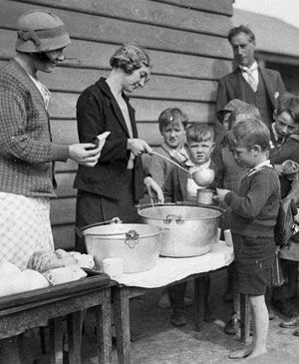
Civic Duty and Competence
Civic duty: a belief that one has an obligation to participate in civic and political affairs
Civic competence: a belief that one can affect government policies

Slide 11
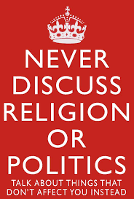
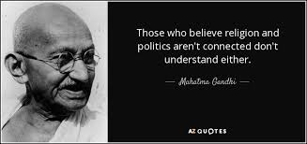
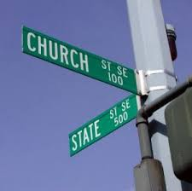
Religion and Politics
Religious beliefs have played an important role in American politics
Both liberals and conservatives use the pulpit to promote political change
Candidates for national office in most other contemporary democracies rarely mention religion; drastically different in the U.S.

Slide 12
Sources of Political Culture
American Revolution was essentially over liberty—asserting rights
Widespread (not universal) participation permitted by Constitution
Absence of an established national religion made religious diversity inevitable
Family instills how we think about world and politics
Not a high degree of class consciousness

Slide 13
The Culture War
The cultural clash in America is a battle over values
The culture war differs from political disputes
The culture conflict is animated by deep differences in people’s beliefs about morality

Slide 14
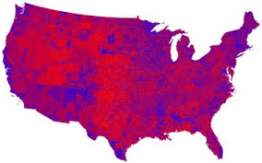
Two Cultural “Camps”
Orthodox: morality is as, or more, important than self-expression; morality derives from fixed rules from God
Progressive: personal freedom is as, or more, important than tradition; rules change based on circumstances of modern life and individual preferences

Slide 15
How large is the divide in Red and Blue America?

Slide 16
American Political Culture
MISTRUST IN GOVERNMENT
Since the 1950’s, Americans have become less trusting of their leaders and political institutions.
The mistrust is linked to a corresponding decline in political efficacy, the belief that one’s political participation really matters.

Slide 17
Mistrust of Government
There is evidence that mistrust has increased since the late 1950s
Causes: Watergate, the Vietnam War and Clinton impeachment
Public confidence is likely to ebb and flow with circumstances
No dramatic change in confidence in Americans

Slide 18
Trust in the Federal Government, 1958-2002

Slide 19
Political Efficacy
Political efficacy: citizen’s capacity to understand and influence political events
Internal efficacy: confidence in one’s ability to understand and influence events
External efficacy: belief that system will respond to citizens

Slide 20
Changes in the Sense of Political Efficacy, 1952-2000

Slide 21
Political Tolerance
A minimal level of tolerance is crucial to democratic politics
Most Americans support tolerance in the abstract
Most Americans would deny these rights in specific cases

Slide 22
How Very Unpopular Groups Survive
Most people do not act on their beliefs
Officeholders and activists are more tolerant than the general public
Usually there is no consensus on whom to persecute
Courts are sufficiently insulated from public opinion to enforce constitutional protections

Slide 23
Political Socialization
IMPORTANCE
Political socialization is a continuing process that is vital to societies and to individuals.
It is the process by which political values are formed and passed from one generation to the next.

Slide 24
Political Socialization
AGENTS OF SOCIALIZATION
The Family
The family is the most important agent
Children raised in households in which both parents strongly identify with the same political party are likely to identify with their parents’ party.
Education
Class elections, student government, and social studies classes play a key role in teaching students the values of liberty, equality, individualism and democracy.
College grads have a higher level of political participation

Slide 25
Political Socialization
Social Groups
Black and white Americans differ on a number of issues, including affirmative action programs and race relations
Religious groups differ on a number of issues, including same-sex marriage, school prayer, and abortion.
Men and women differ on a number issues, including health care programs and support for defense budgets.

Slide 26
Political Ideology
IMPORTANCE
A political ideology is a cohesive set of beliefs about politics, public policy, and the role of government.
Although political ideology is important to politicians and activists, studies consistently find that only about 20% of Americans vote along ideological lines.

Slide 27
Political Ideology
LIBERAL IDEOLOGY
Supports
Political and social reform
Gov regulation of the economy
Expanded programs for the poor, minorities, and women
National health care system
Abortion rights
Opposes
Increases in military spending
Committing troops to foreign wars
School prayer

Slide 28
Political Ideology
CONSERVATIVE IDEOLOGY
Supports
Expansion of American military powers
Free-market solutions to economic problems
Less governmetn regulation of business
School prayer
Opposes
Expensive federal social and welfare programs
Abortion rights
National health care system

Slide 29
Major polling services
Gallop Organization
Pew Research Center for People and the Press
Today, over 1000 polling organizations attempt to measure public preferences on everything from soft drinks to soap operas.
200+ organizations focus on polling the American public’s political preferences.

Slide 30
The Science of Public Opinion Measurement
STEPS IN SCIENTIFIC POLLING
Define the population to be surveyed.
Construct a sample slice of the population. Most polls use random sampling in which every member of the population being studied must have an equal chance of being sampled. If this happens, a small sample should represent the whole population.
Construct carefully designed survey questions that avoid bias
Conduct the poll by using eith telephone or face-to-face interviewing procedures.
Analyze and report the data

Slide 31
Polls and Democracy
A TOOL FOR DEMOCRACY
Supporters argue that polling contributes to the democratic process by providing a way for the public to exprss its opinions.
Supporters also point out that polling enables political leaders to understand and implement public preferences on key issues.

Slide 32
Polls and Democracy
A TOOL FOR THE TIMID AND MAIPULATIVE
Critics argue that polls transform leaders into follower. For example, had polls been available in 1787, the Framers might have been content to follow public opinion by revising the Articles of Confederation.
Critics also charge that polls can be used to manipulate public opinion. Ex. The bandwagon effect occurs when polling results influence people to support candidates and issues that appear to be popular.

Slide 33
Polls and Democracy

