Slide 1
Chapter Two
The Constitution

Slide 2
Weaknesses of the Articles of Confederation
Could not levy taxes or regulate commerce
Sovereignty, independence retained by states
One vote in Congress for each state
Nine of thirteen votes in Congress required for any measure
Delegates to Congress picked, paid for by state legislatures

Slide 3
Weaknesses of the Articles of Confederation
Little money coined by Congress
Army small and dependent on independent state militias
Territorial disputes between states led to open hostilities
No national judicial system
All thirteen states’ consent necessary for any amendments

Slide 4
The Constitutional Convention
The Framers (55) attending: men of practical affairs, including Continental army veterans and members of the Congress of the Confederation
An entirely new constitution was written, although gathering was authorized only to revise Articles
Primary concern was with defense of liberty as a natural right (Lockean reasoning)

Slide 5
Plans and Compromises
The Virginia Plan
National legislature with supreme powers
One house elected directly by the people
The New Jersey Plan
One vote per state
Protect small states’ interests
The Great Compromise
House of Representatives based on population
Two senators per state, elected by state legislatures

Slide 6
Key Principles of Government
Founders did not intent to create a direct democracy
Popular rule only in House of Representatives
Separation of Powers: between branches
Federalism: power divided between national and state governments

Slide 7
Three Categories of Powers
Enumerated powers: given to national government exclusively; include power to print money, declare war, make treaties, conduct foreign affairs
Reserved powers: given to states exclusively; include power to issue licenses and to regulate commerce wholly within a state
Concurrent powers: shared by both national and state governments; include collecting taxes, building roads, borrowing money, having courts

Slide 8
The Antifederalist View
Liberty could be secure only in small republics
Nation needed, at best, a loose confederation of states with most of the power wielded by the state legislatures
If there was a strong national government, there should be many more restrictions on it

Slide 9
Federalist Papers 10 and 51
Coalitions were more likely to be moderate because they would represent a diversity of interests
Governments should be somewhat distant from the passions of the people
No bill of rights was necessary

Slide 10
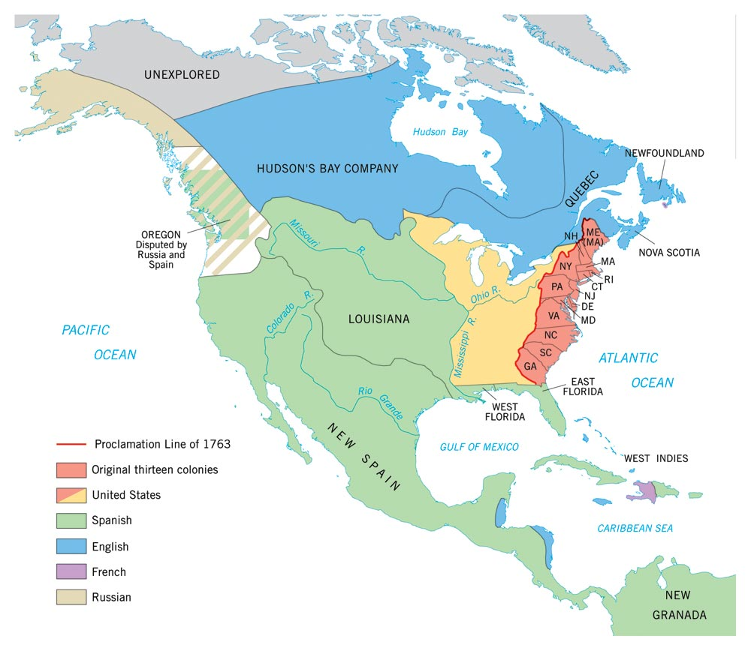
Map 2.2: Ratification of the Federal Constitution by State Conventions, 1787-1790

Slide 11
The Constitution and Slavery
House of Representatives Apportionment: 3/5 Compromise
Congress could not prohibit slave trade before 1808
Fugitive Slave Clause

Slide 12
Suggestions for Constitutional Reform
Reduce separation of powers to enhance national leadership
Make the system less democratic
Questions to consider
How well has it worked in history?
How well has it worked in comparison with other democratic nations?

