Slide 1
Chapter Four
American Political Culture

Slide 2
Political Culture
Political Culture: A distinctive and patterned way of thinking about how political and economic life ought to be carried out
For example, Americans generally believe more strongly in political than in economic equality

Slide 3
American Political Values
Liberty – rights
Equality – equal vote; equal chance to participate and succeed
Democracy – government is accountable to the people
Civic duty – take community affairs seriously and become involved when possible
Individual responsibility – individuals responsible for their own actions and well-being

Slide 4
Questions About Political Culture
How do we know people share these beliefs?
How do we explain behavior inconsistent with these beliefs?
Why is there so much political conflict in U.S. history?

Slide 5
Beliefs About Economics
Americans support free enterprise, but support some limits on marketplace freedom
Americans believe in equality of opportunity but not equality of result
Americans have a widely shared commitment to economic individualism

Slide 6
American Political Culture
Americans tend to assert their rights
Emphasize individualism, competition, equality, following rules, treating others fairly but impersonally
Some other countries put more emphasis on harmony and equality

Slide 7
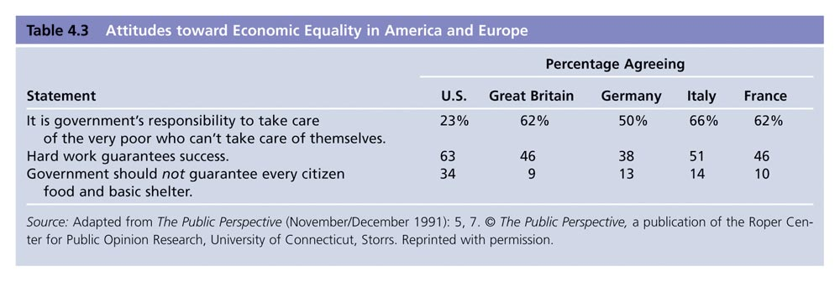
Table 4.3: Attitudes Toward Economic Equality in America and Europe
Notes:
Insert table 4.3

Slide 8
Civic Duty and Competence
Civic duty: a belief that one has an obligation to participate in civic and political affairs
Civic competence: a belief that one can affect government policies

Slide 9
Religion and Politics
Religious beliefs have played an important role in American politics
Both liberals and conservatives use the pulpit to promote political change
Candidates for national office in most other contemporary democracies rarely mention religion; drastically different in the U.S.

Slide 10
Sources of Political Culture
American Revolution was essentially over liberty—asserting rights
Widespread (not universal) participation permitted by Constitution
Absence of an established national religion made religious diversity inevitable
Family instills how we think about world and politics
Not a high degree of class consciousness

Slide 11
The Culture War
The cultural clash in America is a battle over values
The culture war differs from political disputes
The culture conflict is animated by deep differences in people’s beliefs about morality

Slide 12
Two Cultural “Camps”
Orthodox: morality is as, or more, important than self-expression; morality derives from fixed rules from God
Progressive: personal freedom is as, or more, important than tradition; rules change based on circumstances of modern life and individual preferences

Slide 13
Mistrust of Government
There is evidence that mistrust has increased since the late 1950s
Causes: Watergate, the Vietnam War and Clinton impeachment
Public confidence is likely to ebb and flow with circumstances
No dramatic change in confidence in Americans

Slide 14
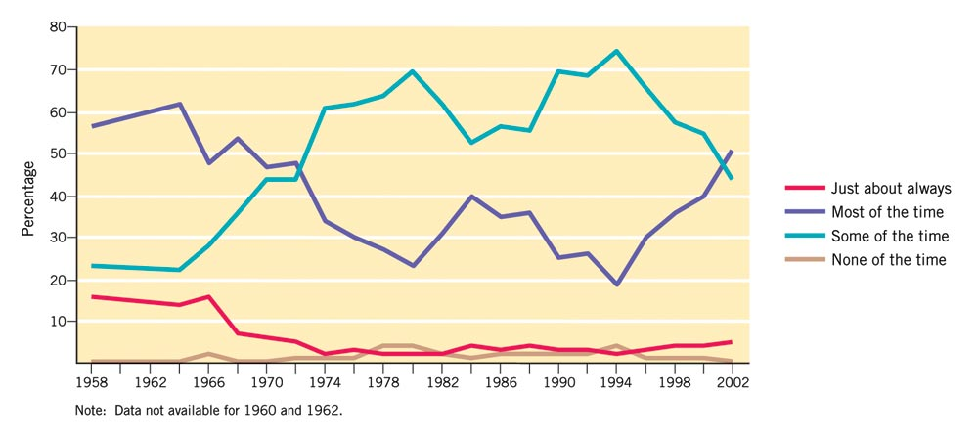
Figure 4.1: Trust in the Federal Government, 1958-2002
University of Michigan, The National Election Studies.
Notes:
Insert figure 4.1

Slide 15
Political Efficacy
Political efficacy: citizen’s capacity to understand and influence political events
Internal efficacy: confidence in one’s ability to understand and influence events
External efficacy: belief that system will respond to citizens

Slide 16
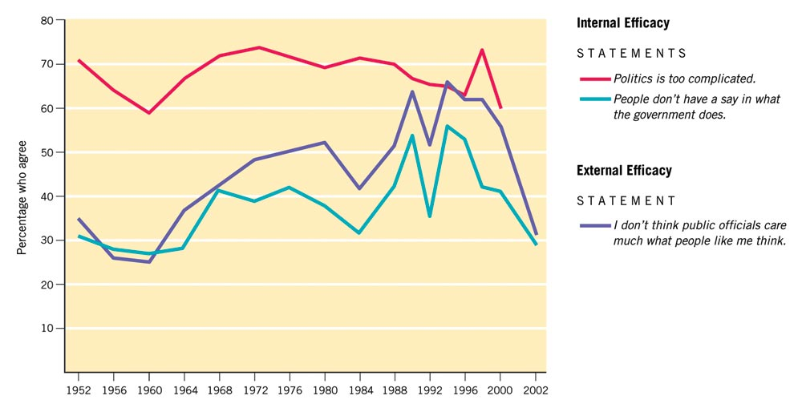
Figure 4.3: Changes in the Sense of Political Efficacy, 1952-2000
University of Michigan, The National Election Studies.
Notes:
Insert figure 4.3

Slide 17
Political Tolerance
A minimal level of tolerance is crucial to democratic politics
Most Americans support tolerance in the abstract
Most Americans would deny these rights in specific cases

Slide 18
How Very Unpopular Groups Survive
Most people do not act on their beliefs
Officeholders and activists are more tolerant than the general public
Usually there is no consensus on whom to persecute
Courts are sufficiently insulated from public opinion to enforce constitutional protections

