Slide 1
Chapter Seven
Public Opinion

Slide 2
What is Public Opinion?
Public opinion: How people think or feel about particular things
Not easy to measure
The opinions of active and knowledgeable people carry more weight

Slide 3
How Polling Works
Pollsters need to pose reasonable questions that are worded fairly
They have to ask people about things for which they have some basis to form an opinion

Slide 4
Random Sampling
Random sampling is necessary to insure a reasonably accurate measure of how the entire population thinks or feels
For populations over 500,000, pollsters need to make about 15,000 phone calls to reach 1,065 respondents, insuring the poll has a sampling error of only +/- 3%

Slide 5
How Opinions Differ
Opinion saliency: some people care more about certain issues than other people do
Opinion stability: the steadiness or volatility of opinion on an issue
Opinion-policy congruence: the level of correspondence between government action and majority sentiment on an issue

Slide 6
Political Socialization
Political socialization: the process by which personal and other background traits influence one’s views about politics and government
Family: Party identification of your family is absorbed, although children become more independent-thinking with time
Religion: Families form and transmit political beliefs through their religious tradition

Slide 7
The Gender Gap
Men have become increasingly Republican since the mid-1960s
Women have continued to identify with the Democratic Party at approximately the same rate since the early 1950s
This reflects attitudinal differences between men and women about the size of government, gun control, social programs, and gay rights

Slide 8
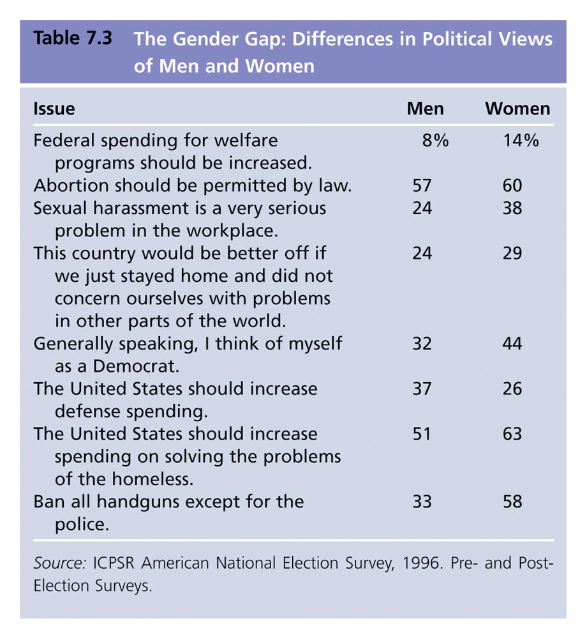
Table 7.3: The Gender Gap: Differences in Political Views of Men and Women

Slide 9
Education
From 1920s through 1960s, studies showed a college education had a liberalizing effect, possibly because of exposure to liberal elites
Contemporary college students’ opinions are more complicated

Slide 10
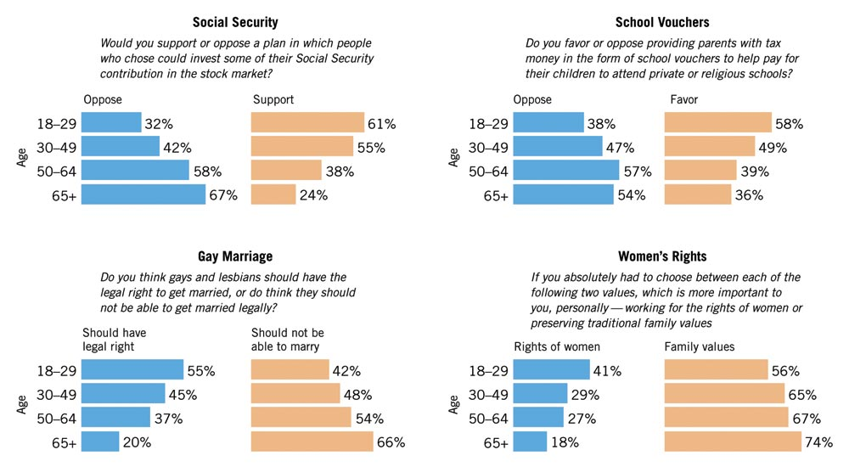
Figure 7.1: Generational Gaps on the Issues
Survey by Washington Post/Henry J. Kaiser Foundation/Harvard University, August 2-September 1, 2002, as reported in Elizabeth Hamel et al., "Younger Voters," Public Perspective, May/June 2003, p. 11.
Notes:
Insert table 5.3

Slide 11
Social Class
Social class: ill-defined in U.S., though recognized in specific cases (e.g., truck drivers and investment bankers)
Social class is less important in the U.S. than in Europe; the extent of cleavage has declined in both places

Slide 12
Race and Ethnicity
Similarities and differences between blacks and whites are complex, but there is some evidence that they may be narrowing
Latinos tend to identify as Democrats, though not as strongly as African Americans

Slide 13
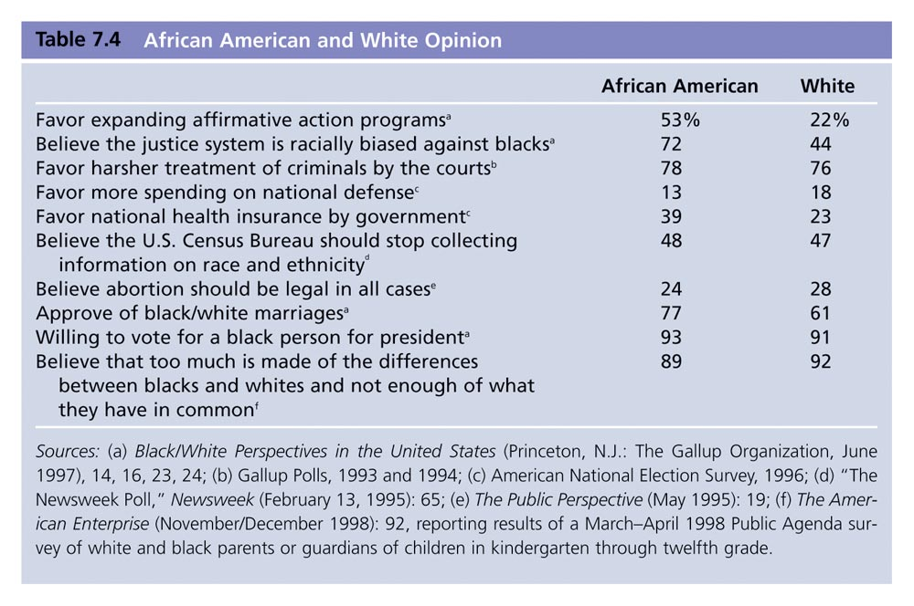
Table 7.4: African American and White Opinion
Notes:
Insert table 7.4 (formerly 5.4 in 9e)

Slide 14
Regional Differences
White southerners were once more conservative than other regions regarding aid to minorities, legalizing marijuana, school busing, and rights of the accused
Southerners are now significantly less Democratic than they were for most of the 20th century

Slide 15
Political Ideology
Political ideology: a more or less consistent set of beliefs about what policies government ought to pursue
The great majority of Americans do not think ideologically
People may have strong predispositions even if they do not satisfy the condition of being “ideological”

Slide 16
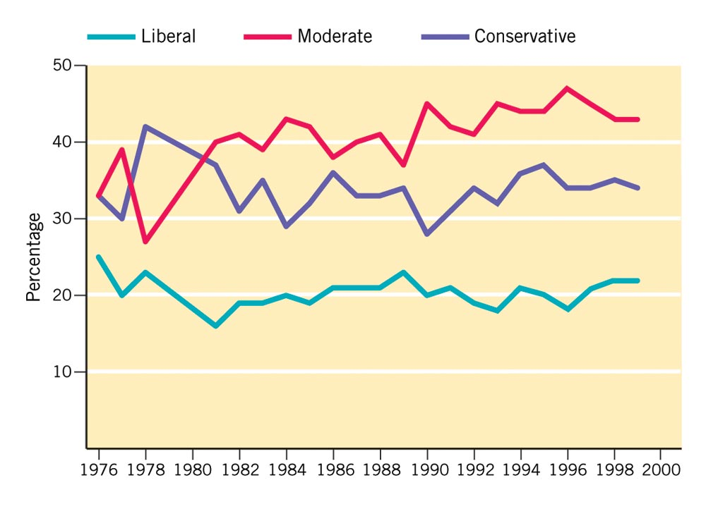
Figure 7.3: Ideological Self-Identification
The American Enterprise (March/April 1993): 84, Robert S. Ericson and Kent L. Tedin, American Public Opinion (New York: Longman, 2001), 101, citing surveys by CBS/New York Times.
Notes:
Insert figure 7.3 (formerly 5.2 in 9e)

Slide 17
Liberals and Conservatives
Economic policy: liberals favor jobs for all, subsidized medical care and education, increased taxation of the rich
Civil rights: liberals favor strong federal action to desegregate schools, hiring opportunities for minorities, and strict enforcement of civil rights laws
Public and political conduct: liberals are tolerant of protest demonstrations, favor legalization of marijuana, and emphasize protecting the rights of the accused

Slide 18
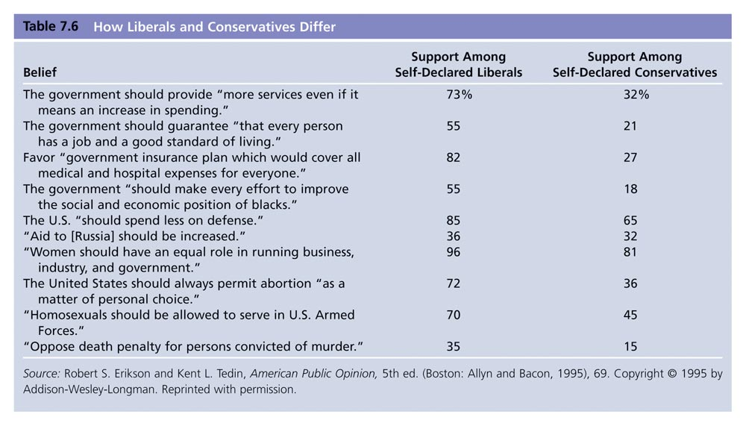
Table 7.6: How Liberals and Conservatives Differ
Notes:
Insert table 7.7 (formerly 5.7 in 9e)

Slide 19
Liberals and Conservative
Pure liberals: liberal on both economic and personal conduct issues
Pure conservatives: conservative on both economic and personal conduct issues
Libertarians: conservative on economic issues, liberal on personal conduct issues
Populists: liberal on economic issues, conservative on personal conduct issues

Slide 20
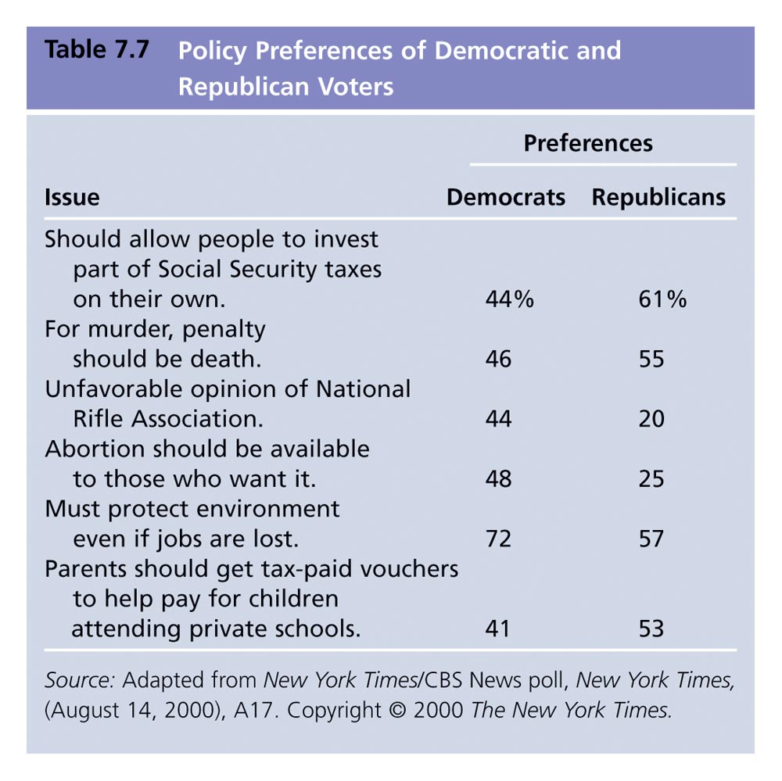
Table 7.7: Policy Preferences of Democratic and Republican Voters

Slide 21
Political Elites
Political elites: those who have a disproportionate amount of some valued resource
Elites influence public opinion by framing issues and stating norms
But elite influence only goes so far; they do not define problems that are rooted in personal experience

