Slide 1
Chapter Nine
Political Parties

Slide 2
Political Parties
A party is a group that seeks to elect candidates to public office by supplying them with a label (party identification), by which they are known to the electorate
United States parties have become weaker as labels, sets of leaders, and organizations

Slide 3
Parties in the US and Europe
European parties are disciplined gatekeepers, to which voters are very loyal, though this has been declining recently
The federal system decentralizes power in U.S.
Parties are closely regulated by state and federal laws, which weaken them
Candidates are now chosen through primaries, not by party leaders

Slide 4
The Rise and Decline of Parties
The founders disliked parties, viewing them as factions
During the Jacksonian era political participation became a mass phenomenon
From the Civil War until the 1930s most states were dominated by one party
Progressives pushed measures to curtail parties’ power and influence

Slide 5
The Results of Reform
The worst forms of political corruption were reduced
All political parties were weakened; parties became less able to hold officeholders accountable or to coordinate across the branches of government

Slide 6
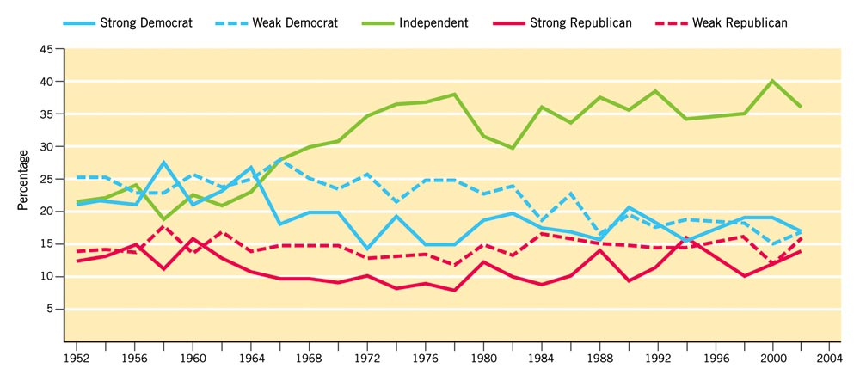
Figure 9.1: Decline in Party Identification, 1952-2002
National Election Studies, The NES Guide to Public Opinion and Electoral Behavior, 1952-2000, table 20.1, and data for 2002 updated by Marc Siegal.
Notes:
Insert Figure 9.1 (formerly 7.1 in 9e)

Slide 7
Party Realignment
Critical or realigning periods: periods when a sharp, lasting shift occurs in the popular coalition supporting one or both parties
Two kinds of realignments
A major party is defeated so badly that it disappears and a new party emerges
Two existing parties continue but voters shift their loyalty from one to another

Slide 8
Realignments
1860: slavery issue fixed new loyalties in the popular mind
1896: economic issues shifted loyalties to East/West, city/farm split
1932: economic depression triggered new coalition for Democrats
1980: Could not have been a traditional realignment, because Congress was left in the hands of the Democrats

Slide 9
Party Decline
Evidence that parties are declining, not realigning
Proportion of people identifying with a party declined between 1960 and 1980
Proportion of those voting a split ticket increased

Slide 10
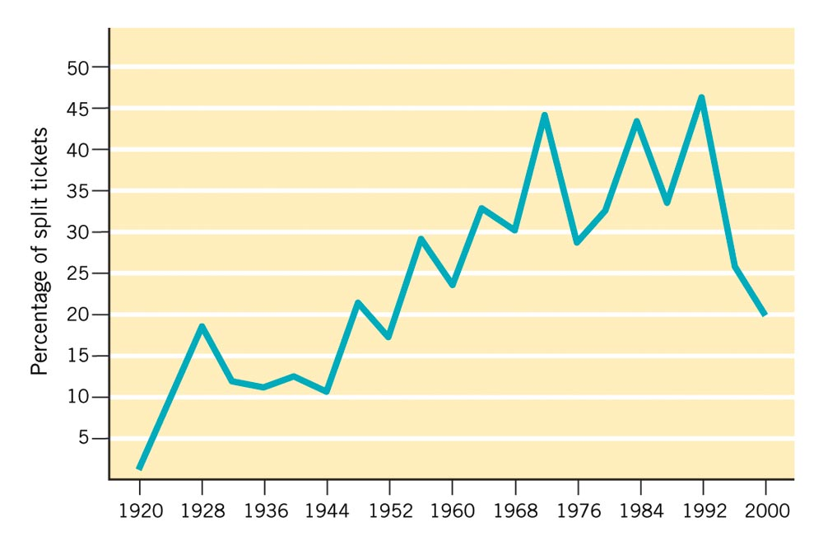
Figure 9.2: Trends in Split-Ticket Voting For President and Congress, 1920-2000
Notes:
Insert 9.2 (formerly 7.2 in 9e)

Slide 11
Party Structure
Parties are similar on paper
RNC effectively created a national firm of political consultants
Democrats moved to factionalized structure and redistributed power
By the 1990s, DNC had learned from the RNC: adopted the same techniques, with some success

Slide 12
Nominating a President
Primary: an election in which voters select the candidate who will run on each party’s ticket
Caucus: a meeting of party followers at which delegates are picked

Slide 13
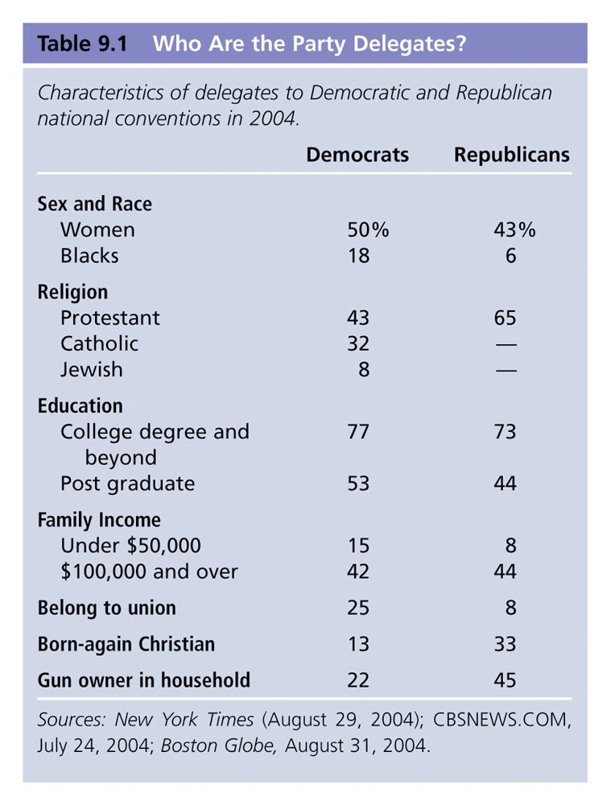
Table 9.1: Who Are the Party Delegates?
Notes:
Insert Table 9.1 (formerly 7.1 in 9e)

Slide 14
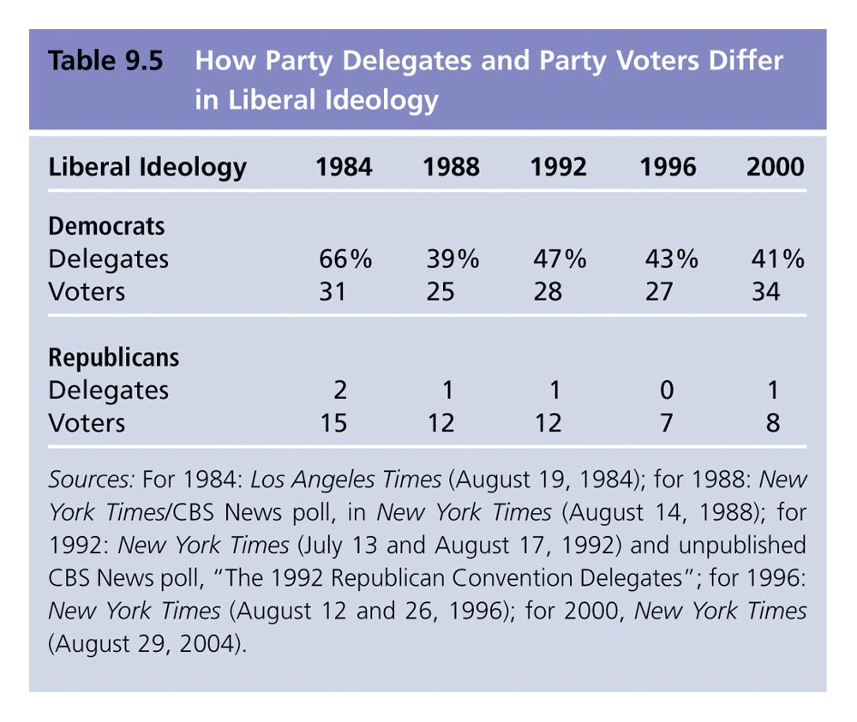
Table 9.5: How Party Delegates and Party Voters Differ in Liberal Ideology
Notes:
Insert Table 9.5 (formerly 7.5 in 9e)

Slide 15
National Conventions
National committee sets time and place; issues a “call” setting the number of delegates for each state and the rules for their selection
In 1970s, Democrats’ rules were changed to weaken local party leaders and increase the proportions of women and minorities
In 1988, the number of superdelegates was increased

Slide 16
Kinds of Parties
Political machine: a party organization that recruits members via tangible incentives
Ideological party: principle is more important than winning election
Solidary groups: members are motivated by solidarity incentives

Slide 17
Kinds of Parties
Sponsored parties: created or sustained by another organization
Personal following: requires an appealing personality, an extensive network, name recognition, and money

Slide 18
Reasons for the Two Party System
Electoral system—winner-take-all and plurality system limit the number of parties
Opinions of voters—two broad coalitions work, although there may be times of bitter dissent
State laws have made it very difficult for third parties to get on the ballot

Slide 19
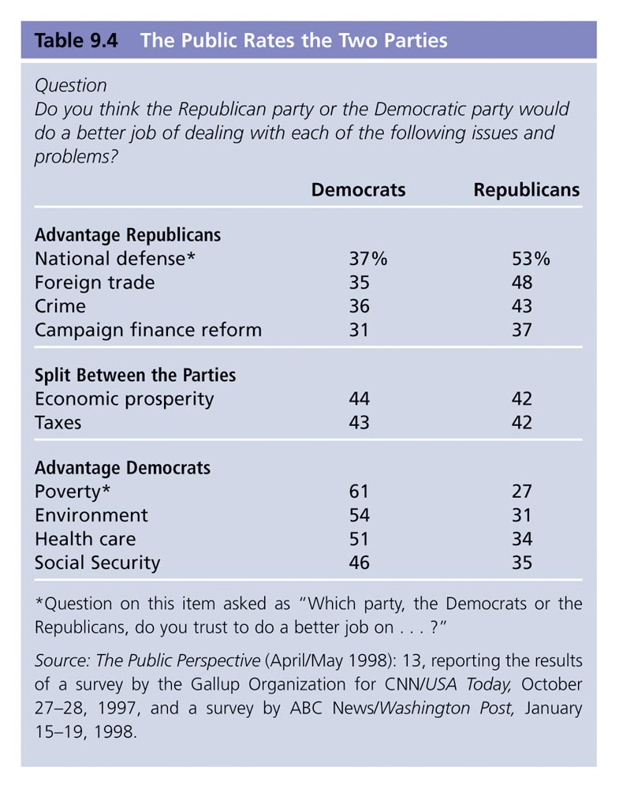
Table 9.4: The Public Rates the Two Parties
Notes:
Insert Table 9.4 (formerly 7.4 in 9e)

Slide 20
Minor Parties
Ideological parties: comprehensive, radical view; most enduring
One-issue parties: address one concern, avoid others
Economic protest parties: regional, protest economic conditions
Factional parties: from split in a major party, usually over the party’s presidential nominee

Slide 21
Impact of Minor Parties
Conventional wisdom holds that minor parties develop ideas that the major parties adopt
Factional parties have had probably the greatest influence on public policy

