Slide 1
Chapter Ten
Elections and Campaigns

Slide 2
Presidential v. Congressional Campaigns
There is more voter participation in presidential campaigns
Presidential races are more competitive than House races

Slide 3
Presidential v. Congressional Campaigns
Lower turnout in off years means that candidates must appeal to more motivated and partisan voters
Members of Congress can do things for their constituents that the president cannot
Members of Congress can distance themselves from the “mess in Washington”

Slide 4
Funding for Congressional Elections
Most money comes from individual small donors ($100–$200 a person)
$2,000 maximum for individual donors
$5,000 limit for PACs, but most give just a few hundred dollars
Challengers must supply much of their own money

Slide 5
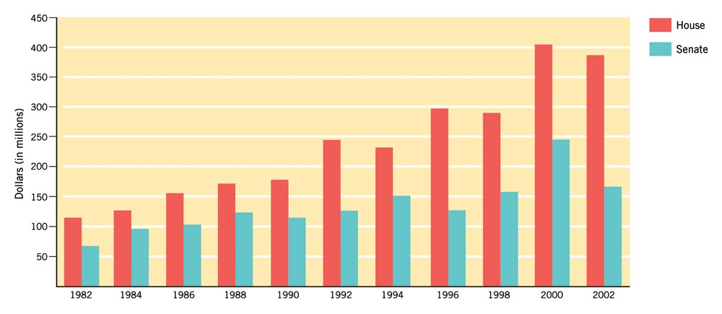
Figure 10.1: The Cost of Winning
Updated from Federal Election Commission report, May 15, 2001.
Notes:
Insert 10.1 (formerly 8.1 in 9e)

Slide 6
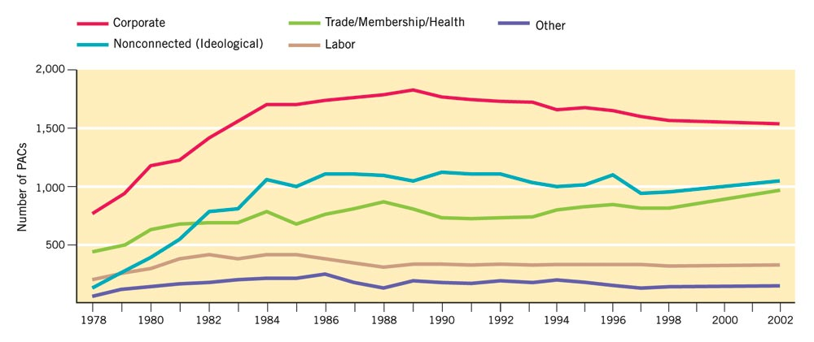
Figure 10.2: Growth of PACs
Federal Election Commission.
Notes:
Insert Figure 10.2 (formerly 8.2 in 9e)

Slide 7
Congressional Elections
Incumbents have an extraordinary advantage – and no terms limits in Congress
Each state has two senators; number of House representatives based on state population, as determined by the census
House members are now elected from single-member districts

Slide 8
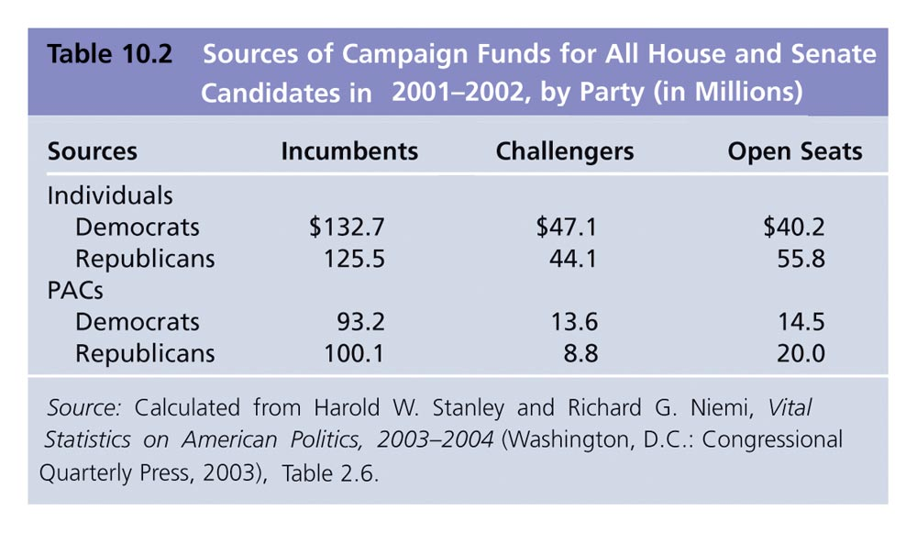
Table 10.2: Sources of Campaign Funds: All House and Senate Candidates in 2001-2002, by Party (in Millions)

Slide 9
Drawing District Boundaries
Malapportionment: districts have very different populations, so the votes in the less-populated district “weigh more” than those in the more-populated district
Gerrymandering: boundaries are drawn to favor one party rather than another, resulting in odd-shaped districts

Slide 10
Staying in Congress
Members gear their offices to help individual constituents
Committee members secure pork for the district
Members must decide to what extent to be delegates ( to do what the district wants) versus trustees ( to use their independent judgment)

Slide 11
1974 Campaign Finance Reform
1972: Watergate and illegal donations from corporation, unions, and individuals catalyzed change
Brought about the 1974 federal campaign reform law and Federal Election Commission (FEC)

Slide 12
Raising Money
Individuals can give $2,000; PACs can give $5,000 in each election to each candidate
Candidates must raise $5,000 in twenty states in individual contributions of $250 or less to qualify for federal matching grants to pay for primary campaigns

Slide 13
Problems with Campaign Financing
Independent expenditures: an organization or PAC can spend as much as it wishes on advertising, so long as it is not coordinated with a candidate’s campaign
Soft money: unlimited amounts of money may be given to a political party, so long as a candidate is not named

Slide 14
Bipartisan Campaign Finance Reform Act
Banned soft money contributions to national parties from corporations and unions after the 2002 election
Raised the limit on individual donations to $2,000 per candidate per election

Slide 15
Bipartisan Campaign Finance Reform Act
Sharply restricted independent expenditures
Corporations, unions, trade associations, nonprofit organizations cannot use their own money for an advertisement referring to a candidate by name 30 days before a primary and 60 days before a general election

Slide 16
527 Organizations
A new source of money under the Bipartisan Campaign Reform Act
Designed to permit the kind of soft money expenditures once made by political parties
They can spend their money on politics so long as they do not coordinate with a candidate or lobby directly for that person

Slide 17
Money and Winning
Presidential candidates have similar funds because of federal funding
During peacetime, presidential elections are usually decided on the basis of three factors:
Political party affiliation
The economy
Character

Slide 18
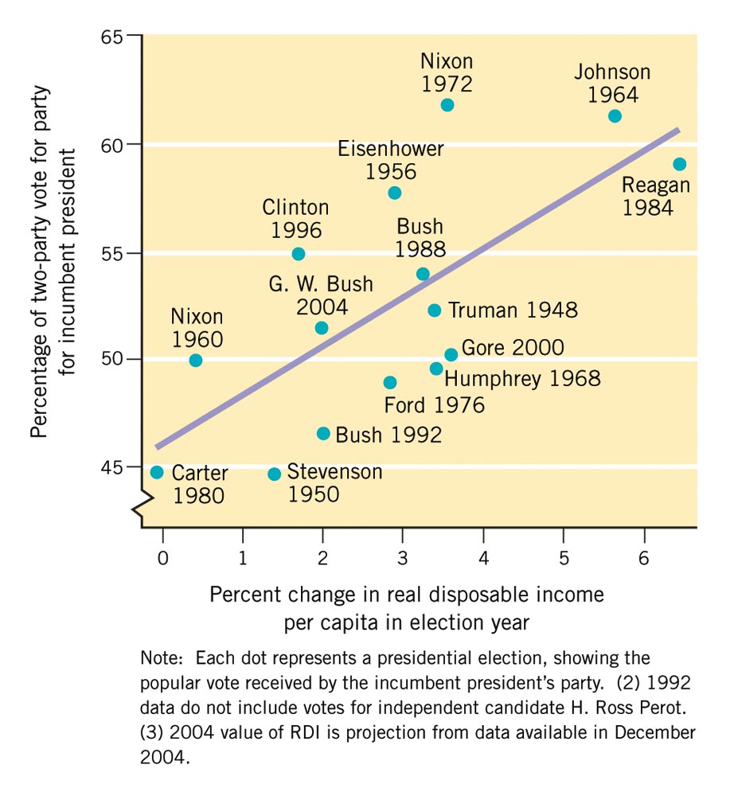
Figure 10.3: The Economy and Vote for President, 1948-2004
Updated from Robert S. Erikson and Kent L. Tedin, American Public Opinion, 5th ed., p. 271. Copyright © 1995 by Allyn & Bacon/Longman. Reprinted by permission of Pearson Education, Inc.
Notes:
Insert Figure 10.3 (formerly 8.3 in 9e)

Slide 19
Voter Behavior
V. O. Key: most voters who switch parties do so in their own interests
Prospective voting is used by relatively few voters
Retrospective voting is practiced by most voters, and decides most elections

Slide 20
Coalitions
Democratic coalition: African Americans, Jews, Hispanics (not Cuban)
Catholics, southerners and union members are leaving the Democrats
Republican coalition: business and professional people who are very loyal, farmers

Slide 21
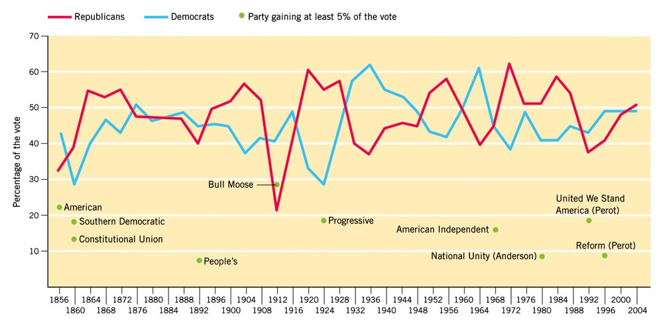
Figure 10.4: Partisan Division of Presidential Vote, 1856-2004
Updated from Historical Data Archive, Inter-University Consortium for Political Research, as reported in William H. Flanigan and Nancy H. Zingale, Political Behavior of the American Electorate, 3rd ed., 32.
Notes:
Insert Figure 10.4 (formerly 8.4 in 9e)

Slide 22
Do Elections Make a Difference in Policy?
Many American elections do make differences in policy
But the constitutional system generally moderates the pace of change

