Slide 1
Chapter Thirteen
Congress

Slide 2
The Evolution of Congress
The intent of the Framers:
To oppose the concentration of power in a single institution
To balance large and small states
Bicameralism
They expected Congress to be the dominant institution

Slide 3
Organization of the House
Historically, power struggles have occurred between members and leadership
1994 brought changes:
Committee chairs hold positions for only 6 years

Slide 4
Organization of the House
Reduced the number of committees and subcommittees
The Speaker dominated the selection of committee chairs
The Speaker set the agenda (Contract with America) and sustained high Republican discipline in 1995

Slide 5
Evolution of the Senate
The Senate escaped many of the tensions encountered by the House
The major struggle in the Senate was about how its members should be chosen; 17th amendment (1913)
The filibuster is another major issue: restricted by Rule 22 (1917), which allows a vote of cloture

Slide 6
Who is in Congress?
The House has become less male and less white
Membership in Congress became a career
Incumbents still have a great electoral advantage
But in 1994, voters opposed incumbents due to budget deficits, various policies, legislative-executive bickering, and scandal

Slide 7
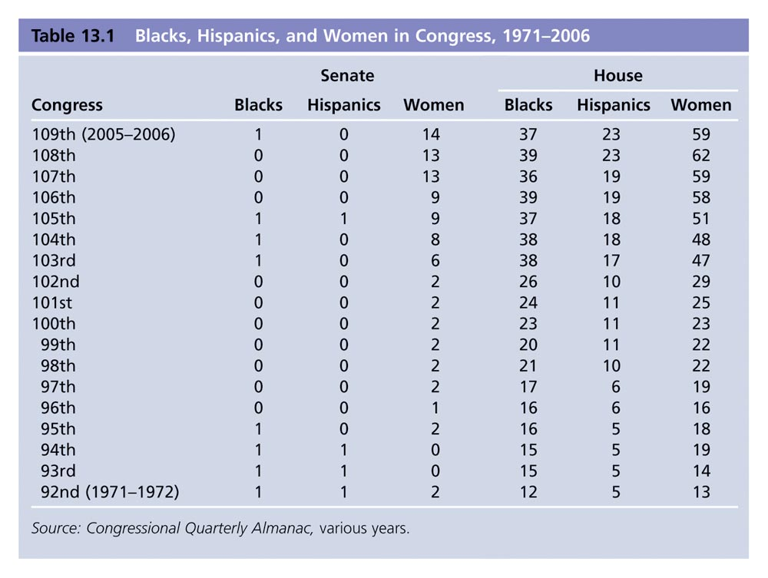
Table 13.1: Blacks, Hispanics, and Women in Congress, 1971-2002

Slide 8
The Incumbency Advantage
Media coverage is higher for incumbents
Incumbents have greater name recognition due to franking, travel to the district, news coverage
Members secure policies and programs for voters

Slide 9
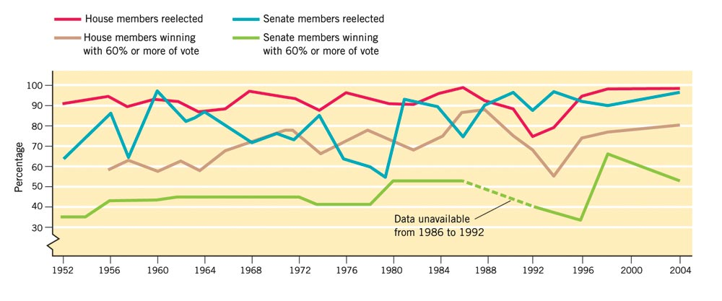
Figure 13.2: Percentage of Incumbents Reelected to Congress
Harold W. Stanley and Richard G. Niemi, Vital Statistics on American Politics, 1999-2000 (Washington, D.C.: Congressional Quarterly Press, 2000), table 1-18; 2004 updated by Marc Siegal.

Slide 10
Member Behavior
Representational view: members vote to please their constituents, in order to secure re-election
Organizational view: where constituency interests are not vitally at stake, members primarily respond to cues from colleagues
Attitudinal view: the member’s ideology determines her/his vote

Slide 11
Party Structure in the Senate
President pro tempore presides; this is the member with most seniority in majority party (a largely honorific office)
Leaders are the majority leader and the minority leader, elected by their respective party members

Slide 12
Party Structure in the Senate
Party whips: keep leaders informed, round up votes, count noses
Each party has a policy committee: schedules Senate business, prioritizes bills
Committee assignments are handled by a group of Senators, each for their own party

Slide 13
Party Structure in the House
Speaker of the House is leader of majority party and presides over House
Majority leader and minority leader: leaders on the floor
Party whips keep leaders informed and round up votes
Committee assignments and legislative schedule are set by each party

Slide 14
Congressional Caucuses
Caucus: an association of members of Congress created to advocate a political ideology or a regional or economic interest
Intra-party caucuses: members share a similar ideology
Personal interest caucuses: members share an interest in an issue
Constituency caucuses: established to represent groups, regions or both

Slide 15
Committees
Committees are the most important organizational feature of Congress
Consider bills or legislative proposals
Maintain oversight of executive agencies
Conduct investigations

Slide 16
Types of Committees
Standing committees: basically permanent bodies with specified legislative responsibilities
Select committees: groups appointed for a limited purpose and limited duration

Slide 17
Types of Committees
Joint committees: those on which both representatives and senators serve
Conference committee: a joint committee appointed to resolve differences in Senate and House versions of the same piece of legislation before final passage

Slide 18
Committee Practices
The number of committees has varied; significant cuts in number of House committees in 1995, and in the number of House and Senate subcommittees
Majority party has majority of seats on the committees and names the chair

Slide 19
Congressional Staff
Constituency service is a major task of members’ staff
Legislative functions of staff include devising proposals, negotiating agreements, organizing hearings, and meeting with lobbyists and administrators
Members’ staff consider themselves advocates of their employers

Slide 20
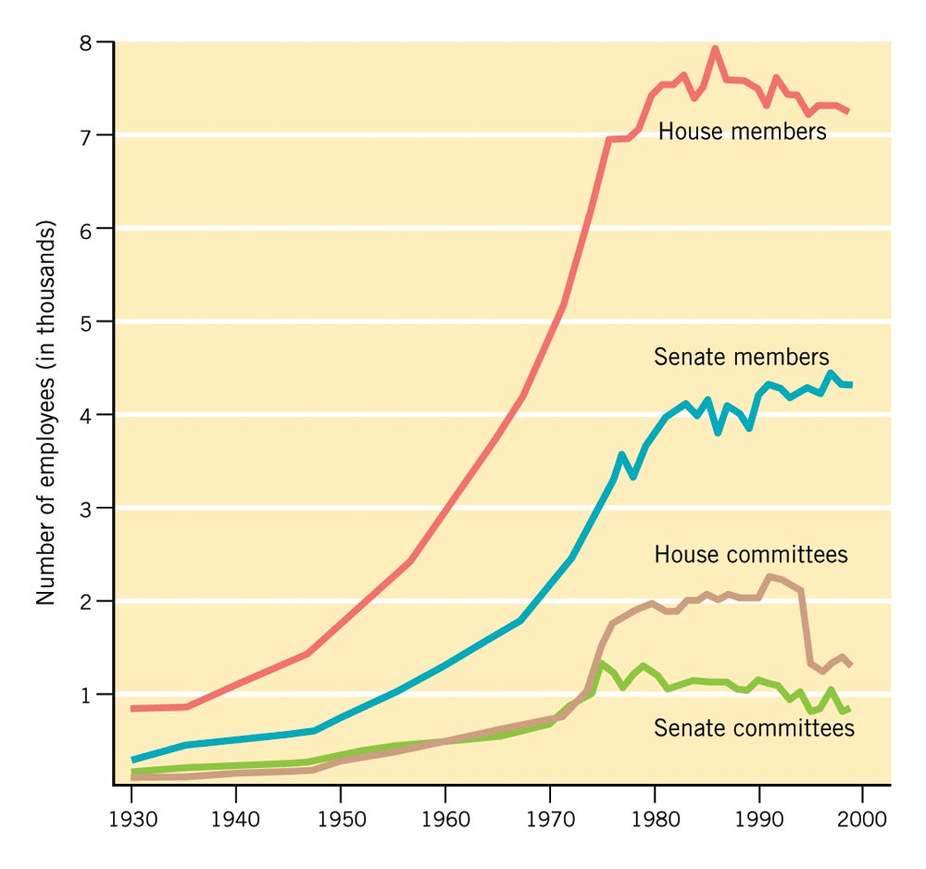
Figure 13.4: The Growth in Staffs of Members and Committees in Congress, 1930-2000
Notes:
Insert Figure 13.4 (formerly 11.4 in 9e)

Slide 21
How a Bill Becomes a Law
Bill must be introduced by a member of Congress
Bill is referred to a committee for consideration by either Speaker or presiding officer of the Senate
Revenue bills must originate in the House
Most bills die in committee

Slide 22
How a Bill Becomes a Law
After hearings and mark-up sessions, the committee reports a bill out to the House or Senate
Bill must be placed on a calendar to come for a vote before either house
House Rules Committee sets the rules for consideration

Slide 23
How a Bill Becomes a Law
Bills are debated on the floor of the House or Senate
If there are major differences in the bill as passed by the House and Senate, a conference committee is appointed
The bill goes to the president

Slide 24
How a Bill Becomes Law
The president may sign it
If the president vetoes it, it returns to house of origin
Both houses must support the bill, with a two-thirds vote, in order to override the president’s veto

Slide 25
Post 9-11 Congress
9-11 Commission recommended Congress make fundamental changes in how it oversees agencies involved in intelligence-gathering and counter-terrorism
Congress passed some of those proposals after some opposition in both parties

