Slide 1
Chapter Seventeen
The Policy-Making Process

Slide 2
Setting the Agenda
The political agenda: deciding what to make policy about
The current political agenda includes taxes, energy, welfare, and civil rights
Shared beliefs determine what is legitimate for the government to do

Slide 3
Scope of Government Action
Government always gets larger
People generally believe that government should continue to do what it is doing now
Changes in attitudes and events tend to increase government activities
Government growth cannot be attributed to one political party

Slide 4
The Influence of Institutions
The courts make decisions that force action by other branches: e.g. school desegregation, abortion
The bureaucracy is a source of innovation and forms alliances with senators and staff
The Senate is a source of presidential candidates with new ideas

Slide 5
Other Influences
Groups may react to a sense of relative deprivation
The media helps place issues on the political agenda
The national government may later adopt ideas pioneered by the states

Slide 6
Costs, Benefits, and Policy
Cost: any burden, monetary or non-monetary, that some people must, or expect, to bear from the policy
Benefit: any satisfaction, monetary or non-monetary, that some people must, or expect, to receive from the policy
Politics is a process of settling disputes over who benefits/pays and who ought to benefit/pay

Slide 7
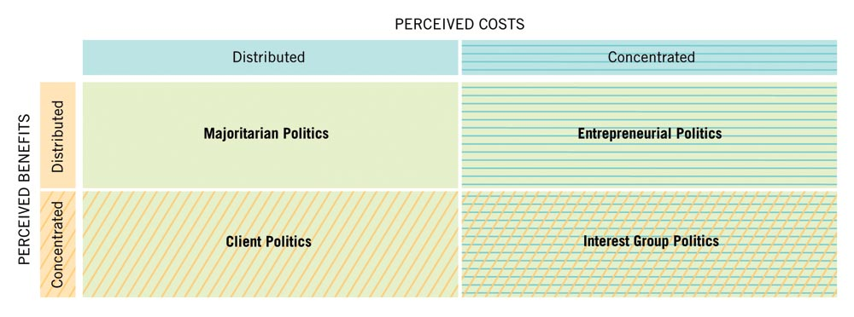
Figure 17.1: A Way of Classifying and Explaining the Politics of Different Policy Issues

Slide 8
Kinds of Politics
Majoritarian politics: distributed benefits, distributed costs
Interest group politics: concentrated benefits, concentrated costs
Client politics: concentrated benefits, distributed costs
Entrepreneurial politics: distributed benefits, concentrated costs

Slide 9
Majoritarian Politics
Example: Antitrust legislation in 1890s was vague with no specific enforcement agency
During the reform era, politicians and business leaders committed to a strong antitrust policy
Enforcement was determined primarily by the ideology and personal convictions of the current presidential administration

Slide 10
Interest Group Politics
Organized interest groups are powerful when regulatory policies confer benefits on one organized group and costs on another equally organized group
Example: In 1935 labor unions sought government protection for their rights; business firms were in opposition

Slide 11
Client Politics
“Agency capture” is likely when benefits are focused and costs are dispersed—an agency is created to serve a group’s needs
Example: National regulation of milk industry, sugar production, merchant shipping
The struggle to sustain benefits depends on insider politics

Slide 12
Entrepreneurial Politics
Relies on entrepreneurs to galvanize public opinion and mobilize congressional support
Example: In the 1960s and 1970s a large number of consumer and environmental protection statutes passed (e.g., Clean Air Act, Toxic Substance Control Act)

Slide 13
Deregulation
Example: airline fares, long distance telephoning, trucking
Deregulation is a challenge to iron triangles and client politics
It is based on the idea that governmental regulation was bad in industries that could be competitive

