Slide 1
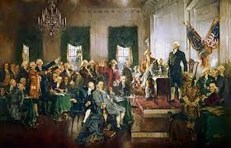
The Constitutional Convention
Compromise and Consensus

Slide 2
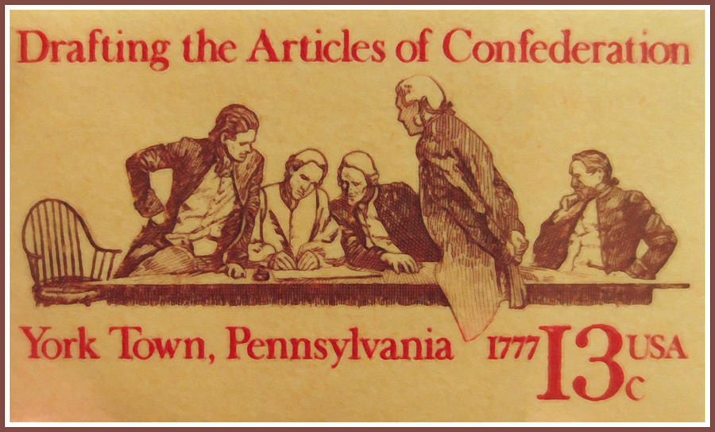
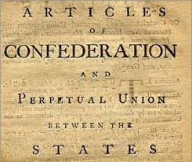
A Momentous Decision
Congress called the Philadelphia Convention “for the sole and express purpose” of revising the A.O.C.
Less than a week after the Convention opened, the delegates voted to abandon the AOC and create a nat’l gov with significantly increased power.

Slide 3
The Connecticut (great) compromise
The Virginia Plan
Called for a bicameral legislature.
Called for representation based on each state’s population in both houses.
The New Jersey Plan
Called for a unicameral legislature.
Called for equal representation regardless of state’s population
Small state delegates threatened to leave the Convention

Slide 4
The Connecticut (great) compromise
Connecticut Plan
Called for a bicameral legislature.
House of Representatives based on population (The Virginia Plan)
Senate would have two members per state. Based on representation (New Jersey Plan)
Consequences
CN Compromise resolved the dispute between large and small states.
The CN Compromise continues to give less populous states a disproportionate influence in congress. The 10 most populous states have a total of 20 Senators to represent 53% of the U.S. population. The 10 least populous states have 20 Senators to represent 3% of the pop.

Slide 5
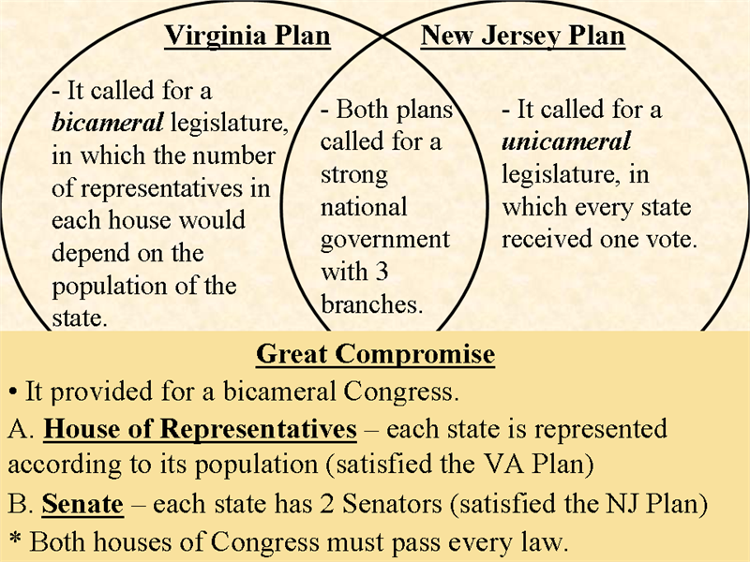

Slide 6
The 3/5’s Compromise
The Southern Position
The slave population was concentrated in the South. Over 90% of all slaves lived in Georgia, Maryland, N.C., S.C., and Virginia. Slave accounted for 30% of the total population of these states.
Southern states demanded that slaves be counted in determining representation in Congress
The Northern Position
If slaves were considered property than they should be taxed and not counted as population. Similar to horses and cattle in the North.

Slide 8
The 3/5’s Compromise
The Framers ageed that all “free persons” and “three-fifths of all other persons” should be counted for representation in Congress.
The Framers also agreed that the same formula would be used to determine taxation.
Consequences
Temporarily defused the tensions between the North and South.
13th Amendment ultimately abolished slavery, thus eliminating the 3/5’s Compromise.

Slide 9
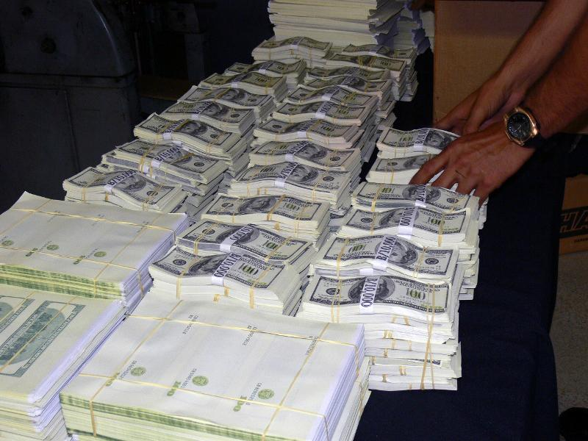
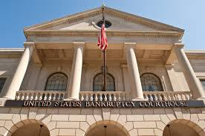
Economic Powers
The Framers assigned a high priority to economic issues.
They agreed on the need for a strong national government to promote growth and protect property.
Examples of increased economic power of the central government:
Obtain revenue through taxing
Pay debts
Coin money and regulate its value
Regulate interstate and foreign commerce
Establish uniform laws of bankruptcy
Punish counterfeiting
Establish post offices

Slide 10
Individual Rights (denied powers) article 1, Section 9
A1, S9 Prohibits the suspension of habeas corpus. A writ of habeas corpus (Latin for “show the body”) is a court order requiring that an individual in custody be brought into court and shown the body of evidence.
A1, S9 prohibits Congress or the states from passing bills of attainder. A bill of attainder is a legislative act that inflicts punishment w/o a court trial.
A1, S9 prohibits Congress or the states from passing ex post facto laws. An EPF law punishes a person for acts that were not illegal when the act was committed.
The constitution also upholds the right to trial by jury in criminal cases.
It also prohibits the imposition of religious qualifications for holding office.

Slide 12
The three branches of government
Separating Powers
The framers accepted Montesquieu’s position that power must be used to balance power.
The Framers believed that separation power in legislative, executive, and judicial branches would provide a defense against TYRANNY.

Slide 13
The three branches of government
The Legislative Branch
Article 1 of the Constitution called for a bicameral Congress consisting of two chambers – a House of Representatives and a Senate.
The Executive Branch
Article 2 of the Constitution called for an executive branch led by a President chosen by an electoral college.
The Judicial Branch
Article 3 of the Constitution called for a judicial branch with a Supreme Court as the highest court of the National Government.

Slide 14
Checks and balances
The 3 branches of government are tied together (not completely separate) by a system of checks and balances that are designed to implement the Framers’ goal of setting power against power to thwart tyranny and restrain irresponsible majorities.
Congress and the President
Congress makes laws, POTUS may veto or reject an act of Congress.
Congress can override a presidential veto by a 2/3 vote in each house.
Pres. Negotiates treaties that must be ratified by the Senate.

Slide 15
Checks and balances
Congress, the President, and the Supreme Court
POTUS has power to nominate justices to the SCOTUS
The Senate has power to approve or reject POTUS nominations.
SCOTUS can use its power of judicial review to declare laws and Presidential acts unconstitutonal.
Congress can propose a constitutional amendment to reverse a Supreme Court ruling.
The House of Reps may, by majority vote, impeach Supreme Court justices and the President. The Senate may, by 2/3’s vote, convict and remove justices and the President.

Slide 16
Checks and balances
Consequences
Slows change and encourages compromise.
Means that the three branches are not completely independent.

Slide 17
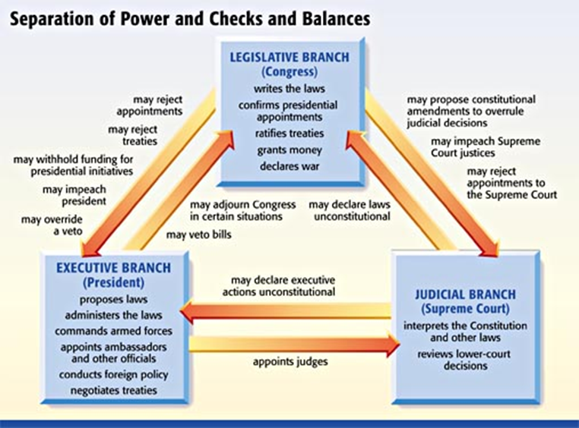

Slide 18
Limitations of majority rule
The Problem of Excessive Democracy
Majority rule is one of the hallmarks of a democratic system of gov.
Framers feared that majorities could abuse their power.
The unruly mobs in Shays’s Rebellion was proof of the dangers posed by “excessive democracy”

Slide 19
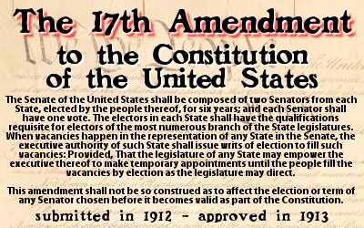
Ways the Constitution limits majority rule
An insulated Senate
The Senate is a bulwark against irresponsible majorities in the House of Reps.
State legislatures originally chose senators (change to direct democracy by 17th)
The staggered term of service in the Senate made it more resistant to popular pressures.
An Independent Judiciary
Federal judges are appointed by the President and confirmed by the Senate.
Federal judges have a lifetime appointment. (Die, resign, retire)
An indirectly elected President
Chosen by the electoral college in mid-December (one month after popular vote)

Slide 20
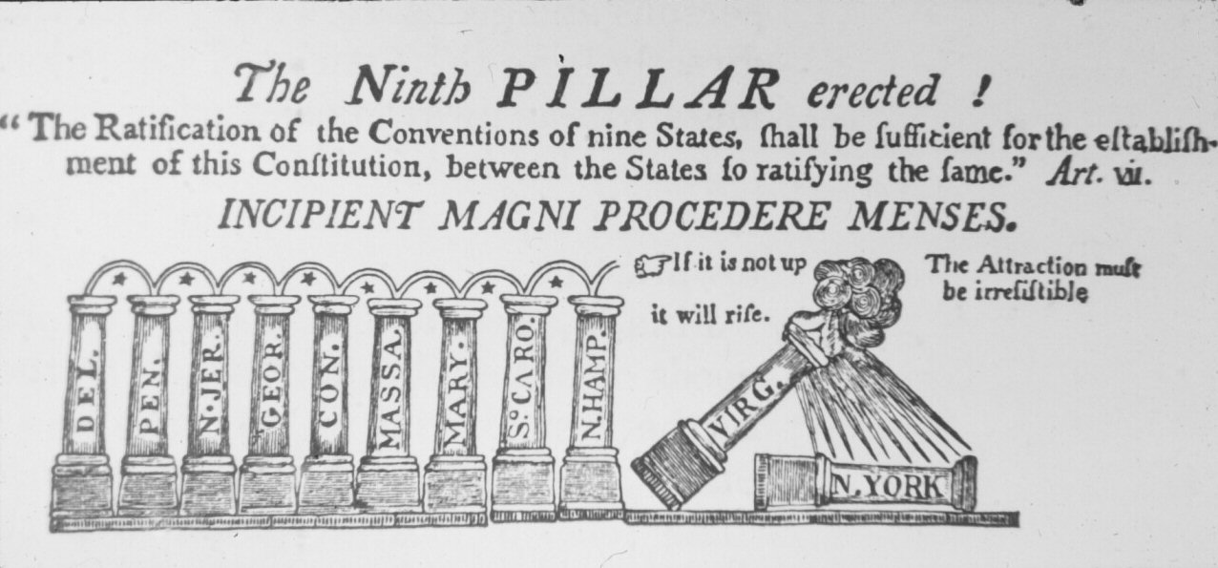
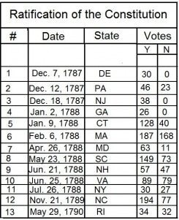
The fight for ratification
The Process
The Framers required that conventions in only 9 of 13 states would be needed to approve the Constitution.
Ratification sparked a nationwide debate between Anti-Federalists who opposed the constitution and Federalists who supported it.

Slide 21
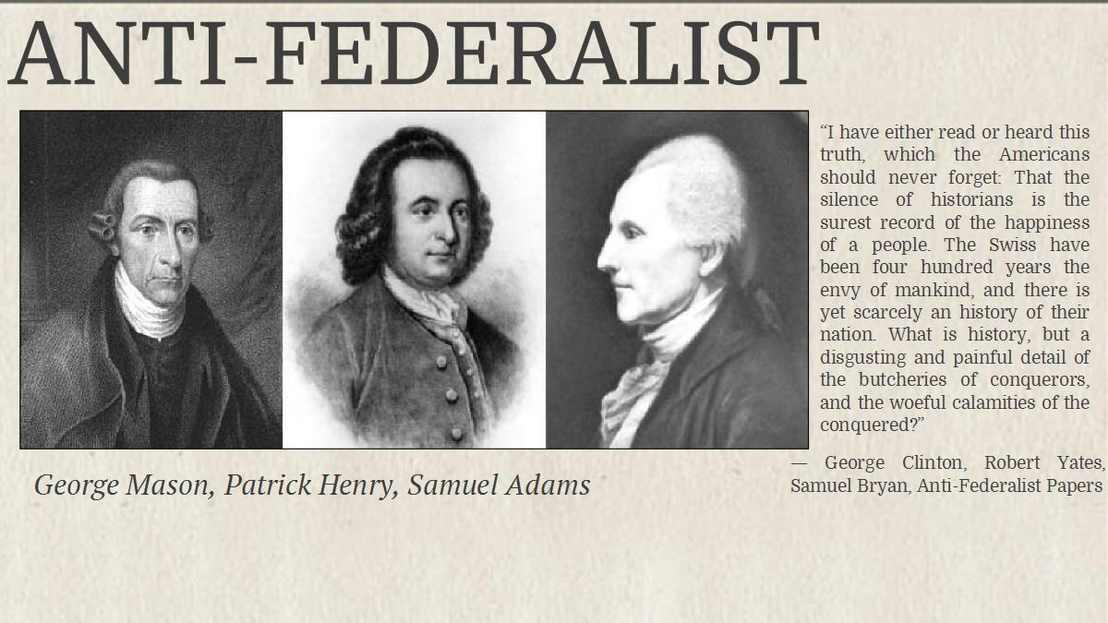
The Anti-Federalists
Included small farmers, shopkeepers, and laborers
Favored strong state governments and weak national governments.
Called for a Bill of Rights to protect individual liberties.
Wrote the Anti-Federalist papers.

Slide 22
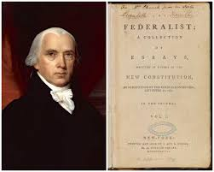
The federalists
Included large landowners, wealthy merchants, and professionals
Favored weaker state governments and a strong national government.
Promised to add amendments specifically protection individual liberties.
Wrote the Federalist papers

Slide 23
The federalist papers
A series of 85 essays written by Alexander Hamilton, James Madison, and John Jay to support the Constitution.
In Federalist #10, James Madison argued that political factions are undesirable but inevitable. Madison believe that the excesses of factionalism could be limited by the system Large Republics created by the Constitution.
Madison also argued that a large republic would fragment political power and thus curb the threat posed by the non-wealthy majority.
Madison understood that political factions are undesirable but inevitable.

Slide 24
ratification
Although Delaware, New Jersey, and other small states promptly ratified the Constitution, the contest proved to be very close in Virginia and New York.
North Carolina and Rhode Island insisted on a bill of rights as a condition for joining the Union.
The First Congress ratified 10 amendments collectively known as the Bill of Rights.

Slide 25
Constitutional change

Slide 26
Informal methods of constitutional change
Congressional Legislation
Congress has passed a number of laws that both clarify and expand constitutional provisions.
The Judiciary Act of 1789 began the process of creating the federal court system we have today.
Acts of Congress created the cabinet departments, agencies, and offices in the Exec Branch
Congress has passed a number of laws that have defined and expanded the Commerce Clause. Ex. Congressional regulations now cover railroad lines, air routes, and Internet traffic. Congress used the Commerce Clause to ban discrimination in public accommodations (ADA)

Slide 27
Informal methods of constitutional change
Executive Actions
Presidents have used their power as commander-in0-chief to send troops into combat without a declaration of war.
An executive agreement is a pact made by the POTUS w/ the head of a foreign state. Unlike treaties, exctuive agreements do not have to be ratified by the Senate. This power circumvents the formal treaty making process in the Constitution.

Slide 28
Informal methods of constitutional change
Judicial Decisions
Judicial review is the power of the SCOTUS to determine if acts of Congress and the President are in accord w/ the Constitution.
Judicial review is not specifically described in the Constitution.
The Supreme Court claimed the power of judicial review in Marbury v. Madison 1803.

Slide 29
Informal methods of constitutional change
Party Practices
Political parties are not mentioned in the Constitution.
Since 1830, political parties have held conventions to nominate candidates for President. As a result, the electoral college had become a “rubber stamp” for the popular vote in each state.
Political parties now determine how congressional committees are organized and led.

Slide 30
Informal methods of constitutional change
Unwritten Traditions
According to the Constitution, the President has the power to nominate federal judges who are approved by the Senate.
The unwritten tradition of senatorial courtesy requires the President to first seek the approval of the senator or senators of the President’s party from the state in which the nominee will serve.

