Slide 1
Voters & Voter behavior

Slide 2
The expansion of voting rights
A. Two Long-Term Trends
Federal laws and constitutional amendments have eliminated restrictions on the right to vote, thus dramatically expanding the American electorate.
Federal laws and constitutional amendments have significantly reduced the power of individual states over a citizen’s right to vote.
The Original ELECTORATE
In 1789, property and tzx qualifications restricted the electorate to white male property owners.
Only about one in fifteen adult white males had the right to vote. (6% of the population)

Slide 3
The expansion of voting rights
JACKSONIAN DEMOCRACY
Andrew Jackson and his supoorters had great respect for the common sense and abilities of the common man. As a result, the Jacksonians eliminated property ownership and tax payments as qualifications for voting.
By 1850, almost all white adult males had the right to vote.
THE FIFTEENTH AMENDMENT (XV), 1870
Prohibited voting restrictions based on “race, color, or previous condition of servitude.”
Despite the XV, a combination of literacy tests, poll taxes, white primaries, and the grandfather clause systematically disenfranchised African Americans.

Slide 4
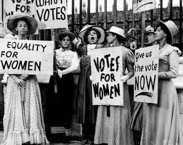
The expansion of voting rights
THE NINETEENTH AMENDMENT XIX, 1920
Prior to 1920, women had full voting rights in New York and a number of western states
The XIX removed voting restrictions based on gender.

Slide 5
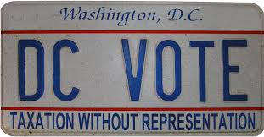
The expansion of voting rights
THE TWENTY-THIRD AMENDMENT XXIII, 1961
Prior to 1961, residents of the District of Columbia could not vote in presidential elections.
The XXIII added voters of DC to the presidential electorate.

Slide 6
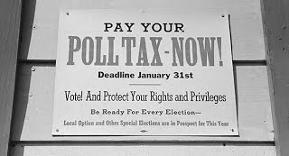
The expansion of voting rights
THE TWENTY-FOURTH AMENDMENT XXIV, 1964
Prior to 1964, a number of states used poll taxes as a means of discouraging citizens from voting.
The XXIV outlawed the poll tax “or any tax” as a qualification for voting.

Slide 7
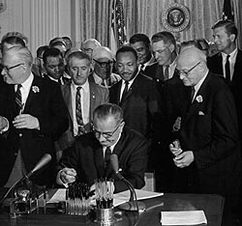
The expansion of voting rights
THE VOTING RIGHTS ACT OF 1965
Prohibited any government from using voting procedures that denied a person the vote on the basis of race or color.
Abolished the use of literacy requirements for anyone who had completed the 6th grade.
Authorized federal registrars to protect African American’s right to vote in Southern states and counties with histories of discrimination.

Slide 8
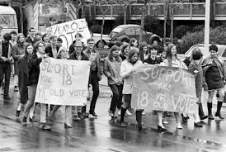
The expansion of voting rights
THE TWENTY-SIXTH AMENDMENT XXVI, 1971
The XXVI provides that the minimum age for voting in any election cannot be less than 18 years.
Note that a state may set a minimum voting age of less than 18.

Slide 9
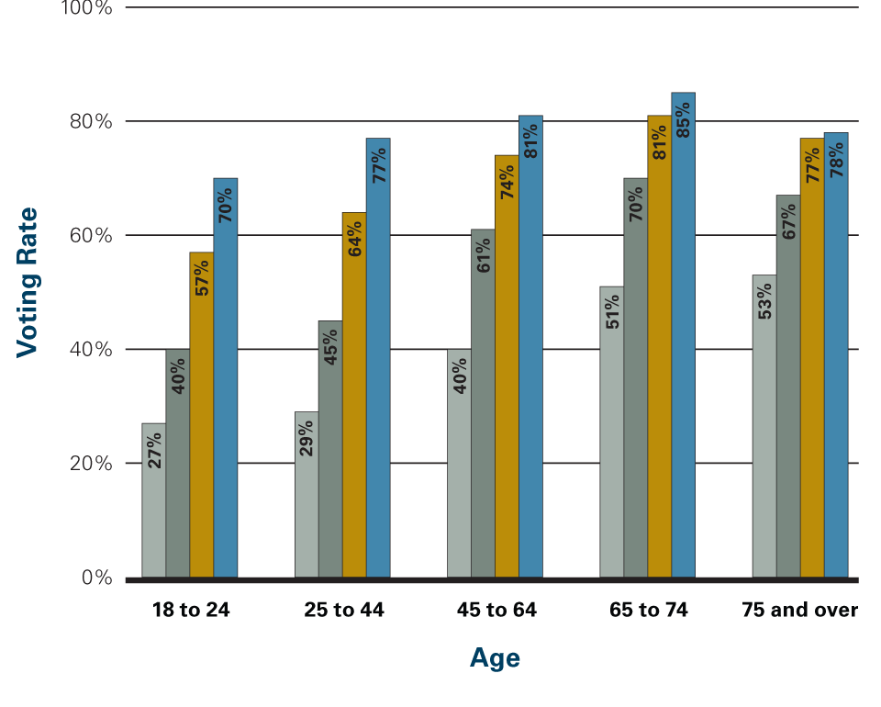
Factors that influence turnout and voter choices
EDUCATION
People with more education are more likely to vote. People with less education are less likely to vote.

Slide 10
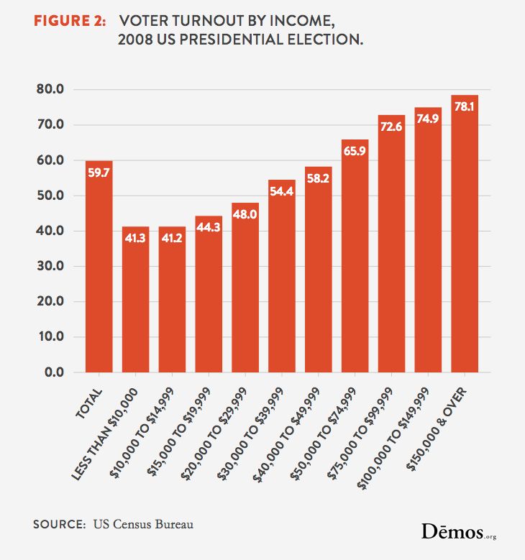
Factors that influence turnout and voter choices
INCOME
People with more income are more likely to vote.
Historically, voters in lower income brackets are more likely to support Democrats, while voters in higher income brackets are more likely to support Republicans. In the 2008 presidential election, however, voters with annual incomes of 50K or more were evenly split between Obama and McCain.

Slide 11
Factors that influence turnout and voter choices
AGE
Older people are more likely to vote than are younger people. Note that voter turnout does decrease over the age of 70 and that turnout among voters age 18 to 24 is beginning to increase.
Historically, young voters are more likely to support Democrats and older voters are more likely to support Republicans.
GENDER

Slide 12
Factors that influence turnout and voter choices
RELIGION
Jews and Catholics are more likely to vote than Protestants.
Historically, a majority of Protestants have supported Republicans, while a majority of Jewish and Catholic voters have supported Democrats
RACE
Whites tend to have higher turnout rates than do African Americans, Hispanics, and other minority groups. Note that when the effects of income and education are eliminated, black citizens vote at a higher rate than do white citizens.
CROSS-PRESSURES
Voters belong to more than one group.
Note that anything that produces cross-pressures reduces voter turnout.

Slide 13
nonvoting
KEY STATISTICS
At the present time, there are approx. 230 million people of voting age in the U.S.
Only about 60% of eligible voters actually voted in the 2008 presidential election.
The majority of the U.S. electorate does not vote in nonpresidential elections.
The voter turnout rate in the U.S. is lower than in most other Western democracies.

Slide 14
Factors that decrease voter turnout
VOTER REGISTRATION
W/ the exception of North Dakota, all states have voter registration laws requiring eligible voters to first place their name on an electoral roll in order to be allowed to vote.
Registration laws have significantly reduced fraud. However, they have created an obstacle that discourages some people from voting.
The National Voter Registration Act of 1993 (Motor Voter Act) made voter registration easier by allowing people to register to vote while applying for or renewing a driver’s license.
A DECLINE IN POLITICAL EFFICACY – voting doesn’t make a difference
Rising level of cynicism and a corresponding decline in trust in government has lowered turnout rates

Slide 15
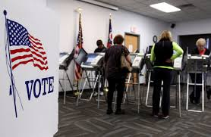
Factors that decrease voter turnout
FREQUENT ELECTIONS
America’s federal system produces more elections than any other modern democracy.
The large number of elections reduces voter turnout by making it difficult for citizens to keep up with all the candidates running for office.
WEEKDAY, NONHOLIDAY VOTING
Many Western democracies hold elections on weekends and on national holidays.
Most elections in the U.S. are held on the first Tuesday after the first Monday in November. Holding elections on a weekday makes it difficult for many people to leave work in order to vote.

