Slide 1
Political parties
Linkage institution

Slide 2
What is a political party?
A political party is a group of citizens who organize to:
Win elections
Hold public offices
Operate the government
Determine public policy

Slide 3
Levels of American political parties
The party in the electorate includes citizens who identify themselves as Democrats of Republicans.
The party organization includes national leaders, state chairpersons, county chairpersons, and other activists who run the party at the national, state, and local levels.
Important note: national, state, and local party organizations are independent and not centrally controlled.
The party in gov. includes the party’s candidates and office holders.

Slide 4
Functions of parties
Recruiting and nominating candidates for public office
Running political campaigns
Articulation positions on issues (BRANDING)
Critiquing the policies of the party in power
Serving as a linking institution that connects citizens to gov. by:
Providing info. to voters about candidates running for office
Mobilizing voters to elect party candidates
Raising funds to support party candidates

Slide 5
Types of party systems
One-party system
A political system in which one party exercises total control over the gov.
China, N. Korea, and Iran are examples
Multi-party systems
A political system in which a number of political parties compete for political offices.
Parties in a multiparty system often represent widely different ideologies about gov. policies.
France, Italy, and Israel are examples.
Two-Party systems
Two major parties compete for control of public offices.
The United States is one of about 15 nations with this system. UK, India, and Jamaica are examples.

Slide 6
Reasons why America has a two-party system

Slide 7
STRONG CONSENSUS ON CORE POLITICAL VALUES
Americans share a strong commitment to a group of core political values that include belief in freedom, political equality, individualism, and equality under the law.
America has never had a strong socialist party dedicated to creating an entirely new political system.
Most Americans identify themselves as moderates who hold beliefs that fall between liberal and conservative views.

Slide 8
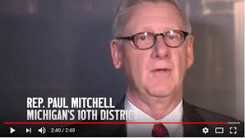
SINGLE-MEMBER DISTRICTS
Almost all American elections are held in single-member districts in which only one candidate is elected to each office on the ballot.
In single-member district elections, the candidate who receives the most votes is the winner. It is important to note the difference between a plurality and a majority. In a plurality election, the winning candidate is the person who receives the most votes. In a majority election, the winning candidate is the person who receives more than half of all votes cast.
The winner-take-all, single-member district plurality system is very diffent than a system based on proportional representation. In a system based on proportional representation, each party is awarded legislative seats in proportion to the vote it receives. For example, in a state with 10 congressional seats, a party receiving 20 percent of the vote would be awarded 2 seats. In contrast, in a winner-take-all, single-member district system, the same party would receive no seats.

Slide 9
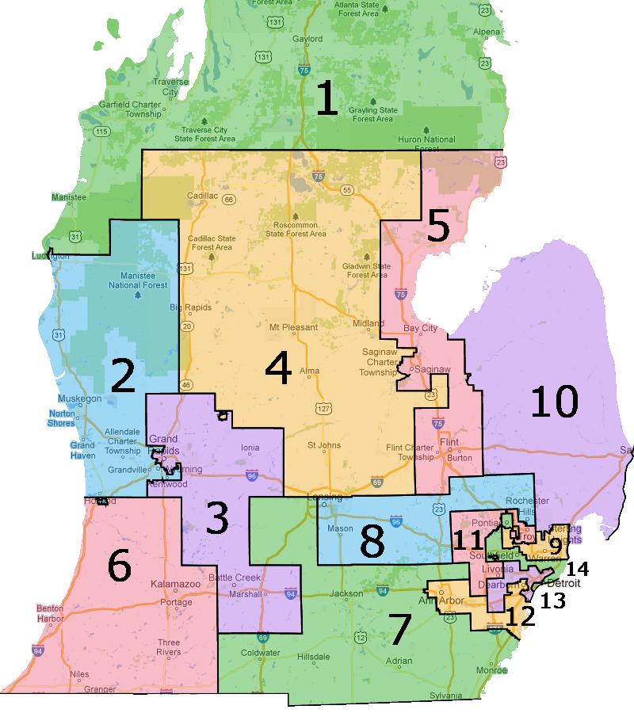
SINGLE-MEMBER DISTRICTS
An electoral system based on winner-take-all, single-member districts discourages the emergence of minor parties by forcing them to wager expensive campaigns with a minimal chance of winning.
The electoral system based on single-member districts produces legislatures dominated by two political parties.

Slide 11
Legal barriers to third parties
The names of Democratic and Republican candidates are automatically placed on the state ballots.
In contrast, minor party candidates must persuade registered voters to sign petitions in order to have their names placed on the ballot.

Slide 12
The force of historic tradition
America has had a two-party system since 1800.
The two-party system has generated self-perpetuation lws and traditions. As a result, it is very difficult for a minor party to become a major force in American politics.

Slide 13
Party eras in American history
Key Terms
Party Era
Historical periods dominated by one party.
Critical Election
A national crisis forces voters to confront divisive issues that fracture party coalitions.
Significant groups of voters change their traditional patters of party loyalty.
Party realignment
Triggered by a critical election.
The majority party is displaced by the minority party, thus ushering in a new party era.

Slide 14
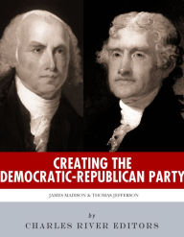
The first party system, 1796-1824

Slide 15
The first party system, 1796-1824
Led by Alexander Hamilton, the Federalists supported a strong federal gov and a national bank. The Federalist coalition included financial, commercial, and manufacturing interests (Wall Street)
Led by Thomas Jefferson and James Madison, the Democratic-Republicans supported a limited federal government and opposed the national bank (McCulloch v. Maryland). The Democratic-Republican coalition included farmers, shopkeepers, laborers, and planters (Main Street)
Jefferson defeated the Federalist president John Adams in 1800. This election marked the first time that a party in power peacefully gave up power after losing an election.

Slide 16
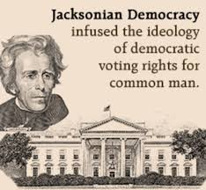
Jackson and the Democrats 1828-1856

Slide 17
Jackson and the Democrats 1828-1856
Led by Andrew Jackson, the Democratic Party supported voting rights for all white males, opposed the national bank, and used the spoils system to reward party loyalists. The Democratic coalition included debtors, frontier pioneers, and small farmers in the West and South.
Led by Henry Clay and Daniel Webster, the Whigs supported high tariffs and the national bank. The Whig coalition included a loose alliance of eastern bankers, merchants, industrialists, and owner of large plantations. The Whigs elected only two presidents: William Henry Harrison in 1840 and Zachary Taylor in 1848.

Slide 18
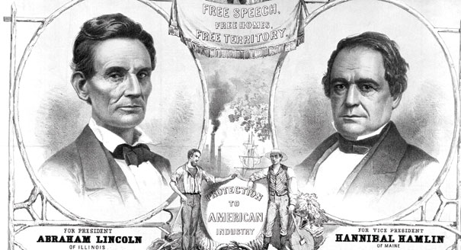
The republican era, 1860-1928

Slide 19
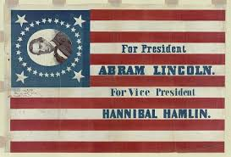
The republican era, 1860-1928
The issue of slavery dominated American politics during the 1850’s. It spit the Democrats and led to the demise of the Whigs.
Led by Abraham Lincoln, the Republican Party emerged as the most dynamic antislavery party. In the critical election of 1860, the Republicans elected Lincoln, thus becoming the only party in American history to make the transition from minor party to major party status.
The Democrats survived the Civil War by becoming the dominant party in the South. The so-called Solid South remained a fixture of American politics for the next 100 yrs

Slide 20
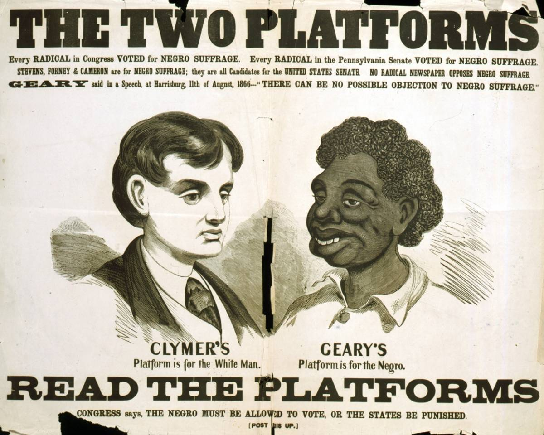
The republican era, 1860-1928
The election of 1896 marked a second critical election that transformed American politics. Led by William Jennings Bryan, a Democratic coalition of small Western farmers and emerging labor unions advocated free silver and regulations to control the railroads. Led by William McKinley, a Republican coalition of industrialist, financial monopolies, and small businesspeople backed the gold standard, high tariffs, and industrialization.
McKinley’s victory enabled the Republicans to remain America’s majority pary until the Great Depression.

Slide 21
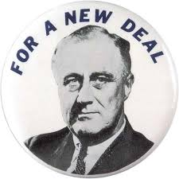
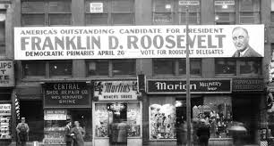
Fdr and the new deal coalition 1932-1964

Slide 22
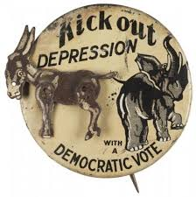
Fdr and the new deal coalition, 1932-1964
The Great Depression marked an abrupt end to the era of Republican dominance. Led by FDR, the revived Democrats advocated a program of relief, recovery, and reform known as the New Deal.
The New Deal coalition included:
Urban dwellers (immigrants) and alcoholics (left the Republican Party)
Labor unions
Catholics and Jews
African Americans (left the Republican party)
The coalition did not include Northern business leaders and wealthy industrialist.

Slide 23
Divided government, 1968 to the present

Slide 24
Divided government, 1968 to the present
The election of Richard Nixon in1968 marked the beginning of a period of Republican dominance in presidential politics. With the exception of the Carter presidency from 1977 to 1981, the Republicans held the White House from 1969 through 1993.
Beginning with Nixon in ‘68, the Republicans adopted a “Southern strategy” designed to break the Democratic Party’s long dominance in the South. Party realignment gradually occurred as Southern conservatives transferred their loyalty to the Republican Party.
Nixon’s election also marked the beginning of a new pattern of divided government. For the first time in the twentieth century, a newly elected president moved into the White House while the opposition party control both houses of Congress.

Slide 26
Divided government, 1968 to the present
The pattern of divided government has dominated American politics from 1969 to 2017. The same party has controlled the presidency and both houses of Congress for just 13 years (and counting).
Divided Government has a number important of consequences:
It has heightened partisanship and made it more difficult for moderates to negotiate compromises.
It has slowed both the confirmation and the legislative processes, thus creating more gridlock
It has increased public frustration, thus contributing to the decline in trust and confidence in gov. (external efficacy)

Slide 27
Divided government, 1968 to the present
The last half century has witnessed a decline in the percentage of voters who identify themselves as Democrats or Republicans and a rise in the number of voters who identify themselves as independents. As a result, there has been a significant increase in the number of “split-ticket” voters who support candidates of different parties on the same ballot. This process of disengagement of people from political parties is called “party dealignment”

