Slide 1
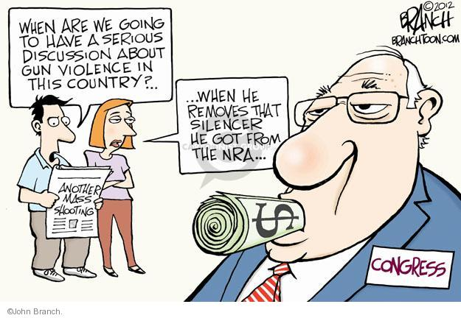
SPECIAL INTEREST GROUPS

Slide 2
Definition
An interest group is an organization of people whose members share policy views on specific issues and attempt to influence public policy to their benefit.
Interest groups operate at every level of gov. in America’s federal system.

Slide 3
Ways sig’s link citizens to government
SIG’s express their members’ preferences to government policymakers.
SIG’s convey government policy information to their members. https://www.nrapvf.org/grades/
SIG’s raise and spend money to influence policymakers. (PAC’s)

Slide 4
Differences between interest groups & political parties
PARTIES
Nominiate candidates, contest elections, seek and gain control over government
PP’s have positions on a wide range of public issues (POLICY GENERALISTS)
pp’s are accountable to voters
INTEREST GROUPS
Seek to support public officials and influence public policies.
SIGs focus only on specific issues that directly affect their members. As a result, they are able to articulate specific policy positions. (POLICY SPECIALISTS)
SIGs are private organizations that are accountable to their members.

Slide 5
Types of interest groups

Slide 6
Types of interest groups
THE EXPLOSION OF SIG’S
Officials in the legislative and executive branches control the distribution of billions of fereal dollars. As a result, most industries, corporations, professions, and unions now have SIG’s to represent them in Washington D.C.
The number on interest groups has increased from 6,000 in 1959 to approximately 22,000 in 2010.

Slide 7
Business groups
Most large corporations employ lobbyists to monitor legislative activity that may affect their business.
The National Assoc. of Manufacturers NAM represents 12,000 small and large manufacturers in every industrial sector and in all 50 states. It focuses on legislation affecting labor laws, minimum wages, corporate taxes, and trade regulations.
The Chamber of Commerce is the world’s largest business federation. It spends $20 million a year lobbying for its 3,000 local chambers and 3 million members.
The Business Roundtable is an association of about 150 CEO’s of leading U.S. Corporations with $5 trillion in annual revenues and nearly 10 million employees.

Slide 8
Labor groups
The American labor movement reached its peak in 1956 when 33% of the nonagricultural work force belonged to a union. Today, 16 million Americans, or about 13% of the nonagricultural work force, belong to a union.
The American Federation of Labor and Congress of Industrial Organizations (AFL-CIO) is America’s largest labor union both in size & political power. About 10 million belong.

Slide 11
Agricultural groups
Although farmers comprise less than 2% of America’s population, their interest groups play an influential role in shaping agricultural policies.
The Farm Bureau and the National Farmers Union are broadbased organizations that speak for farmers.
Specialized SIG’s represent different farm products. Ex. The National Milk Producers Federation represents the dairy farmers.

Slide 12
Professional associations
The National Education Association (NEA) represents 3.2 million public school teachers, support personnel, and retired educators.
The American Medical Association (AMA) is the nation’s largest assoc. of physicians and medical students. The AMA is actively involved in proposals to reform the health care system.
The American Bare Association (ABA) is a boluntary assoc. of 410,000 lawyers and law students. The ABA is actively involved in setting academic standards for law schools and in formulation ethical codes for the legal profession.

Slide 13
Environmental groups
Environmental groups promote policies to control pollution and to combat global warming, wilderness protection, and species preservation.
They oppose supersonic aircraft, nuclear power plants, drilling in Alaska’s Arctic National Wildlife Refuge, and strip mining (Fracking)

Slide 14
Public interest groups
Consumer and Other Public Interest Lobbies
Public interest Lobbies – Groups that see a collective good, and the achievement of which will not selectively and materially benefit the membership or activists of the organization.
Consumer groups – In 1973, Congress responded to consumer advocacy by creating the Consumer Product Safety Commission, which it authorized to regulate all consumer products and to ban products that were dangerous.

Slide 15
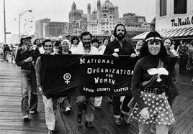
Equality interest
National Assoc. for the Advancement of Colored People (NAACP) is one of America’s oldest and most influential civil rights organizations. It is dedicated to fighting racial discrimination.
The National Organization of Women (NOW) is the largest feminist organization in the United States. Its mission is “to take action to bring women into full participationin society- sharing equal rights, responsibilities and opportunities with men, while living free from discrimination.”

Slide 16
Single-issue groups
Single-issue groups focus their efforts on one issue. For example, the National Right to Life Committee opposes abortion, while Planned Parenthood lobbies for reproductive rights and women health programs.
The NRA is one of the best known and most influential single-interest groups. It works to uphold the right of people to bear arms for recreation and self-defense. In contrast, the Michigan Coalition for Responsible Gun Owners is a single-issue SIG dedicated to gun control.

Slide 17
Interest group goals and strategies

Slide 18
Interest group goals and strategies
FUNDAMENTAL GOALS
GAIN ACCESS TO POLICY MAKERS.
Money / Contributions
Supply valuable information
Revolving Door – offer a job to Congressmen and their staffers when the leave public office.
INFLUENCE PUBLIC POLICY.
See above
SUPPORT SYMPATHETIC POLICYMAKERS.

Slide 19
LOBBYING
Definitions
The process by which interest groups attempt to influence the decisions of policymakers.
Lobbyists are people who attempt to persuade policymakers to support the goals of an interest group.
Lobbying Congress
Approx. 30,000 lobbyists currently work in Washington D.C. They spend over $2 billion a year lobbying Congress.
Lobbyist often testify before congressional committees
Lobbyists provide members of Congress with INFORMATION on technical issues.
Lobbyists often meet informally with congressional aides.
Lobbyists often bring influential constituents to Washington to discuss important policy matters with their representatives.

Slide 20
LOBBYING
Lobbying the EXECUTIVE BRANCH
Most Executive lobbying focuses on presenting a point of view to White House aides and other government officials.
Most presidents have created a staff position to provide interest groups with access to their administration.
SIGs direct particular attention to establishing access to regulatory agencies.

Slide 21
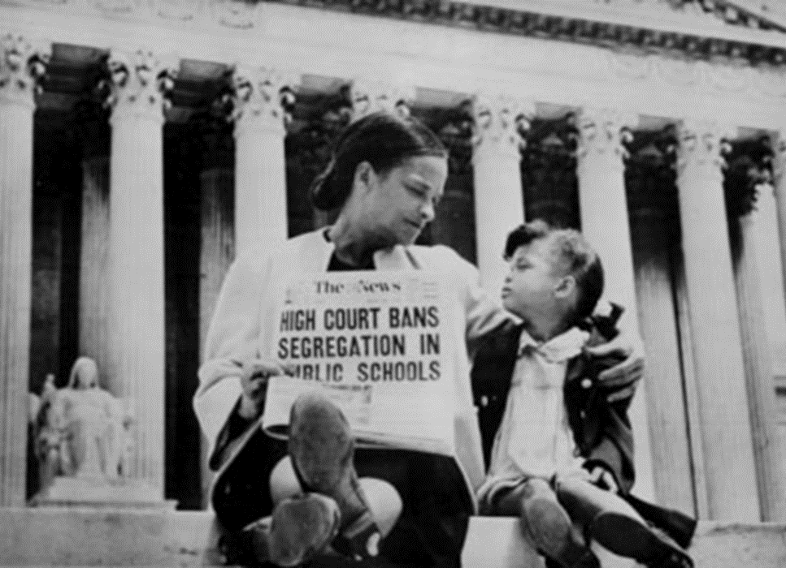
LOBBYING
Lobbying the COURTS
It’s inappropriate for lobbyists to have an informal meeting with a federal judge who is hearing a case important to the interest group the lobbyists are representing. CORRUPT!!!!
If SIGs fail in Congress, they can often take their case to the courts.
For example, in the 1950s, Congress repeatedly thwarted the NAACP’s efforts to support civil riths legislation. The NAACP responded by sponsoring the Brown v. Board of Education of Topeka case. The Supreme Court’s landmark decision marked ahistoric victory for the NAACP, while at the same time encouraging other interest groups to use litigation to achieve their goals.

Slide 22
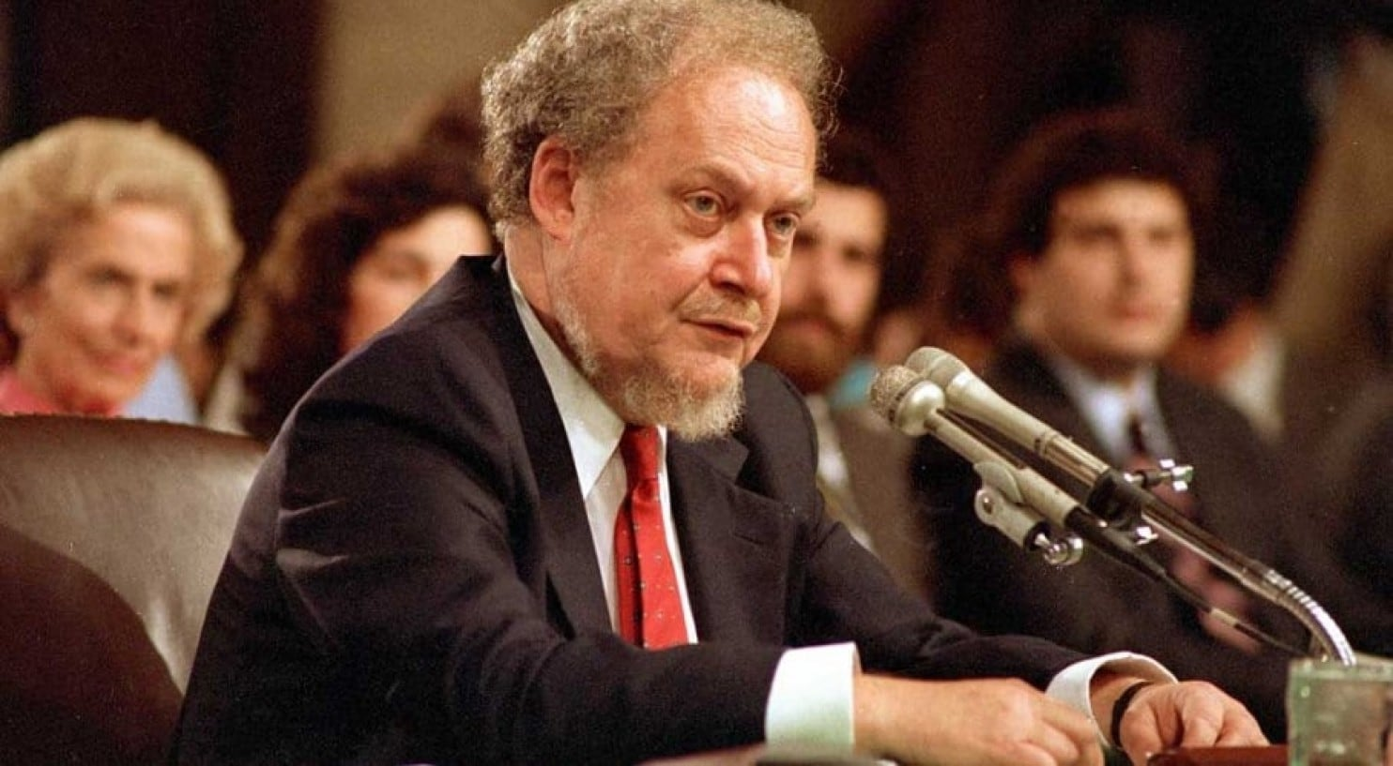
Lobbying the COURTS
SIGs are not limited to directly sponsoring a case. They can also file an amicus curiae (“friend of the court”) brief in a case the group is interested in. Amicus briefs consist of written arguments submitted to a court in support of one side of a case.
SIGs now play a prominent role in influencing who is nominated to the federal courts. This is especially true for Supreme Court nominations.

Slide 23
Contributing money to candidates
Electioneering
Direct group involvement in the electoral process by helping to fund campaigns, getting members to work for candidates, and forming political action committees (PACs)
PACs are political funding vehicles created by the 1974 campaign finance reforms
PACs play a significant role in supporting incumbent members of the House of Reps. PACs typically contribute to the campaigns of House members who serve on committees or subcommittees that consider legislation affecting the interest group.

Slide 26
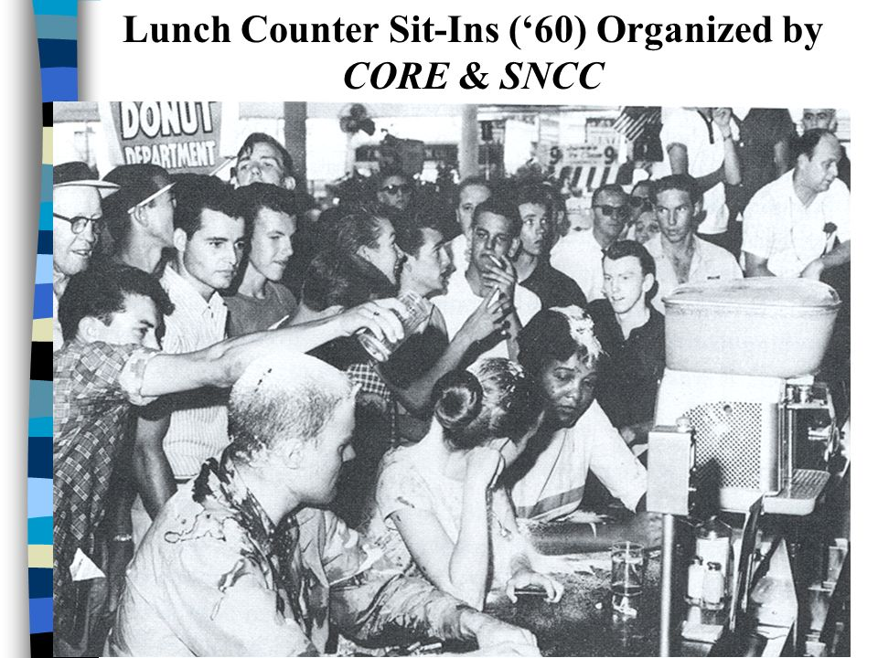
Sharing public opinion
Interest groups often undertake expensive public relations campaigns to bring an issue to the public’s attention.
SIGs also use advertisements to promote their image as good citizens who prtect the environment and care about their communities.
GRASSROOTS tactics - SIGs may also engage in highly visible protest demonstrations designed to draw attention to their cause.
Ex. During the 1960s, civil rights groups used nonviolent marches and sit-ins to direct public attention to the injustices of segregation.

Slide 27
Go public
Groups try to
cultivate a good public image
build a reservoir of goodwill with the public
use marketing strategies to influence public opinion of the group and its issue
advertise to motivate and inform the public about an issue.
**With enough money they can control the message and issues candidates have to address (Defend or sit back and watch)

Slide 28
Factors that contribute to the success of an interest group

Slide 29
size
Size can be an important asset. A large interest group can marshal its members to email legislators, work in election campaigns, and participate in public protests.
Size is NOT always an asset. “pressure politics is essentially the politics of small groups.”
Large groups are vulnerable to the FREE-RIDER problem.
Free riders are people who benefit from an interest group without making any contributions.
As size of group increases, its free-rider problem also increases.

Slide 30
intensity
SIGs that contain passionately committed activists tend to be more successful than those groups whose members are less intensely involved.
Single-Issue groups (narrow focus) are able to mobilize members who are intensely committed to the group’s goals.
Examples: MADD, NRA, Pro-Life and Pro-Choice groups

Slide 31
Financial resources
All interest groups require adequate funding. Money is necessary to hire lobbyists, support PACs, write amicus curiae briefs, and pay for a host of other activities.
Deep financial resources can compensate for a lack of size and intensity!!

