Slide 1
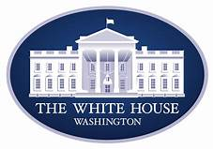
The Presidency
The Executive Branch

Slide 2
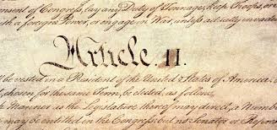
The President as chief executive
Executive Power
The Constitution declares that “the executive Power shall be vested in a President of the United States of America.”
As the nation’s chief executive, the POTUS enforces the provisions of federal laws and administers a vast federal bureaucracy that spends more than $3 trillion a year and includes 2.1 million civilian employees.

Slide 3
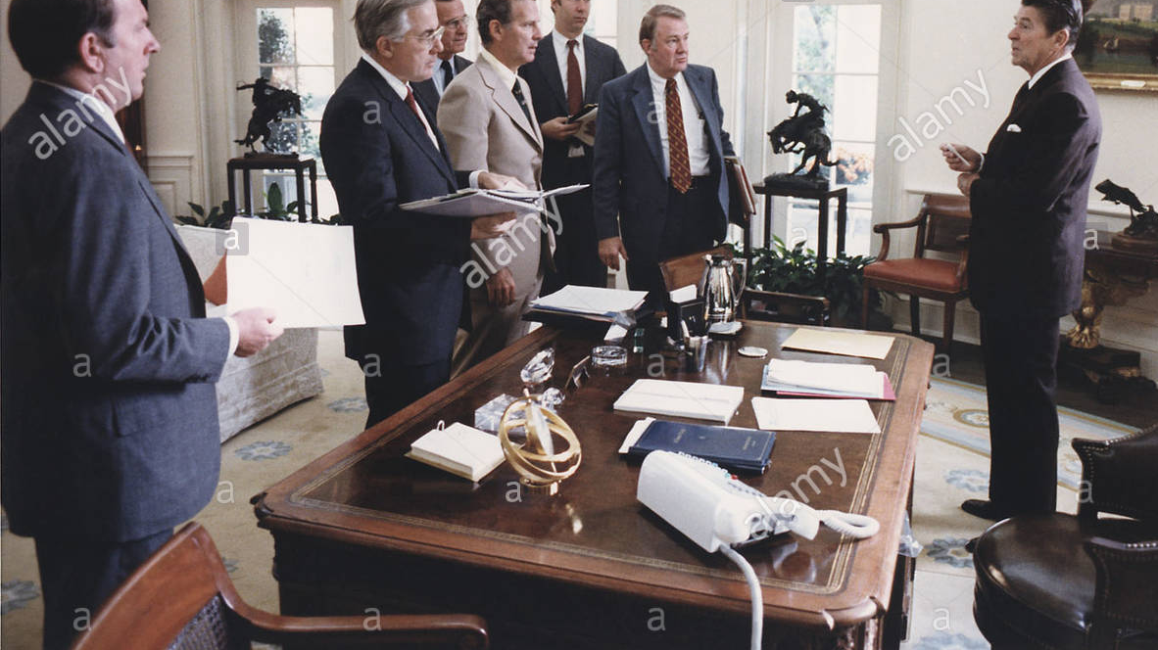
Appointment power
The president has the power to appoint all of the following top-ranking officers of the federal government:
Cabinet members and their top aides.
The heads of independent agencies.
Ambassadors and other diplomats.
All federal judges, U.S. marshals, and attorneys.

Slide 4
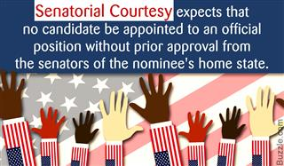
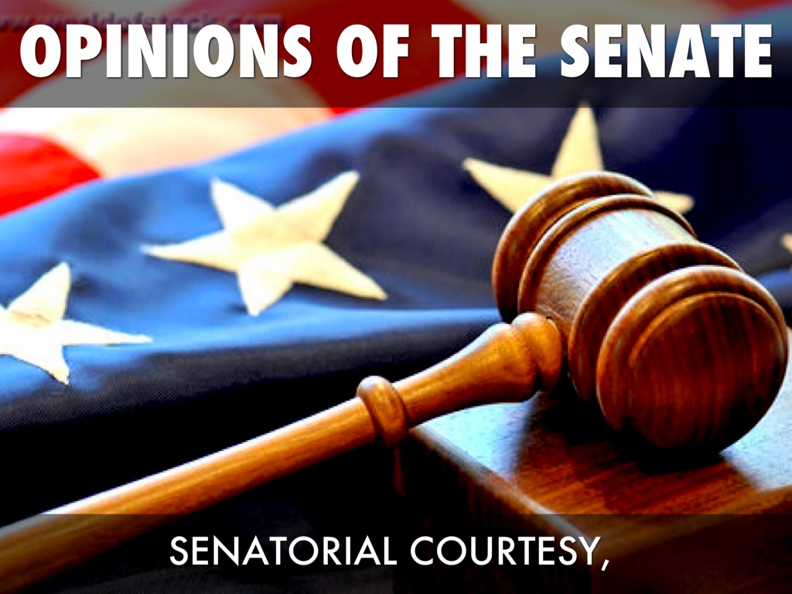
Appointment power
These appointments are all subject to confirmation by a majority of the Senate.
The POTUS’s appointment power is limited by an unwritten rule known as senatorial courtesy. According to this custom, the Senate will not approve a presidential appointment opposed by a majority party senator from the state in which the appointee would serve.

Slide 5
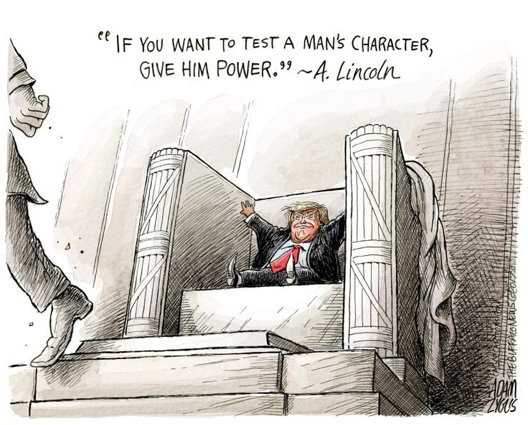
Removal power
Presidents have the power to dismiss most of the officials he or she appoints.
It is important to note that the president cannot dismiss federal judges or commissioners of independent regulatory agencies. Examples of Independent Regulatory Agencies:
CIA – Central Intelligence Agency
SSS – Selective Services SystemEPA – Environmental Protection Agency
FEC – Federal Elections Commission
FCC – Federal Communications Commission
Federal Reserve Board
NASA
SSS – Selective Services System

Slide 6
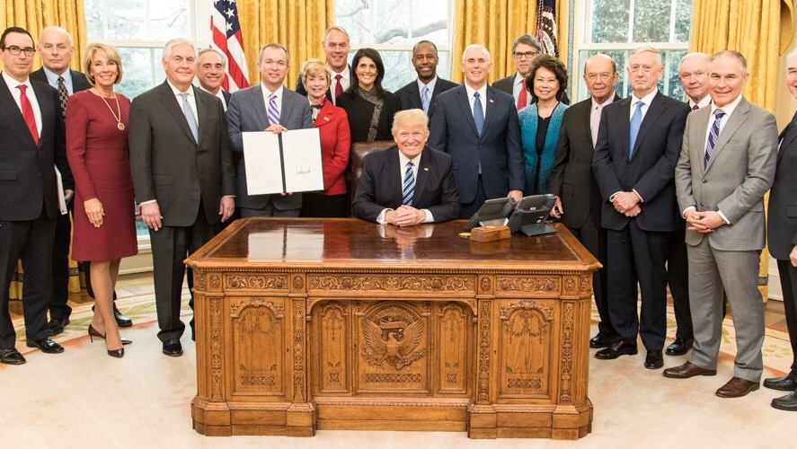
The cabinet
The cabinet currently includes 14 executive department heads and the attorney general. These 15 executive departments employ nearly two-thirds of the federal government’s civilian employees.
Cabinet members often have divided loyalties. Their loyalty to the president can be undermined by loyalty to the institutional goals of their own department (GROW).
The following factors explain why presidents often experience difficulty in controlling cabinet departments.
Interest groups often form close ties with cabinet departments.
The careers of many civil servants extend beyond a single presidential administration. As a result, they develop a strong loyalty to their department.
Congress competes with the POTUS for influence over cabinet departments.

Slide 7
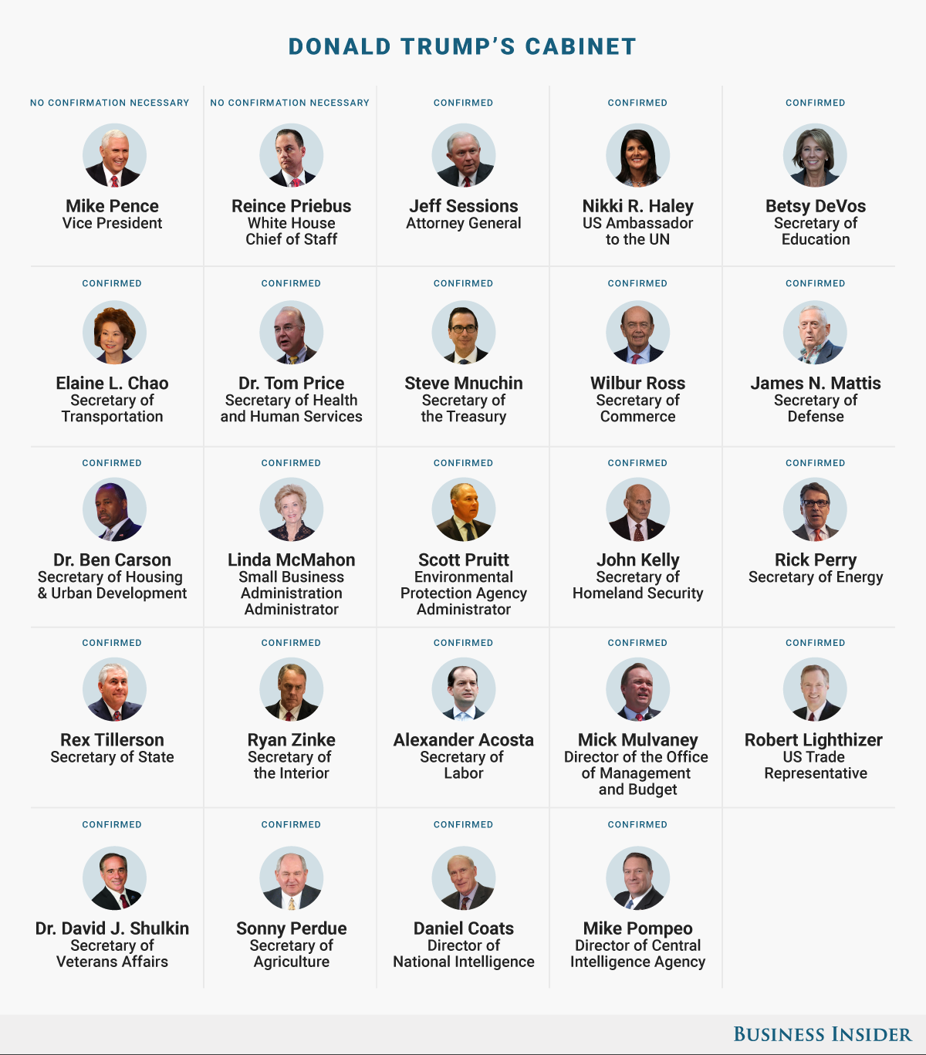

Slide 8
The Executive office of the president (Eop)
The Office of Management and Budget (OMB)
The OMB is the largest office with the Executive Office of the President. It includes a staff of over 500 career officials.
The OMB’s primary responsibility is to assist the POTUS in overseeing he preparation of the federal budget
The National Security Council (NSC)
The NSC is composed of the president’s principal foreign and military advisers. It includes the VP, secretary of state, secretary of the treasury, sec of defense, national security advisor, and others
The NSC’s principal function is to advise and assist the president on national security and foreign policies.
The Council of Economic Advisors (CEA)
Is a group of three leading economists who advise the POTUS on economic policy. Prepares annual Economic Report.

Slide 9
The White house staff
The White House staff includes key presidential aides such as the chief of staff and the press secretary.
The chief of staff is the highest-ranking member of the EOP. The chief of staff’s duties include selecting and supervising key White House staff and managing the flow of people and info. into the Oval office.
Must be personally loyal to the president (or you’re FIRED!)
WHS primary responsibility is to provide the POTUS with policy options and analysis.

Slide 11
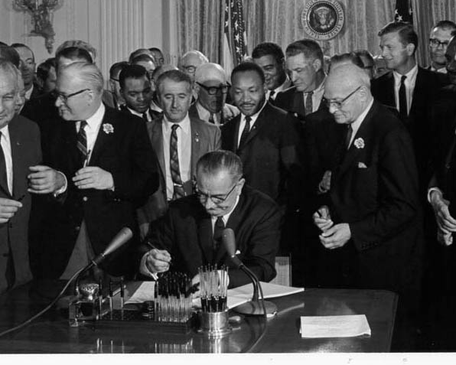
The president as chief legislator

Slide 12
Legislative powers
The Constitution does not actually call the president the chief legislator.
The Constitution does give the president the following powers:
The president is required to give a State of the Union address to Congress.
The president can bring issues to the attention of Congress “from time to time.”
The pres. Can veto congressional legislation.
POTUS use their roles as national leader and head of the party to set the policy agenda. As a result, the POTUS now initiates much of the major legislation that Congress considers.

Slide 13
Veto power
Presidential options
Sign bill into law
Can veto a bill. Congress may override with 2/3’rds vote in both chambers.
Has 10 days to sign or not. If not, and Congress is in session, bill becomes law.
The pres. Can wait ten full days and if Congress adjourns before the ten days are up, bill dies. Called a POCKET VETO.

Slide 14
Using the veto
Congress is usually unable to override a presidential veto. Less than 10% have been overridden.
Presidents often use the threat of a veto to persuade Congress to modify a bill.
A vetoed bill is often revised and then passed in another form.
Congress often inserts provisions the president wants into an objectionable bill in order to reduce the chances of a veto.

Slide 15
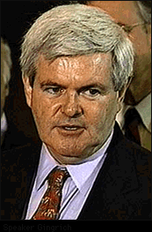
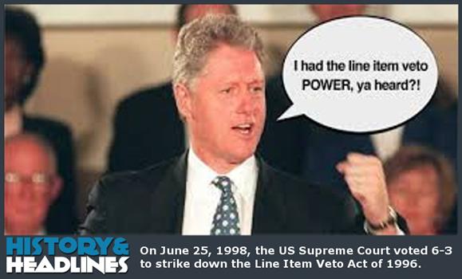
The line-item veto
The President must accept or reject an entire bill. He or she cannot veto a portion of a bill.
Many state governors have this power (including Michigan’s governor).
In 1996, Congress passed a Line-Item Veto Act giving the pres. The power to strike individual items from major appropriations bills. Supporters hoped the line-item veto would enable the president to reduce wasteful government spending, pork, and earmarks.
Just two years later, the Supreme Court struck down the line-item veto as an unconstitutional expansion of the president’s veto power. (Violation of the Separation of Powers)
Line-item veto can be enacted only by a constitutional amendment or reversal of SCOTUS decision

Slide 16
Working with congress
Presidents prefer to establish a cooperative bipartisan relationship with Congress.
Presidents use the following strategies to influence Congress to pass legislation:
Assigning legislative liaisons from the EOP to lobby legislators.
Working with both the majority and the minority leaders.
Using the media to focus public attention on important issues. “GOING PUBLIC”
Using high presidential approval ratings to persuade legislators to support presidential programs.
Bargaining with wavering legislators by offering concessions and pork that will benefit a member’s district.

Slide 17
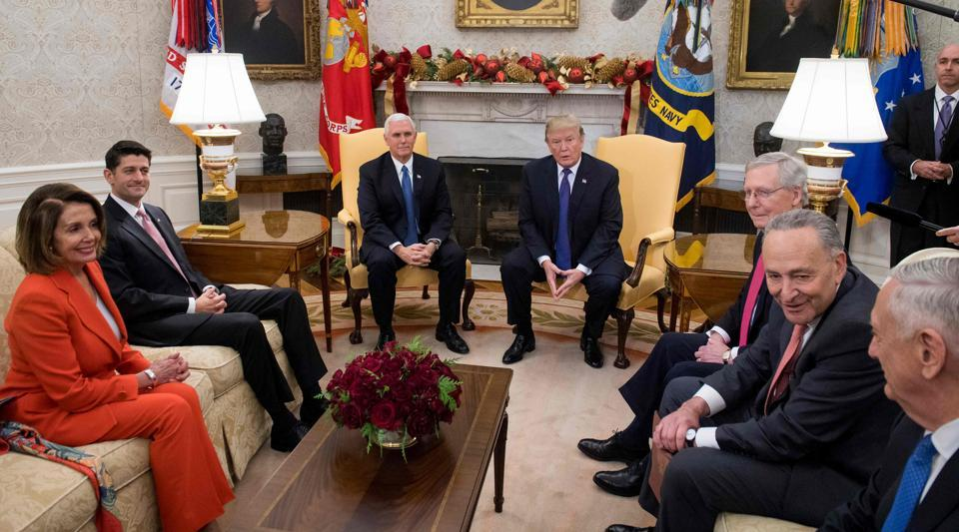

Slide 18
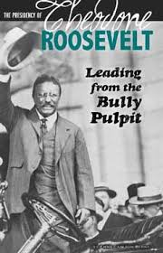
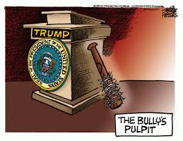

Slide 19
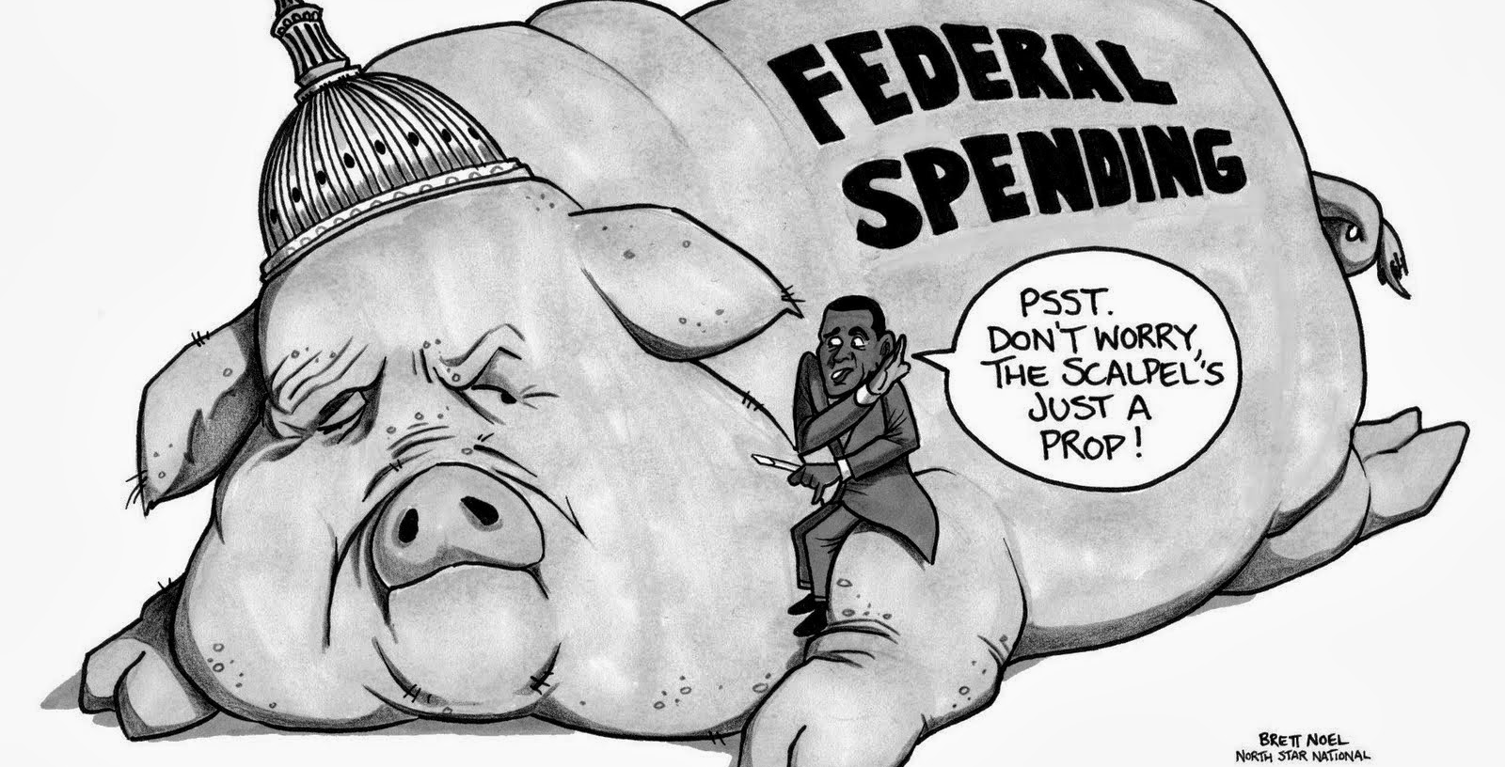

Slide 20
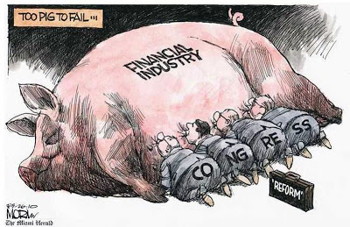

Slide 21
Divided government
Divided government occurs when the presidency and Congress are controlled by different parties. It also occurs when the chambers of Congress are controlled by different parties.
Divided government has been a frequent result of elections over the past half century and is the result of 1.) Presidential (not Parliamentary) form of government and 2.) Ticket-splitting vote
The pattern of divided government has had a number of important consequences:
It has heightened partisanship and made it more difficult for moderates to negotiate compromises.
Creates gridlock
It has contributed to the decline of public trust in government.

Slide 22
How presidents attempt to overcome divided government
Use the media to generate public support.
Threatening to veto objectionable legislation.
Making deals with key congressional leaders.
Building coalitions with key interest groups.
Increasing reliance on the White House Staff.
A number of free-response questions have asked to explain the impact of divided government on public policy, legislative gridlock, and federal appointments.

Slide 23
The president and national security

Slide 24
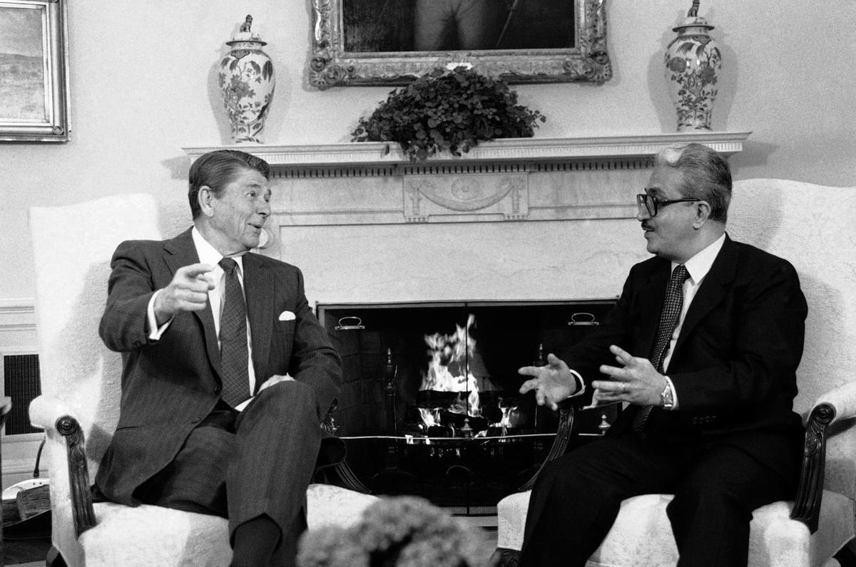
Formal constitutional powers
The pres is the commander-in-chief and thus has the power to deploy troops.
The pres appoints all ambassadors subject to Senate confirmation.
The pres negotiates treaties, which are then subject to Senate ratification
The pres has the sole power to recognize nations.
The pres receives ambassadors and other public ministers.
Tariq Aziz, top aide to Saddam Hussein

